Slide 1
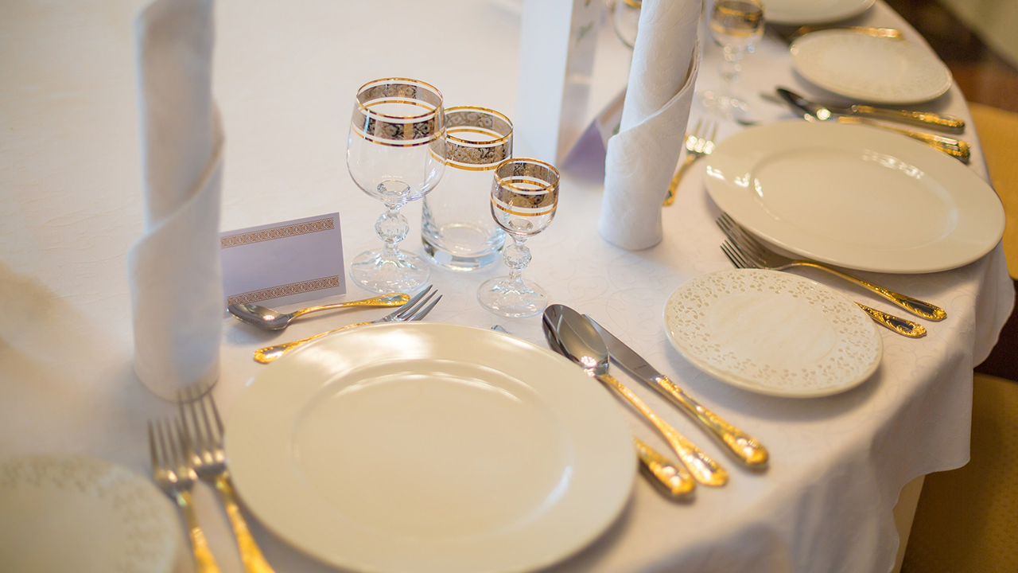

DINING WITH
CONFIDENCE
Notes:
Welcome to Dining with Confidence. My name is your name. I am title, credentials, etc. Let’s start out by reviewing what we will be covering in today’s workshop.
Knowing the rules of dining etiquette can help you appear more confident and feel more at ease in both social and business dining situations. Dining with Confidence, is designed to enhance personal dining skills and increase your level of professionalism by providing dining skills that you need to know, to feel more comfortable when dining casually or formally, in business and in life.
Dining Etiquette soft skills enable you to:
Project confidence
Distinguish yourself from the competition
Project a positive image
Make others more comfortable
Make a great impression

Slide 2
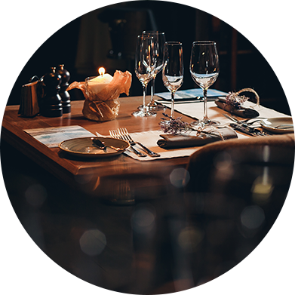
2
TODAYS WORKSHOP
Social vs. Business
DINING ETIQUETTE TRAINING KIT
Notes:
In this practicum we are going to start by comparing the differences between social and business dining. We will talk about seating arrangements and who should sit where, when dining with friends or when dining for business. Then we will discover how to impress your guests as a gracious host, and how to be the perfect guest.

Slide 3
3
TODAYS WORKSHOP
Place Settings & Napkins
DINING WITH CONFIDENCE™
Notes:
If you have ever been unsure about which bread plate is yours or what the fork and spoon at the top of your place setting are for you or not alone. I will show you easy tricks to navigate a crowed table, so that you know what comes next and what to expect at your next meal.

Slide 4
4
TODAYS WORKSHOP
WINE 101
DINING WITH CONFIDENCE™
Notes:
Then we will have an introduction to wine. This section we will cover what you need to know about wine. We will cover the basics on what to order, how to order it, and how to pair it with different foods.

Slide 5
5
TODAYS WORKSHOP
Table Manners
DINING WITH CONFIDENCE™
Notes:
Next we will be talking about table manners. I will demonstrate European and American dining styles, how to use utensils, and napkins. Then we will cover what not to do at the dining table. By using good table manners and avoiding mistakes, you will appear more confident and make a great impression at the dining table.

Slide 6
6
TODAYS WORKSHOP
Tricky Foods
DINING WITH CONFIDENCE™
Notes:
Many people find it surprising to know that there is a correct way to eat bread, soup, and even dessert. So, I will demonstrate how to eat 5 common foods that you may find tricky. In the study guide Formal Dining for Informal People there are several more examples of tricky foods and how to eat them.
Dining etiquette depends on culture, and can vary from one region to another. The main consideration is to conduct yourself as appropriately and politely as possible. It’s also important to remember that manners override etiquette.
Ask participants: Do any of you know what the difference is between manners and etiquette?
Etiquette is the rules of dining that have been passed down from generation to generation. Manners are about making others feel comfortable.
For example: I once heard a story about Queen Elizabeth’s mother, the Queen Mother. Now I may be embellishing the story a little bit, but it goes something like this. The Queen Mother was entertaining Asian dignitaries at Windsor Palace. At the end of the meal the finger bowls were placed in front of the diners. The guests mistook the finger bowls as a soup that is traditionally served at the end of the meal in their culture. They picked up the finger bowl and drank from the finger bowl. The Queen mother could have used her etiquette skills and cleansed her fingers in the finger bowl. Instead she also picked up her finger bowl and drank from the finger bowl. This is a perfect example of how manners override etiquette. The Queen mother knew the etiquette but in that moment she decided that it was more important that her guests feel comfortable and not embarrassed.

Slide 7
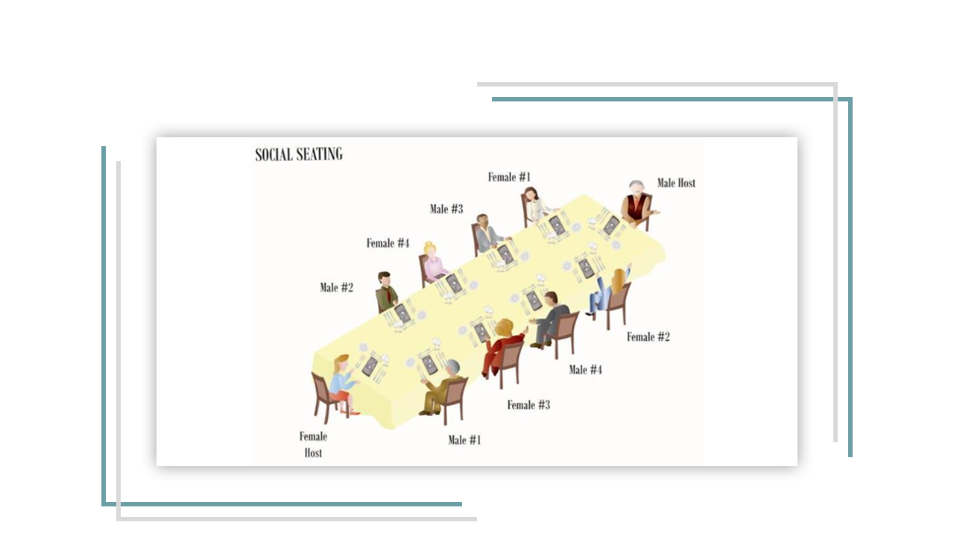
7
SOCIAL SEATING
DINING WITH CONFIDENCE™
Notes:
For many of us, when dining with friends and family, Seating may or may not be planned, and often guests will sit wherever they want.
However, it may surprise you to know that there is protocol for formal seating arrangements. And the interesting thing is that they differ somewhat depending on whether you are dining socially or for business.
When dining socially, we take age, gender and title or rank into consideration.
If everyone at the table has equal rank, the guests are seated alternately by gender. Husbands and wives are not seated together. The hosts are seated at the opposite ends of the table.
If the guests have title, the most important person sits at the host’s right. If there is only one host, the second most important person sits at the host’s left. If there is a male and female host, the most important female would sit at the male hosts right and the second most important female would sit at his left. The most important male guest would sit at the female hosts right and the second most important guest would sit at her left.
The meal would be served starting with the guest of honour, then the female guests, the male guests, the female host and then the male host.
Formal Dining for Informal People: Page 18

Slide 8
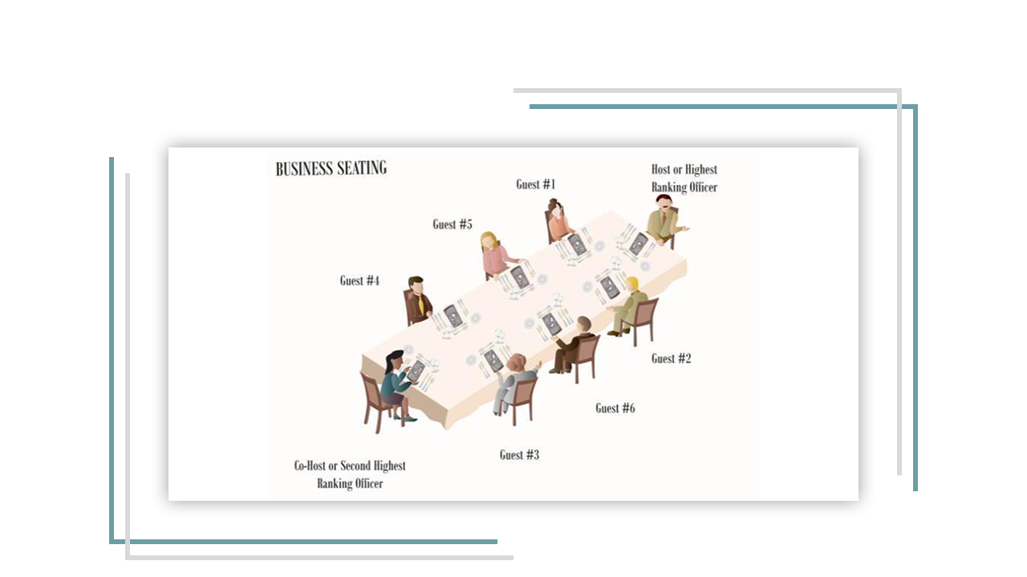
8
BUSINESS SEATING
DINING WITH CONFIDENCE™
Notes:
When dining for business purposes, the most important thing to remember is that the key word is business and just as in any business situation, the etiquette is based on business rank. There are no gender or age considerations.
The highest-ranking person or the person with the most important title is always treated as the most important person unless there is a guest of honour. This guest is traditionally given the “best seat” at the table--which usually means the one located farthest from the door or has the nicest view.
In a formal dining situation, the most important guest should be seated on the host’s right. The next most important person should be on the hosts left.
If there were a co-host, the third most important person would be on the co-hosts right and the fourth most important guest would on the co-hosts left.
Formal Dining for Informal People: Page 5

Slide 9
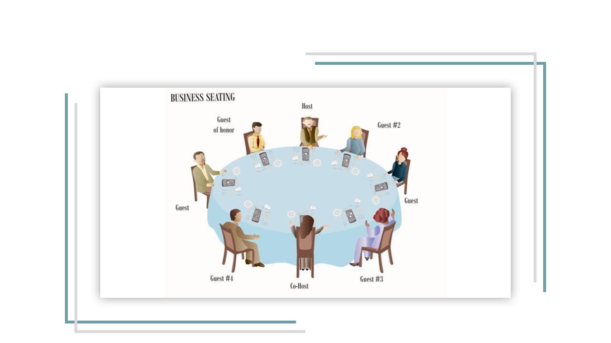
9
BUSINESS SEATING
DINING WITH CONFIDENCE™
Notes:
Here is an example at a round table. As you can see the Host and Co-host are seated across the table from one another. The guests are seated as shown in the previous slide.

Slide 10
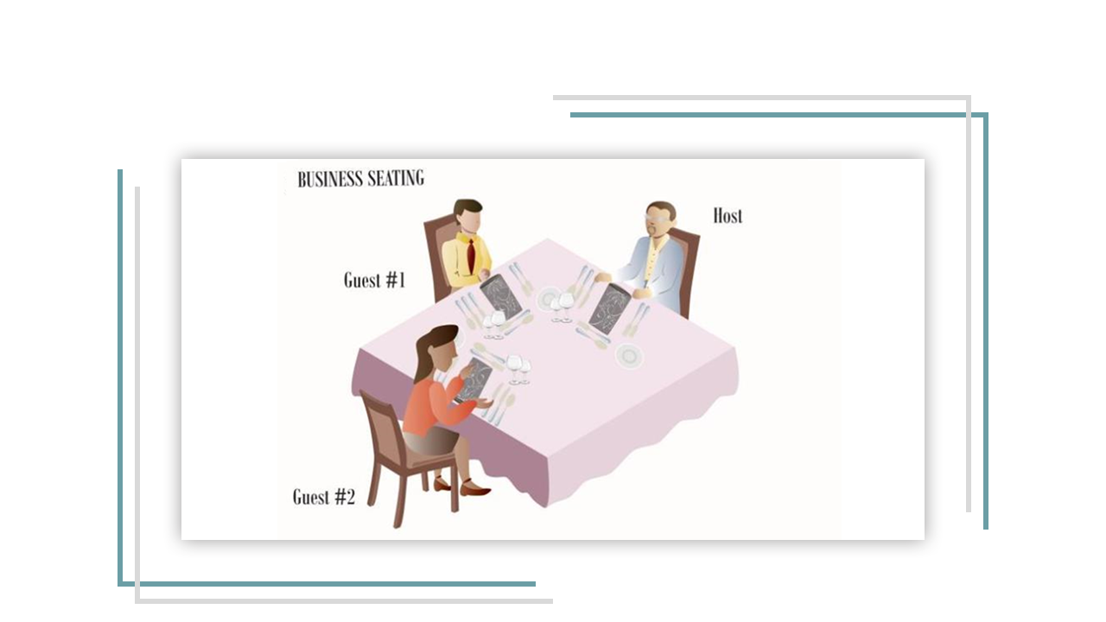
10
BUSINESS SEATING
DINING WITH CONFIDENCE™
Notes:
If there is only one host and two guests it is usually more appropriate to take conversation into consideration. Instead of having one guest on the left and another on the right, it may be more practical to have the highest ranking guest on the right of the host and the second guest across the table from the host.
Formal Dining for Informal People: Page 5

Slide 11
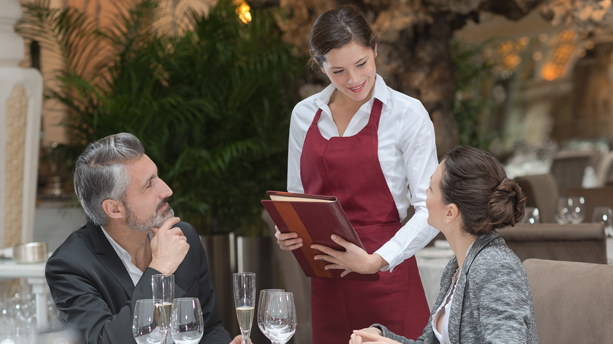
11
HOW TO BE A
GRACIOUS HOST
DINING WITH CONFIDENCE™
Notes:
So now, let’s talk about how to be a gracious host. The hosts and guests each have very distinct roles. As the host, it’s your role to take the lead and create a comfortable atmosphere for your guests. It is your responsibility to attend to your guests’ needs, and it should be clear to the servers that you are the host.
One question I get asked a lot, is when dining at a restaurant how do you determine where to take your guest?
Before making a reservation find out if your guest has any preferences. He or she may really dislike a particular type of food, have allergies or not be able to eat a particular food because of cultural or religious reasons.
If meeting your guest at the restaurant, select a restaurant close to your guest's home or office. It’s always a good idea to go to a restaurant that you are familiar with. Get to know a few good restaurants in the city. That way you will get to know the staff and what the setting and menu items are like.
The morning of the meeting call your guest to confirm. If you’re meeting your guest at the restaurant, try to arrive about 10 minutes before the arranged time. You can wait for your guest either in the lobby or at the table. However, if you wait at the table don’t touch anything. That includes your water and napkin. And wait for your guest to arrive before or ordering a drink. When your guest arrives, stand as your guest is shown to the table, shake hands, then gesture where you would like your guest to sit.
If you arrive at the restaurant with your guest, precede your guest to the table. And gesture where you would like your guests to sit.
Formal Dining for Informal People: Page 3-4

Slide 12
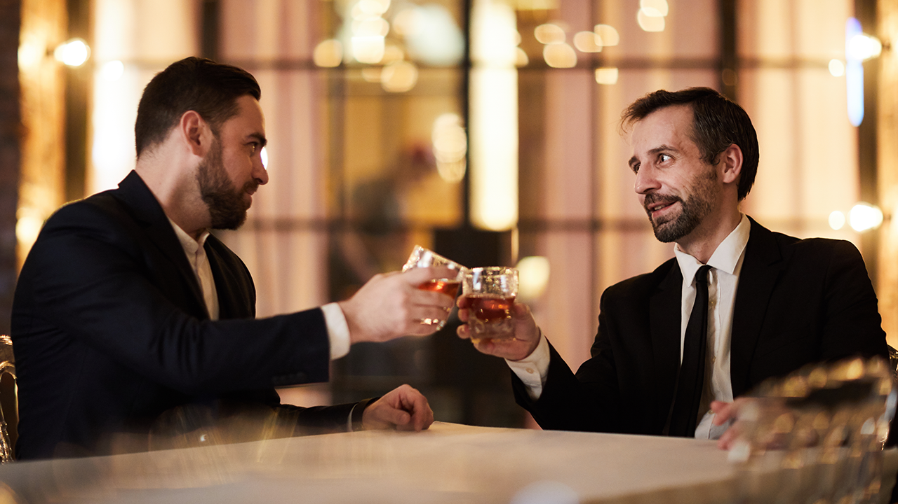
12
HOW TO BE A
PERFECT GUEST
DINING WITH CONFIDENCE™
Notes:
As the guest, understanding the rules of dining is the first step to a relaxing and having an enjoyable dining experience. Make sure you arrive on time, and dressed according to the occasion.
Ask participants: If you are the guest and you arrive at a restaurant first what do you think you should do?
Go to the table, but touch nothing. Wait for your host. Stand when the host arrives. The host will initiate the greeting and then gesture for you to sit. Then follow the lead of your host. The host should always lead the way.
After the meal thank the host. I would also recommend sending a thank you note or card to show your appreciation.
As a guest although you should never indicate likes and dislikes unless you are asked, you should politely let your host know if you have food allergies.
If you must be late, call to let your host know, and insist that the meal be served on time. When you arrive, accept the current course being served.
Formal Dining for Informal People: Page 6

Slide 13

13
Flat Breads and Rolls
Soup
Salad
Main Course
Dessert
Freshly Brewed Coffee & Selection of Teas
Wine
DINING WITH CONFIDENCE™
Notes:
OK now we are going to move onto the finer points of dining.
[EXCHANGE THE DISPLAYED MENU FOR THE MENU THAT WILL BE SERVED.] Tell participants that this is the menu that they will be served. Go through it with them for e.g. “We will be starting with a _____________ soup, then main course which will include __________________, then we will have ____________ for dessert. _________Wine will be served with the _______________. Tea or coffee will be served with dessert. As you can see your place settings are not set. All of the dishes and utensils that you will need for your place setting are stacked at the side of the table. Today you will be setting your own place setting based on how you think it should be set based on this menu. Each of you will need 1 plate, # of forks,.. etc.”
[GIVE PARTICIPANTS 5 – 10 MINUTES MAXIMUM (AS TIME ALLOWS) TO SET THEIR OWN PLACE SETTING. AFTER ABOUT 5 MINUTES PUT PPT SLIDE ON SCREEN THAT SHOWS THE APPROPRIATE PLACE SETTING BASED ON THE MENU BEING SERVED.]

Slide 14
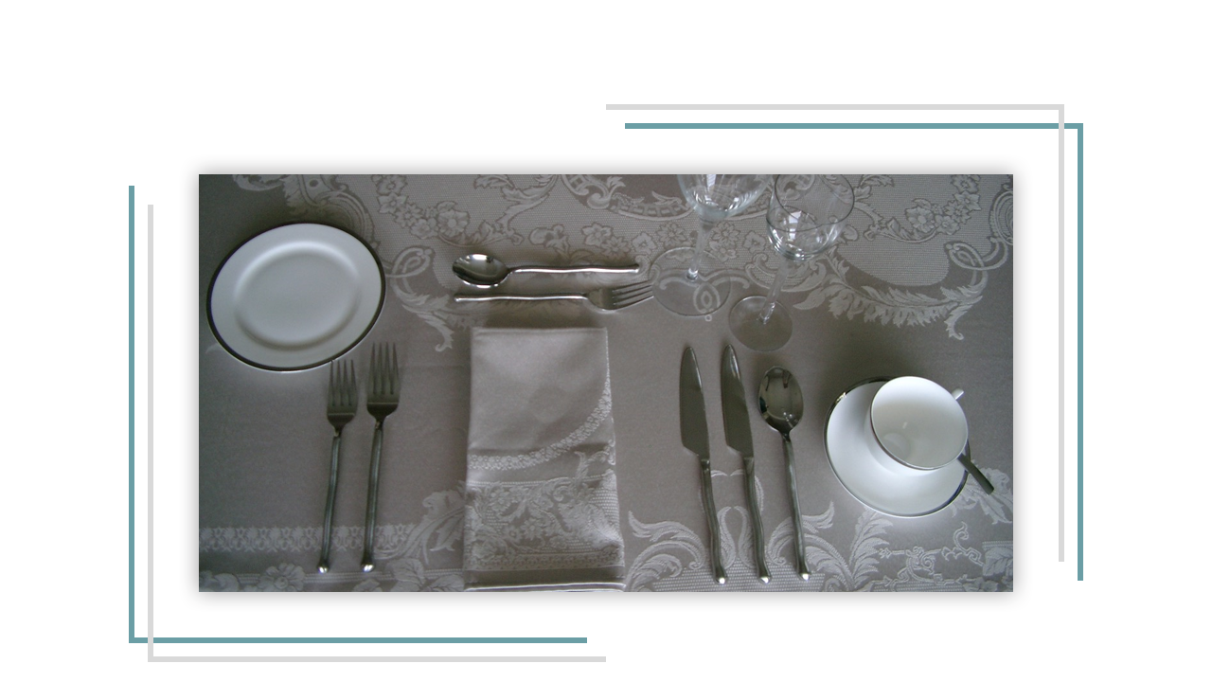
YOUR TABLE SETTINGS
14
DINING WITH CONFIDENCE™
Notes:
Here is an example of what your place setting should look like. Cutlery is arranged in order of use, from outside in.
Ask participants: How many letters are in the word knife? (5). How many letters are in the word spoon? (5). How many letters are in the word right? (5). So there are 5 letters in the word knife, 5 letters in the word spoon and 5 letters in the word right.
So, now you have an easy way to remember that knives and soup spoons are placed to the right of the place setting. Knives are placed to the right of the place setting, sharp edge facing towards the left. Soup spoons are placed to the right of the knives, bowls up.
So let’s do another little quiz. How many letters are in the word fork? (4) How many letters in the word left? (4) There are 4 letters in the word fork and 4 letters in the word left.
So now you have an easy way to remember that the forks are generally placed to the left of the place setting, with the tines up. In this example the only exception is the dessert fork at the top of the place setting, which I will explain in a moment.
Here is another exercise. I would like you to use your imagination. Hold your hands up and make a circle. Now hold your last three fingers on each hand straight up. Now when you look at your left hand doesn’t it look a bit like a ‘B’ like bread? And doesn’t you right hand look a bit like a ‘D’ like drink?
So now you have an easy way to remember that your bread plate is always the one on your left and your drinks are to your right.
The water goblet is placed at the tip of the knife, with the others to the right of it. Glasses are arranged in order of use and generally size.
The bread plate is placed to the left of the tip of the fork and it may have a butter knife lying across it. If a butter knife is on the plate, it may be placed across the bread plate, horizontally or at a diagonal from upper left to lower right, with the sharp edge toward the table edge.
In this place setting the fork and spoon at the top of the place setting are the dessert fork and spoon. The spoon is placed above the fork with the handle towards the right; the fork is below, with the handle towards the left. This indicates that a dessert will be served - which if eating European style will require a fork and spoon. Often only utensils that are required are placed on the table for example a pudding dessert would have a spoon placed on the table and no fork. I will explain more about that later in this program.
Coffee cup often forms part of the place setting and if space allows it would be placed the right of the setting. Coffee spoons or teaspoons are placed on the saucer with the cup.
Formal Dining for Informal People: Page 9

Slide 15
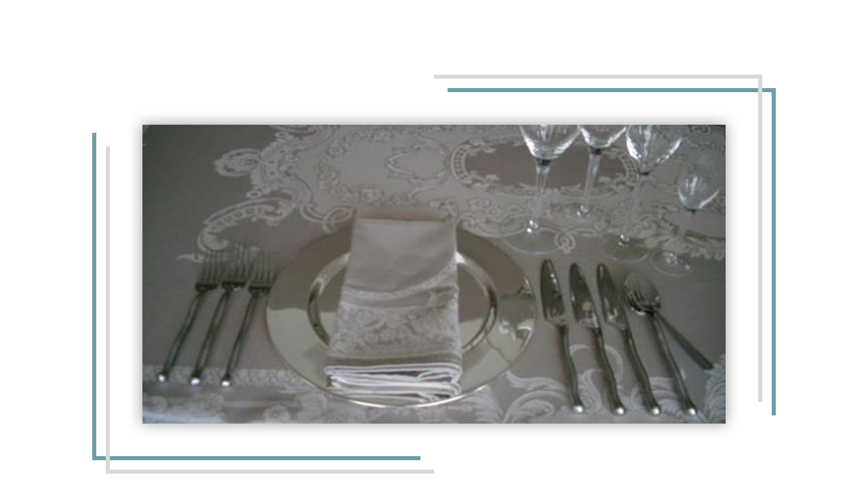
15
THE FORMAL PLACE SETTING
DINING WITH CONFIDENCE™
Notes:
Even though we tend to be more casual in our day-to-day dining and meals may only consist of 1 to 3 courses, on occasion you may have an elaborate meal. So if you were eating a formal 7-course meal your table setting might look something like this.
As I mentioned in the previous example, cutlery is arranged in order of use, from outside in.
In this place setting the large plate in the centre of the place setting is called a charger. This is just a decorative plate that serves as part of the place setting. It will be removed at some point prior to the main course being served. Sometimes it is used as a service plate for the starter or soup course and sometimes it will be removed prior to the first course being served.
You will notice in this example that there is a fork in the bowl of the soupspoon. The only fork that is ever place to the right of the place setting is the cocktail fork, which will be placed the farthest to right if there is a seafood cocktail starter. The cocktail fork is often set at a diagonal with the tines up lying in the bowl of the soupspoon.
As you can see there is no bread plate in this example. Historically a bread plate was not traditionally set at a formal place setting; the roll was placed on the tablecloth to the left of the fork. However, now bread plates are very common and may be included at a formal meal.
The water goblet is placed at the tip of the knife, with the others to the right of it. Glasses are arranged in order of use and generally size. Generally no more than 4 glasses are set at once. If more than 4 are called for, they are brought out, as they are required.
As in this example - the Coffee cup may not form part of the place setting. When dining formally the coffee is often brought out at the end of the meal, as it’s own course often and served with a Brandy, Sherry or Liqueur.
The napkin is placed either to the left of the forks, on the dinner plate, on the charger, on the bread plate, in the center of the place setting or in the water goblet.
Formal Dining for Informal People: Page 19

Slide 16
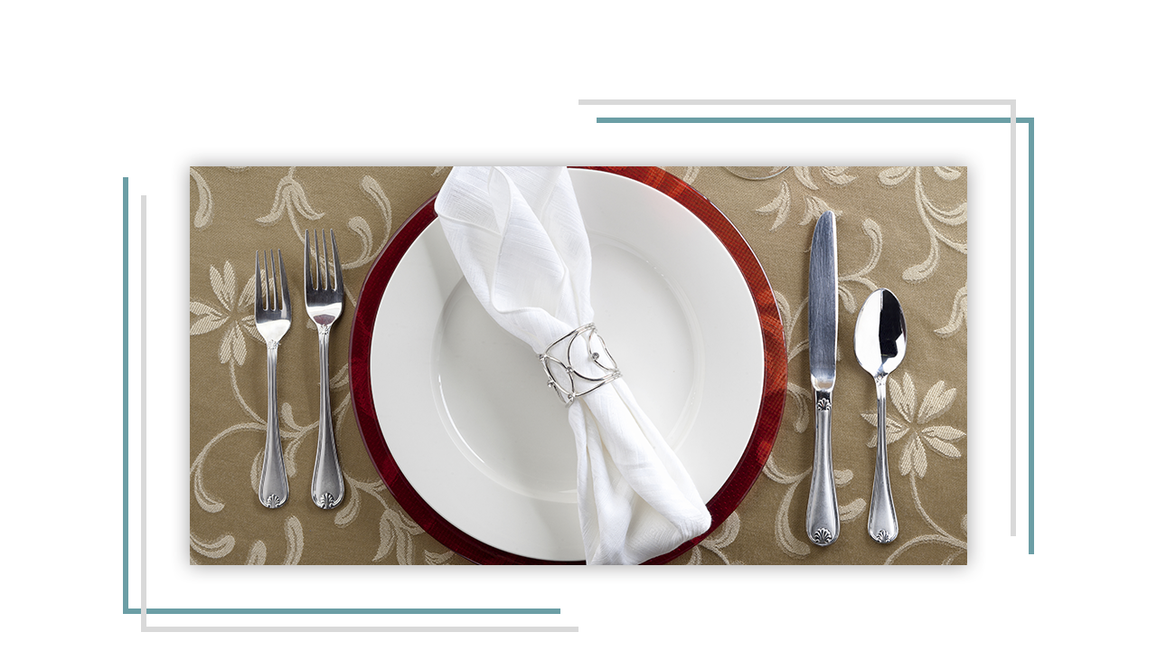
16
NAPKIN NUANCES
DINING WITH CONFIDENCE™
Notes:
In any dining situation, as soon as you are seated, place your napkin on your lap. At a formal meal, wait until your host picks up his or her napkin first. At a more formal restaurant, the Maître d’ will often place the napkin on your lap when you sit down.
There are 2 kinds of Napkins, a luncheon napkin and a dinner napkin.
Show participants how to open and place a napkin on their lap.
Luncheon napkins are smaller should be completely opened up and placed on your lap over both knees. Dinner napkins are larger and should be opened half way and placed on your lap with the fold toward you.
The purpose of the napkin is to blot your mouth and wipe your fingers; not blow your nose, or spit food into. If you need to blow your nose, use a tissue discretely at the table or go to the restroom. If you put something inedible into your mouth, remove it discretely and place it on the side of your plate.
The napkin stays on your lap throughout the meal. Never crumple a cloth napkin onto your plate. When finished your meal, the napkin is placed on the table to the left of your place setting. It should look neat but not perfectly folded.
Formal Dining for Informal People: Page 15

Slide 17
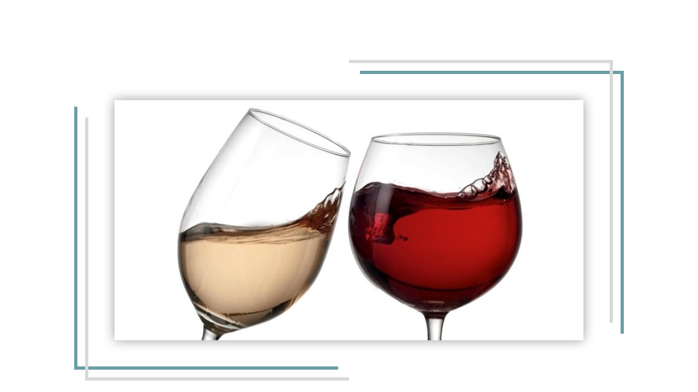
17
WINE
DINING WITH CONFIDENCE™
Notes:
As host, after everyone is seated ask your guests if they would like to order a drink.
When ordering wine its up to you as the host to choose and order it. Depending on where you are, the wine list may be presented to the host by the wine steward, the sommelier or the server.
The general rule for ordering wine is the lighter the meat; fish or poultry the lighter bodied the wine. Red wines are generally served with red meat and white wines are generally served with white meat.
White wine is traditionally served chilled and red wine is traditionally served at room temperature.
The wine should be ordered either based either on what your guest is ordering or based on your guest’s preference. If there are several people dining, you may want to order different bottles to accommodate different tastes. For example, you may want to order a bottle of red wine and a bottle of white wine. You would probably want to order one bottle of wine for every 3 people.
With a smaller group, if nobody has a preference I would choose the wine based on your guest of honour’s meal or traditionally a dry white wine would be served at lunch or a light red wine at dinner.
Before serving, a small amount of wine is poured into the host’s glass by the server or wine steward. The host then smells the bouquet and tastes the wine to ensure that the wine is good. If the wine is in a corked bottle it also ensures that any tiny pieces of cork at the top of the bottle will not be poured into a guest’s glass. More and more wines are bottled with screw tops these days, which alleviates concern about cork falling into the glass.
In a formal setting if wine is being served, it is acceptable to refuse by lightly placing your fingertips of the right hand on the rim of the glass.
If there is a host, don’t begin drinking your wine until the host has lifted his or her glass.
Hold a white wine glass by the stem, to not warm the wine. In the past a red wine glass was held by the bowl, but the trend seems to be changing and many people now hold the red wine glass by the stem.
Because most rooms now have central heating, room temperature tends to be much warmer than it was in the past. Because of this, red wine is sometimes served warmer than it’s optimal temperature. In order to compensate, many restaurants are now chilling red wine for up to 15 minutes before serving it. White wine may be taken out of the fridge up to 15 minutes before serving it to bring is up to it’s optimal temperature.
During the meal, the server will refill glasses at the table; guests should not need to refill their own glasses. A wine glass is never more than two-thirds full.
The white wine bottle may be placed in a bucket of ice to stay cool.
The bottle of red wine is may be placed in a cradle so that it tips at about a 45-degree angle; this moves the sediment into the lower corner of the bottle. The wine is then poured into a decanter, being careful to not disturb the sediment. While pouring, the steward may hold a candle beneath the neck of the bottle to monitor the approach of the sediment. The sediment remains in the wine bottle, with only clear wine in the decanter.
Formal Dining for Informal People: Page 30 - 33

Slide 18
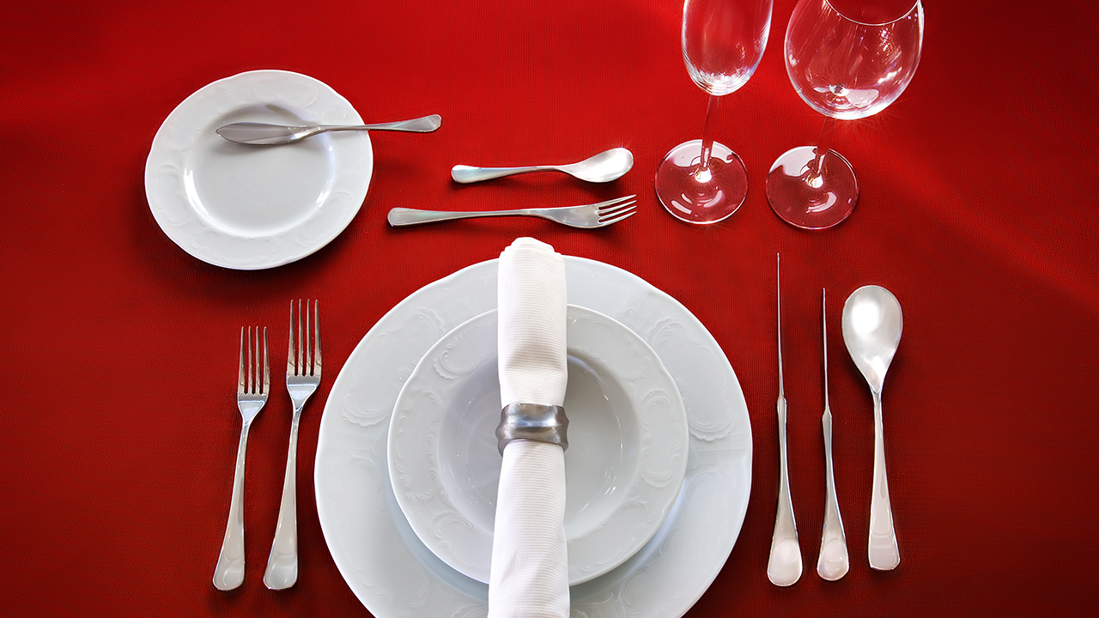
18
DINING ETIQUETTE
WESTERN
DINING STYLES
‘EUROPEAN / AMERICAN’
DINING WITH CONFIDENCE™
Notes:
Dining etiquette is something that evolves over time. Even if you go into restaurants these days you can see that even restaurants in an effort to be unique are turning to more untraditional styles of setting the table and serving. But there are 2 distinct dining styles that you should be familiar with. One of them is the European (or Continental) dining style and the other is the American dining style.
The main difference is that with the European and Continental style, the fork stays in the left hand. With the American dining style, the fork is in the left hand when cutting the food but then is transferred to the right hand for eating.
Formal Dining for Informal People: Page 12 - 14

Slide 19
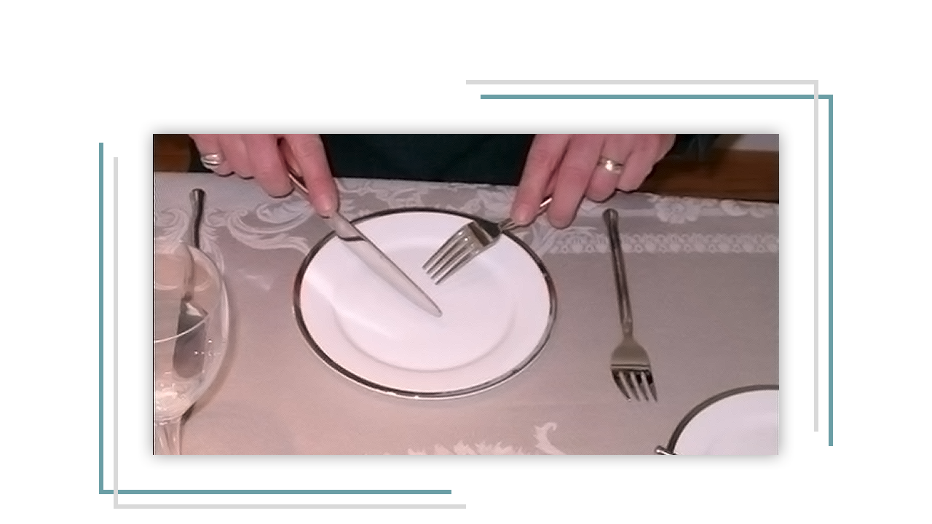
19
DINING STYLE - EUROPEAN
DINING WITH CONFIDENCE™
Notes:
Demonstrate holding and using utensils European Dining Style
The fork is held in the left hand with the tines (prongs) facing down. The knife is held in the right hand with the index finger along the back edge of the knife and the blade facing down toward the plate. The food is cut and speared, or pushed onto the back of the fork with the knife. The knife remains in the right hand while eating.
Formal Dining for Informal People: Page 12-13

Slide 20
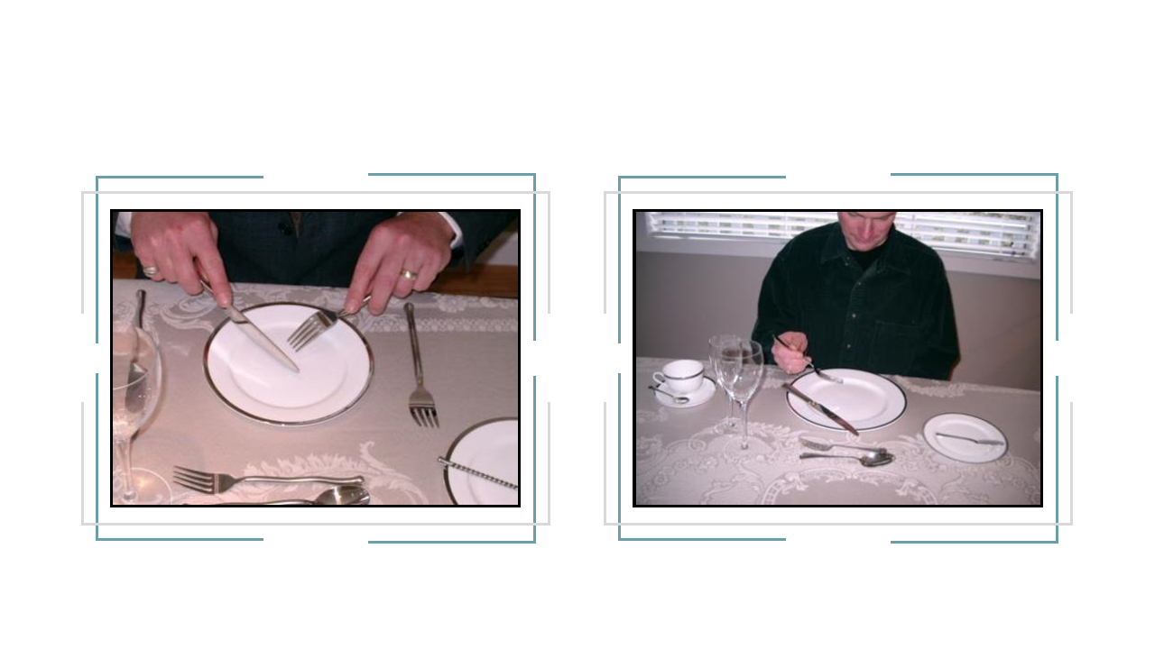
20
DINING STYLE - AMERICAN
DINING WITH CONFIDENCE™
Notes:
Demonstrate how to hold and use utensils American Dining Style
The American Style is a little bit different. When cutting your food, hold the fork in your left hand and the knife in your right hand. This is the same as the European method. After one piece of food is cut, the knife is placed at the top right corner of the plate, with blade facing the plate. Transfer the fork to the right hand. Food is eaten with the tines facing up. The left hand stays in your lap. . We see this method most often in the USA. However in Canada and some other Western countries, this method may be used as well as the European method.
Formal Dining for Informal People: Page: 12-13

Slide 21
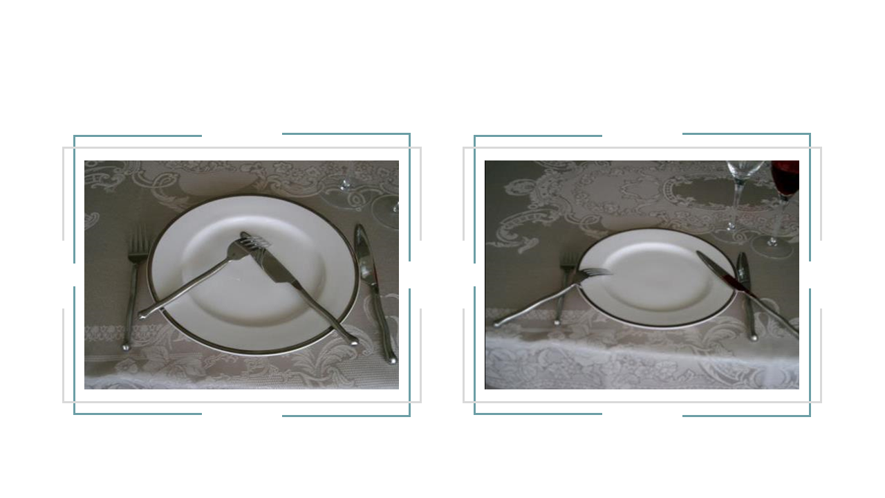
21
RESTING POSITION- EUROPEAN
Right
Wrong
DINING WITH CONFIDENCE™
Notes:
When taking a break before you have finished your meal – including times when you must excuse yourself from the table – signal this by placing the fork and knife appropriately on the plate:
Demonstrate how to place cutlery in resting position European Dining Style
When resting European Style, the fork and knife are placed at right angles on the plate, tines facing down. The blade of the knife faces towards the fork. Keep hands and wrists above the table at all times. Always make sure the utensil handles are resting on the plate not the table.
Formal Dining for Informal People: Page: 13

Slide 22
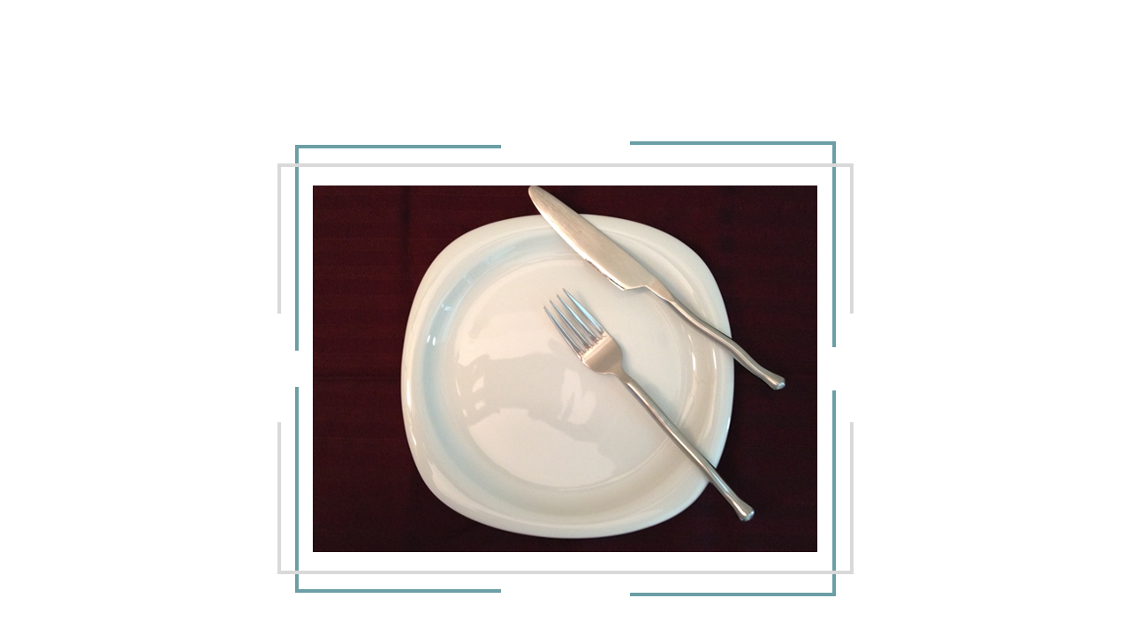
22
RESTING POSITION- AMERICAN
DINING WITH CONFIDENCE™
Notes:
Demonstrate how to place cutlery in resting position American Dining Style
When dining American Style, the fork is placed with the tines facing up diagonally at the 10:20 clock position. The knife is placed on the upper right corner of the plate with the blade facing inward towards the plate. Hands go in the lap.
With either style, the elbows and forearms stay off the table until the meal has ended and dishes have been cleared.
Formal Dining for Informal People: Page: 13

Slide 23
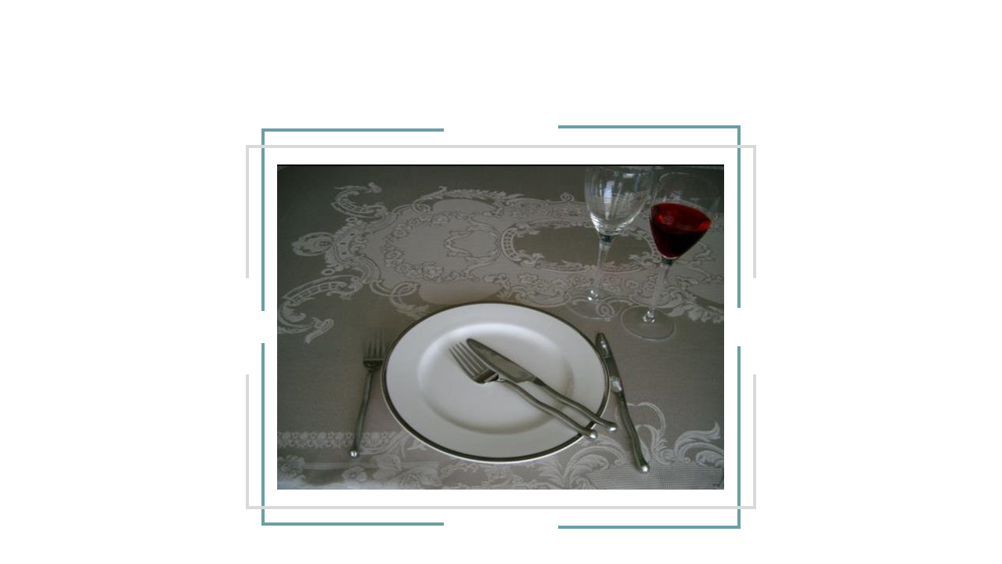
23
FINISHED POSITION
DINING WITH CONFIDENCE™
Notes:
When you are finished eating the course or meal, there is a signal that tells the wait staff that you are finished eating does anyone, know what that is?
Demonstrate how to place cutlery in the finished position
When the meal is finished, place your fork and knife on the plate diagonally like the 10:20 clock position. The knife sits above the fork with the blade facing toward it. Your napkin goes to the left of the plate, never on it. In some regions, it is the custom to place the fork and knife vertically in the centre of the plate, at 6 o'clock instead of the 10:20 position.
Formal Dining for Informal People: Page: 14

Slide 24

24
DINING ETIQUETTE
TEST YOUR
SKILLS
DINING WITH CONFIDENCE™
Notes:
Interactive Activity: Quiz - Test your dining skills
Before we start our meal, I have prepared a short quiz on dining etiquette and table manners to test your skills. Let’s go through it together as a group.

Slide 25
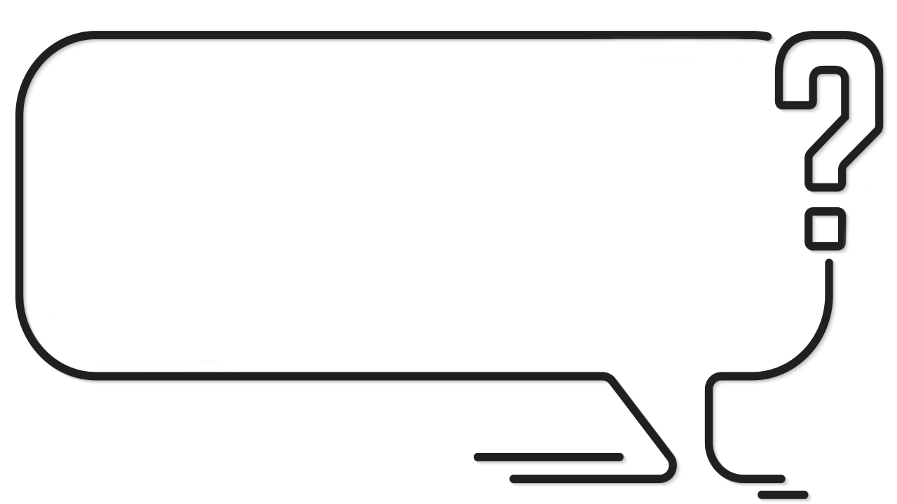
25
When dining socially, who is served first?
The Host
The Guest of Honour
The Hosts Grandmother
DINING WITH CONFIDENCE™
Notes:
Ask participants: When dining socially, who is served first?
The host
The guest of honour
The host’s grandmother
Formal Dining for Informal People: Page: 18

Slide 26
26
When dining socially, who is served first?
The Host
The Guest of Honour
The Hosts Grandmother
DINING WITH CONFIDENCE™
Notes:
The guest of honour
Whether you are dining socially or for business the most important person is served first. Which means if there is a guest of honour he or she would be served first. In a social setting if there is no guest of honour we would take age into the consideration an the most elderly person would be served first.
Formal Dining for Informal People: Page: 18

Slide 27
27
The best time to conduct business at a meal is…
Before the meal
During the meal
After the meal
During dessert
DINING WITH CONFIDENCE™
Notes:
Ask participants: The best time to do business at a meal is…
Before the meal
During the meal
After the meal
During dessert

Slide 28
28
The best time to conduct business at a meal is…
Before the meal
During the meal
After the meal
During dessert
DINING WITH CONFIDENCE™
Notes:
The best time to do business at a meal is…
Before the meal
During the meal
After the meal
During dessert
If you plan to discuss business request a table that will give you enough privacy. In Canada and the USA, business may be discussed anytime during the meal. However, it’s always a good idea to break the ice with small talk first. At breakfast or lunch, the general rule is to let at least 10 minutes lapse before business is discussed. At dinner, you may want to wait until the coffee is served.
If you are travelling to other countries it is a good idea to get to know the local customs. In some regions, business is discussed only towards the end of the meal.

Slide 29
29
At business, should you order an alcoholic
beverage if your client declines?
Yes
No
DINING WITH CONFIDENCE™
Notes:
Ask participants: When dining for business purposes, should you order an alcoholic beverage if your client declines?
Yes
No

Slide 30
30
At business, should you order an alcoholic
beverage if your client declines?
Yes
No
DINING WITH CONFIDENCE™
Notes:
Yes
No
This is an interesting question, because dining etiquette would say that if you would like to have an alcoholic beverage, it would be alright to have one. However, as we previously discussed, manners always override etiquette. So if it were me I would evaluate the situation based on the occasion, time of day, and how well I know the person I am dining with. Having said that if you do decide to have a drink, keep it to one or two drinks and don’t over do it.

Slide 31
31
When dining, food should be passed…
Clockwise to the left
Counter-Clockwise to the right
DINING WITH CONFIDENCE™
Notes:
Ask participants: When dining, food should be passed…
Clockwise – to the left
Counter-Clockwise – to the right
Formal Dining for Informal People: Page: 11

Slide 32
32
When dining, food should be passed…
Clockwise to the left
Counter-Clockwise to the right
DINING WITH CONFIDENCE™
Notes:
Counter-Clockwise – to the right
When passing dishes containing food or condiments, they are passed counter-clockwise to the right, ideally starting with the guest of honour or the most important guest.
Formal Dining for Informal People: Page: 11

Slide 33
33
When leaving the table but will return, leave your
napkin…
On the table to the right of your place setting
On your chair
On the table to the left of your place setting
DINING WITH CONFIDENCE™
Notes:
Ask participants: When leaving the table but will return, leave your napkin…
On the table to the right of your place setting
On your chair
On the table to the left of your place setting
Formal Dining for Informal People: Page: 15

Slide 34
34
When leaving the table but will return, leave your
napkin…
On the table to the right of your place setting
On your chair
On the table to the left of your place setting
DINING WITH CONFIDENCE™
Notes:
On your chair
If you are leaving the table but will be returning to finish your meal the napkin is placed on your chair. Once you have completely finished your meal and wish to have your dishes and utensils removed, the napkin is placed on the table to the left of your place setting.
Formal Dining for Informal People: Page: 15

Slide 35
35
While dining, may small objects such as cell
Phones be placed on the table?
Yes
No
DINING WITH CONFIDENCE™
Notes:
Ask participants: While dining, should keys, cell phones and other small objects be placed on the table?
Yes
No

Slide 36
36
While dining, may small objects such as cell
Phones be placed on the table?
Yes
No
DINING WITH CONFIDENCE™
Notes:
No
Nothing should go on the table that isn’t part of the meal until the meal is finished and the dishes are cleared.

Slide 37
37
If you have gristle or a pit in your mouth you
should…
Spit it into your napkin
Swallow it
Remove it discretely the same way it went into your mouth &
place it on the side of your plate.
DINING WITH CONFIDENCE™
Notes:
Ask participants: If you have gristle or a pit in your mouth you should…
Spit it into your napkin
Swallow it
Remove it discretely the same way it went into your mouth and place it on the side of your plate.
Formal Dining for Informal People: Page: 7

Slide 38
38
If you have gristle or a pit in your mouth you
should…
Spit it into your napkin
Swallow it
Remove it discretely the same way it went into your mouth &
place it on the side of your plate.
DINING WITH CONFIDENCE™
Notes:
If you have gristle or a pit in your mouth you should… Remove it discretely the same way it went into your mouth and place it on the side of your plate.
It should never be spit into a napkin. Ideally it should be removed from your mouth the same way in went into your mouth (with your utensil or fingers) and discretely placed on the side of your plate.
Formal Dining for Informal People: Page: 7

Slide 39
39
If your utensil drops on the floor you should…
Pick it up, put it on the table, then ask your server for another one.
Leave it on the floor and ask your server for another one.
Pick it up discretely and use it.
DINING WITH CONFIDENCE™
Notes:
Ask participants: If your utensil drops on the floor you should…
Pick it up, put it on the table, then ask your server for another one.
Leave it on the floor and ask your server for another one.
Pick it up discretely and use it.
Formal Dining for Informal People: Page: 7

Slide 40
40
If your utensil drops on the floor you should…
Pick it up, put it on the table, then ask your server for another one.
Leave it on the floor and ask your server for another one.
Pick it up discretely and use it.
DINING WITH CONFIDENCE™
Notes:
If your utensil drops on the floor you should… Leave it on the floor and ask your server for another one.
Formal Dining for Informal People: Page: 7

Slide 41
41
If women wish to touch up make-up or reapply
lipstick after eating they may…
Discretely touch it up at the table.
Excuse themselves and go to the restroom.
Apply it openly at the table. Everyone does it.
DINING WITH CONFIDENCE™
Notes:
Ask participants: If women touch up their make-up or reapply lipstick after eating they should…
Discretely touch it up at the table.
Excuse themselves and go to the restroom
Apply it openly at the table. Everyone does it.

Slide 42
42
If women wish to touch up make-up or reapply
lipstick after eating they may…
Discretely touch it up at the table.
Excuse themselves and go to the restroom.
Apply it openly at the table. Everyone does it.
DINING WITH CONFIDENCE™
Notes:
If women touch up their make-up or reapply lipstick after eating they should… Excuse themselves and go to the restroom

Slide 43
43
When the bill is placed on the table you should…
Haggle over the bill to decide who pays.
The person who did the inviting should be prepared to pay.
Flip a coin to decide who pays
Split the bill
DINING WITH CONFIDENCE™
Notes:
Ask participants: When the bill is placed on the table you should…
Haggle over the bill to decide who pays
The person who did the inviting should be prepared to pay
Flip a coin to decide who pays
Split the bill
Formal Dining for Informal People: Page: 39

Slide 44
44
When the bill is placed on the table you should…
Haggle over the bill to decide who pays.
The person who did the inviting should be prepared to pay.
Flip a coin to decide who pays
Split the bill
DINING WITH CONFIDENCE™
Notes:
When the bill is placed on the table you should… The person who did the inviting should be prepared to pay
Formal Dining for Informal People: Page: 39

Slide 45
45
As Host, when the bill is presented you should…
Calculate the gratuities and pay the bill discretely.
Let your guest know how much they owe.
Ask your guest if they have a calculator that you can borrow to calculate how much is owed.
DINING WITH CONFIDENCE™
Notes:
Ask participants: As Host, when the bill is presented you should…
Calculate the gratuities and pay the bill discretely.
Let your guest know how much they owe.
Ask your guest if they have a calculator that you can borrow to calculate how much is owed.

Slide 46
46
As Host, when the bill is presented you should…
Calculate the gratuities and pay the bill discretely.
Let your guest know how much they owe.
Ask your guest if they have a calculator that you can borrow to calculate how much is owed.
DINING WITH CONFIDENCE™
Notes:
As Host, when the bill is presented you should… Calculate the gratuities and pay the bill discretely.
It should be clear to the wait staff that you are the host. If possible, pay the bill privately. One way to do this is by giving your credit card to the Maître d’ prior to the arrival of your guest and sign the receipt before leaving.
Tipping guidelines depend on where you are. Some countries tip and others don’t. So before travelling it is a good idea to research regional guidelines before you arrive. In Canada and the USA tips range from 15% to about 20% for really good service.
For more information on Tipping turn to page 39 in Formal Dining for Informal People

Slide 47
47
When eating bread and rolls…
Butter the whole piece and eat it one bite at a time.
Rip off one bite sized piece, butter it and eat each piece at a time
DINING WITH CONFIDENCE™
Notes:
Ask participants: When Eating Bread or Rolls do you …
Butter the whole piece and eat it one bite at a time.
Rip off one bite sized piece, butter it and eat each piece one piece at a time.
Formal Dining for Informal People: Page 25

Slide 48
48
When eating bread and rolls…
Butter the whole piece and eat it one bite at a time.
Rip off one bite sized piece, butter it and eat each piece at a
time
DINING WITH CONFIDENCE™
Notes:
When Eating Bread or Rolls… Rip off one bite sized piece, butter it and eat each piece one piece at a time.
Don’t reach for the bread basket; ask the person closest to the basket to pass it to you. Take the bread or roll and place it on your bread plate. Ask the person closest to the butter to pass it to you. Using the butter serving utensil (if there is one) or your butter knife (if there is no serving utensil), to place some butter on your bread plate. Rip off a small piece of bread/roll, the appropriate size for one or two bites. Butter that piece of bread/roll, holding it on the plate while spreading the butter. Eat it with your mouth closed and enjoy!
Formal Dining for Informal People: Page: 25

Slide 49


49
MORE TABLE MANNERS
Sit up straight; no slouching, slumping, or tipping your chair back.
Don’t touch any part of your head while eating.
You can refuse a dish with a polite “no thank you”; you don’t need to give an explanation.
DINING WITH CONFIDENCE™
Notes:
Sit up straight, no slouching, slumping, or tipping your chair back.
Don’t touch any part of your head while eating.
You can refuse a dish with a polite “no thank you”; you don’t need to give an explanation. However having said that if you are the guest and you know that the host has prepared a special meal for you unless you have food allergies your should at least try everything.
Formal Dining for Informal People: Page 7-8

Slide 50
50
MORE TABLE MANNERS
Do not reach for food; ask the closest diner to pass it to you.
If the food is served for you, eat what you can and leave the rest.
Do not speak with food in your mouth.
DINING WITH CONFIDENCE™
Notes:
Do not reach for food; ask the closest diner to pass it to you. Food is passed to the right.
If the food is served for you, eat what you can and leave the rest. If you serve yourself you should eat what you put on your plate.
Do not speak with food in your mouth.
Formal Dining for Informal People: Page 7-8

Slide 51
51
MORE TABLE MANNERS
Don’t drink with food in your mouth.
Don’t chew with your mouth open.
Eat quietly; avoid slurping, smacking, etc.
Wipe your fingers on your napkin; blot your mouth with a corner of the napkin.
DINING WITH CONFIDENCE™
Notes:
Don’t drink with food in your mouth.
Don’t chew with your mouth open.
Eat quietly; avoid slurping, smacking, etc.
Wipe your fingers on your napkin; blot your mouth with a corner of the napkin.
[IN WESTERN CULTURE IT IS CONSIDERED GOOD MANNERS TO EAT QUIETLY. BE AWARE THAT IN SOME CULTURES IT IS CONSIDERED GOOD MANNERS TO MAKE NOISE WHILE YOU EAT.]
Formal Dining for Informal People: Page 7-8

Slide 52
52
MORE TABLE MANNERS
Don’t push your empty plate away from you.
Elbows may be placed on the table only when the meal if finished and plates have been cleared.
If something is stuck in your teeth, don’t pick your teeth at the table.
Once a piece of cutlery is picked up it is never put back on the table. It rests on the edge of the plate.
DINING WITH CONFIDENCE™
Notes:
Don’t push your empty plate away from you and say things like “I’m full” or “I’m stuffed”.
Elbows may be placed on the table only when the meal if finished and plates have been cleared.
If something is stuck in your teeth, don’t pick your teeth at the table. Excuse yourself and go to the powder room.
Once a piece of cutlery is picked up it is never put back on the table. It rests on the edge of the plate.
[SOMETIMES TOOTHPICKS WILL BE SET ON THE TABLE. THIS DOES NOT MEAN YOU MAY USE THEM AT THE TABLE. TAKE ONE AND USE IT IN THE RESTROOM.]
Formal Dining for Informal People: Page 7-8

Slide 53
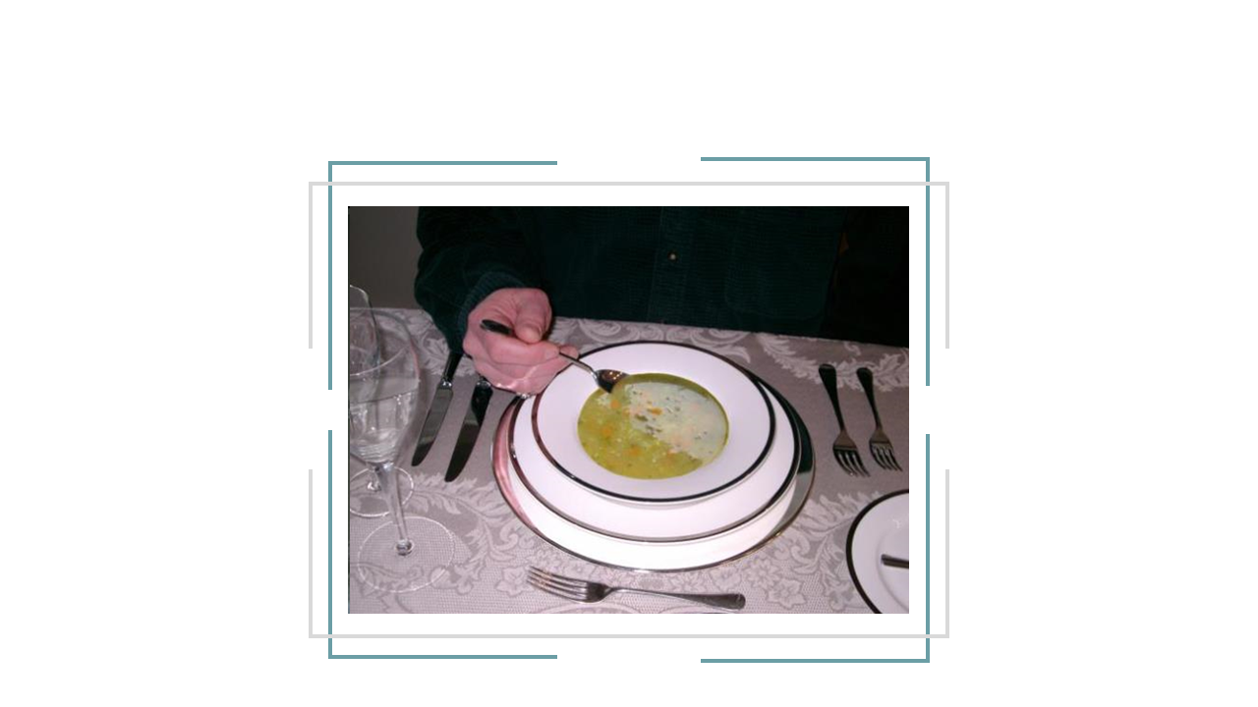
53
SOUP COURSE
DINING WITH CONFIDENCE™
Notes:
[SERVE SOUP COURSE – SOUP COURSE]
While our soup is being served, let’s talk about soup! Soup is all about creativity, and comes in many varieties from thin to thick, and cold to hot. So many styles present many challenges.
Soup may be served in a soup plate, a soup cup, or a two-handled soup bowl, any of which may be served on top of a service plate or saucer.
The soup spoon is held like a pen between your index finger and middle finger and steadied with your thumb on top. Traditionally the soup spoon was held with the right hand. And although the soup spoon is placed on the right hand side of the place setting, a left-handed person may hold the spoon with their left hand instead of their right hand.
Demonstrate how to hold a soup spoon
Soup is spooned away from you, towards the centre of the bowl, and brought to your lips. Whenever possible, it is sipped from the side of the spoon instead of putting the spoon into your mouth.
And easy way to remember how to do this is with this verse: Like ships that sail out to sea, I spoon my soup away from me.
The soup plate or bowl may be tipped away from you to get the last few spoonfuls.
If a services plate is included in the setting, the spoon is placed on it between sips, when taking a break and when the soup is finished.
When you are in a small group, don’t begin eating until everyone has been served.
Invite participants to pass the rolls and to start eating their soup. Tell them that you will be come around to answer questions while they are eating.
Formal Dining for Informal People: Page 25

Slide 54
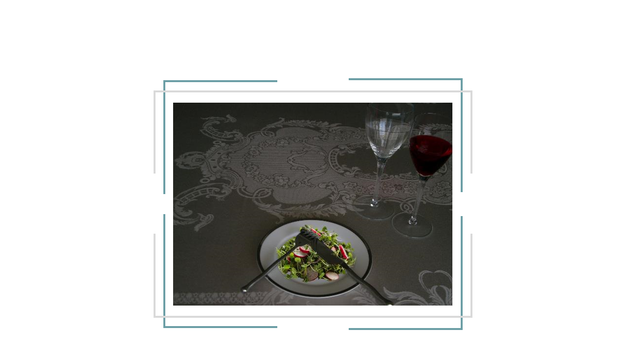
54
SALAD COURSE
DINING WITH CONFIDENCE™
Notes:
[SERVE SALAD COURSE – SALAD COURSE]
Let’s talk about salad. Salad comes in many varieties some with meat, some with vegetables, some with fruit and some with a bit of everything. Traditionally in a formal setting salad way served after the main course. However these days it is more common to see it served before the main course.
Demonstrate how to hold the fork and knife
Salad may be eaten European or Continental style as it is sometimes called or American style. If is served with meat or if the pieces are larger it may be cut and eaten with a fork and knife. If there is no knife as part of the place setting it would traditionally be eaten with the fork in the right or left with the tines facing up.
When finished the fork and knife (if there is one) would be placed at the 10:20 position like on a clock. The same as when finishing the main course.
Invite participants to start eating their salad. Tell them that you will be come around to answer questions while they are eating.

Slide 55


WESTERN DINING STYLES
55
DINING WITH CONFIDENCE™
Notes:
While we are waiting for the main course to be serviced, I would like to show you a video that demonstrates European and American Dining Styles.

Slide 56
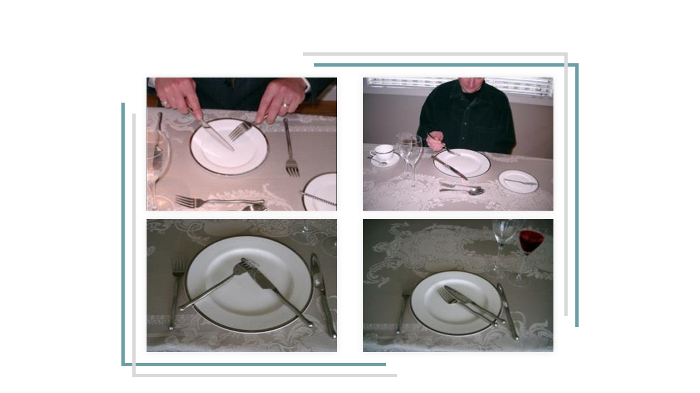
56
MAIN COURSE
DINING WITH CONFIDENCE™
Notes:
[MAIN COURSE (MEAT COURSE) IS SERVED.]
Invite participants start eating the main course. Tell them that you will be come around to answer questions while they are eating.

Slide 57
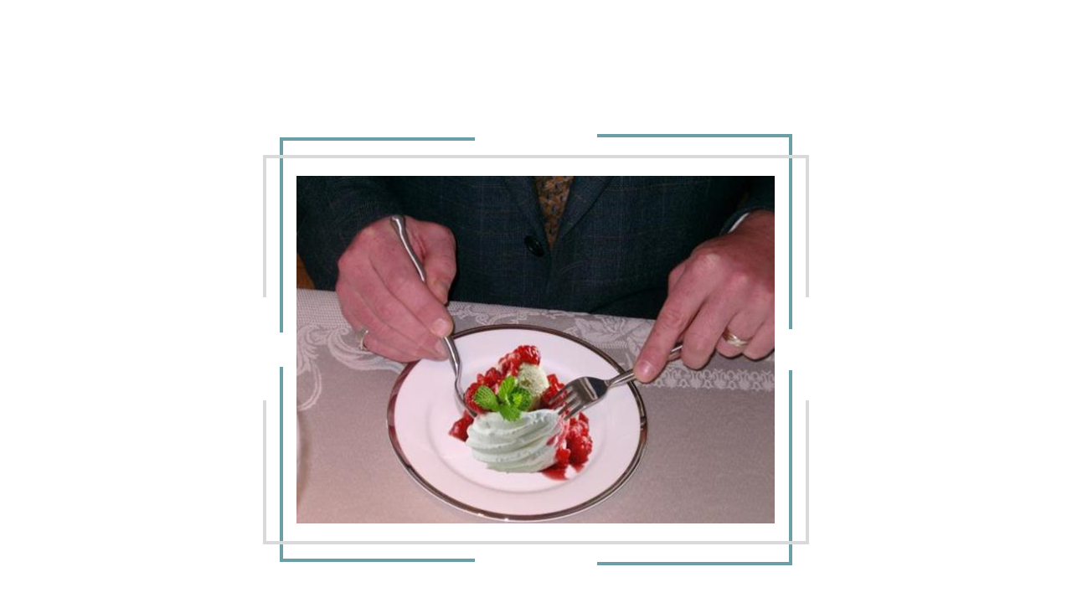
58
DESSERT COURSE
DINING WITH CONFIDENCE™
Notes:
Dessert can be eaten with a spoon, a fork, or a fork and spoon.
If there is just a fork at the place setting, that means that it is something solid, served on a plate such as cake or pie. It is cut with the side of the fork and eaten with the tines facing up.
If there is just a spoon, it means that the dessert is something that would be served in a bowl. The spoon is held like a pen in either your right or left hand. When you are taking a break or finished eating the spoon would rest on the service plate if there is one. If not it would rest in the bowl.
Sometimes there is a dessert fork and dessert spoon. If this is the case, it probably means that you are being served something that might be messy or something like pie or cake alamode where there will be some kind of topping or ice cream or a filling like pastries or creampuffs. In this situation if you were eating European style, the dessert would be eating with the fork and spoon.
Demonstrate holding and using the dessert fork and spoon
The fork may be held with the tines up or down in the left hand and the spoon is held in the right hand. The spoon is used to cut the food on the side of the spoon and fork is used to push the dessert onto the spoon. The dessert is eaten with the spoon.
When you are finished eating, the fork and spoon are placed in finished position.
Today coffee and tea are being served with your dessert. However in a very formal setting it may be brought out as a separate course after the dessert course is finished.
[SERVE DESSERT COURSE – DESSERT COURSE]
Invite participants to start the dessert course. Tell them that you will come around to answer questions while they are eating.
Formal Dining for Informal People: Page 9, 21, 29

Slide 58
DINING MADE EASY
58
Work from the outside - in on the utensils
Work from the bottom - up on your glasses
Your bread plate is always on your left.
Your glasses are always on your right
Put your napkin on your lap
Follow your host’s lead
Only begin eating when everyone is served
DINING WITH CONFIDENCE™
Notes:
If you are ever in a formal dining situation or any dining situation if you remember a few simple rules, you will never have a problem:
Work from the outside in on the utensils
Work from the outside - in on your glasses. Your bread plate is always the one on your left. Your glasses are always on your right.
Only begin eating when everyone is served. The host picks up her or his cutlery first.
Put your napkin on your lap
…and enjoy.
This brings us to the end of this session but I would like to leave you with a quote by Emily Post:
“Manners are ultimately a combination of common sense and know how, that help us to treat each other with care and consideration. Etiquette is the guiding code that enables us to use our manners and to practice our traditions. Neither should be rigid, formal or stuffy. They should be used as guidelines for eating with grace and consideration for others.”
Thank you for your energy and contributions today. Dining etiquette does take practice. But once you master the skills you will feel more confident and appear more at ease in any dining situation.

