Slide 1

INTERNATIONAL
BUSINESS
ETIQUETTE
Notes:
Welcome to International Business Etiquette. I am so happy to have you here. My name is your name, I am title, credentials, etc. at company name.
Today, I am going to give you some key strategies for presenting yourself confidently when interacting with others in any business situation, inside or outside of the office.

Slide 2

2
TODAY’S WORKSHOP
Effects of Defective Behaviour
BUSINESS ETIQUETTE TOOL KIT™
Notes:
So, let’s review what you’re going to learn. We are going to start by identifying the effects of defective behaviour. We will define the role of business etiquette and discuss the impact it can have on your ability to get a job, retain a job, and advance in your company.

Slide 3
3
TODAY’S WORKSHOP
Networking & Business Mixers
BUSINESS ETIQUETTE TOOL KIT™
Notes:
Next, we are going to cover strategies for networking at business mixers and how to interact as a professional. We will identify the tools you need to be successful, how to behave and how to schmooze with confidence to make a good impression.

Slide 4
4
TODAY’S WORKSHOP
Greetings & Handshakes
BUSINESS ETIQUETTE TOOL KIT™
Notes:
Then , we will cover greetings and handshakes. We are going to break down the 3 steps to a great personal introduction. First, we will identify what good eye contact really means. Then we will discuss the how-to’s of a professional greeting so you can introduce yourself with confidence. Finally, we will identify the do’s and don’ts of a professional handshake. With these three steps, you can master your introduction and maximize your sphere of influence in any business setting.

Slide 5
5
TODAY’S WORKSHOP
Workplace Decorum
BUSINESS ETIQUETTE TOOL KIT™
Notes:
The next section is all about how to win the respect of your colleagues and clients in a formal workspace. I will show you how to display a winning attitude to increase your likability. Then I will demonstrate the art of introductions and identify do’s the and don’ts of business meetings.
.

Slide 6
6
TODAY’S WORKSHOP
Electronic Communication
BUSINESS ETIQUETTE TOOL KIT™
Notes:
Next, we will talk about the newest etiquette: techno-etiquette. Techno-etiquette includes all forms of electronic communication. In this section, I will share phone, mobile phone, and email etiquette to make a great impression and effectively communicate in the office and on the road.

Slide 7
7
TODAY’S WORKSHOP
Non-Verbal Communication
BUSINESS ETIQUETTE TOOL KIT™
Notes:
Then we will finish by discussing non-verbal communication, also known as body language. Body language is what your body says when you’re not talking. In this section, we will identify common pitfalls. By avoiding these common mistakes, you will appear more confident and communicate your message more effectively.

Slide 8

EFFECTS OF
DEFECTIVE BEHAVIOUR
Notes:
Ask participants: To start off I would like you to think about some of the courtesies that you think are missing in the workplace. In other words, what are some of the things that you have experienced, either in your workplace or when doing business with another company? It could be the way you were treated by someone at work or it might be some interaction you had as a client or when doing business. Start the discussion by sharing one of your experiences. [GIVE PARTICIPANTS 5 MINUTES (AS TIME ALLOWS) TO SHARE THEIR EXPERIENCES.]
Ask participants: So, what was it about your experience that affected you, and how did these experiences make you feel? If it was at work, did it affect your productivity? If you were planning to do business with a company, did it affect your decision to do business or to be a repeat customer? [GIVE PARTICIPANTS 5 MINUTES (AS TIME ALLOWS) FOR THIS DISCUSSION.]
I think that we would all agree that when we are mistreated in any environment, whether it is in a business or personal situation, it can leave us feeling bad, frustrated or outright angry. As a mistreated client, it can impact your decision to do business with a company. As an employee, it can impact your productivity. Making these kinds of errors can get in the way of your professional credibility and influence people’s impressions of you and your company. Ultimately, it can have a detrimental effect on the success of your business.

Slide 9
9
BARBARA JORDON
IF YOU’RE GOING TO PLAY THE GAME,
YOU’D BETTER KNOW EVERY RULE.
BUSINESS ETIQUETTE TOOL KIT™
Notes:
A former United States Congresswoman named Barbara Jordon once stated: “If you're going to play the game properly, you'd better know every rule.” The rules of business conduct are no exception.
The rules for business conduct are based on showing consideration to anyone you come into contact with professionally. Because, without basic civility, business relationships can fall apart, affecting company profitability.

Slide 10
10
PROTOCOL SCHOOL OF WASHINGTON
FOR THOSE WHO DO UNDERSTAND THE IMPORTANCE, IT CAN GIVE YOU AN OPPORTUNITY TO STAND OUT AND BE NOTICED.
BUSINESS ETIQUETTE TOOL KIT™
Notes:
According to the Protocol School of Washington, “For those who do understand the importance, of business etiquette, it can give you an opportunity to stand out and be noticed.” When you treat people with courtesy and you put people at ease, you can outshine your competition.
It’s important to present yourself appropriately and show respect for your work environment, co-workers, clients and the public as a representative of your company.
There should be a comma after “importance” above.
The importance of what? Is there something missing here?

Slide 11
BUSINESS ETIQUETTE TRAINING
11
  DISTINGUISH YOURSELF FROM THE COMPETITION
  DEVELOP AND MAINTAIN BUSINESS
  PROJECT A POSITIVE IMAGE
  PROJECT CONFIDENCE AND CREDIBILITY
  BUILD TEAMS
BUSINESS ETIQUETTE TOOL KIT™
Notes:
These soft skills are necessary for anyone that wishes to do business locally or anywhere in the world. It is important to be equipped with knowledge and understanding of the business customs of the people we intend to do business with. And we must have an understanding of the international rules of business conduct. Etiquette has become more important than ever, and in business, know-how will bring us success.
Business etiquette training prepares you to distinguish yourself from the competition, develop and maintain business, project a positive image, project confidence and credibility. It also helps create a comfortable atmosphere for team building.
We just reviewed what you can expect from this program. My goal is to provide you with business soft skills that you can use to make a great impression at work, whether you work locally or anywhere in the world.

Slide 12
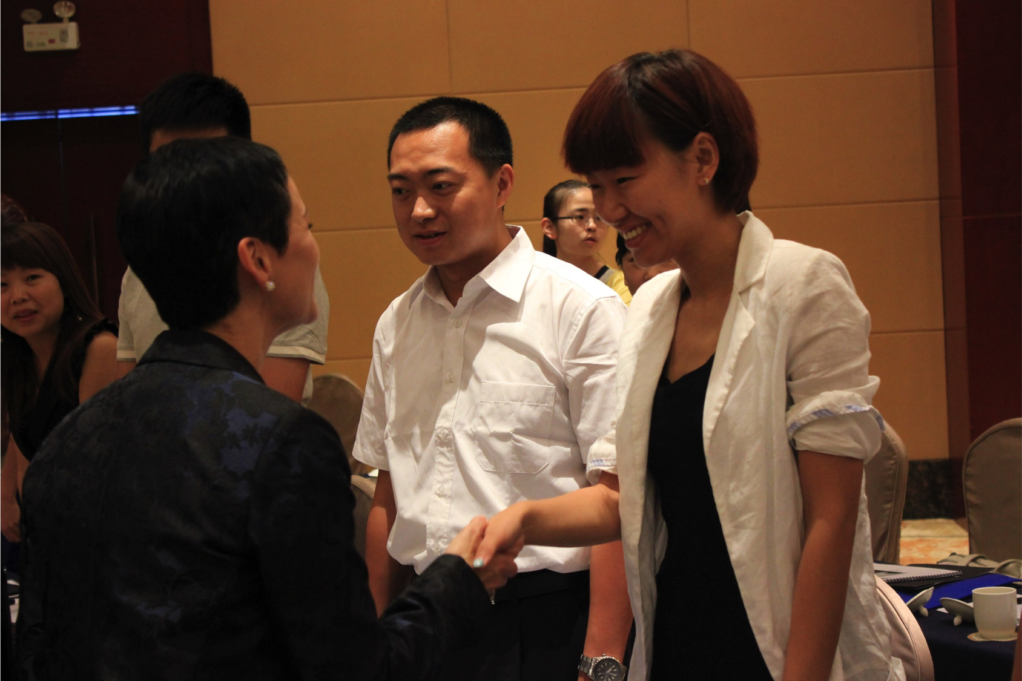
NETWORKING &
BUSINESS MIXERS
Notes:
Sometimes you will be in a position where you are representing your company outside of the office. Trade shows and business mixers are a great example of this as they are a great opportunity to network and develop business relationships.
Ask participants: How many of you love the thought of entering a room full of strangers at a business event? Raise your hand if you do. How many of you break into a cold sweat, just thinking about having to meet new people at a business event?
For many of us, the thought of meeting new people at a business mixer causes a lot of anxiety. So, let’s start off by talking about the expectations of networking and how to make it easier.
When it comes to any kind of in-person contact, your personal image is just as important as your company image. The way you conduct yourself is critical to your success.

Slide 13
FIRST IMPRESSIONS
13
  YOUR ENTRANCE
  YOUR EYE CONTACT
  YOUR HANDSHAKE
  YOUR INTRODUCTION
  YOUR PEOPLE SKILLS
  YOUR BUSINESS ATTIRE
BUSINESS ETIQUETTE TOOL KIT™
Notes:
The entrance you make, your eye contact, the way you shake hands, the way you introduce yourself to others, your people skills, and your business attire are all advertising plenty about you and can determine the first impression you convey.
If your image has made a good impression, you will draw your audience to you. If you have made a poor impression, you will lose their attention and it will be very hard to get back.
Networking is something we all do every day, even if we’re not thinking about it. The purpose of networking is to build business relationships. It isn’t about selling your product or service.
The easiest way to feel more comfortable is to prepare ahead of time with the right attitude, the right tools and with a full stomach.
Yes, you heard me. I said a full stomach. Even though these events generally provide food, I always recommend having a snack before you arrive so you are not starving when you get there. Even though standing in line at the buffet table can be a great place to strike up a conversation, hovering over the buffet table the whole time isn’t going to make the best impression. It can also create juggling problems when meeting people and carrying on a conversation. Remember, the host didn’t invite you because they thought you might be hungry or thirsty.
Minding Your Manners Everyday Matters: page 26

Slide 14
WHEN EATING
14
  SMALL PORTIONS
  1-2 BITES
  NO DOUBLE DIPPING
  DISPOSE APPROPRIATELY
BUSINESS ETIQUETTE TOOL KIT™
Notes:
However, if you do wish to eat something or have a drink, here are some suggestions that will help you make a good impression.
If hors d'oeuvres are being served, take only 1 or 2 at a time and make sure you have a napkin in your hand before taking anything. Don’t load up on several items. Wipe your hands before shaking hands. Hands should always be clean when meeting people as nobody likes to shake hands with someone who has sticky fingers.
I recommend sticking to food items that can be eaten easily. Finger-foods that are small and can be eaten in 1 or 2 bites are best.
No double dipping. If dips or sauces are provided, dip the food item once. Don’t dip the food item, take a bite, and then dip the food a second time.
Never place toothpicks on a serving tray. Most corporate hosts will provide a tray or garbage container to dispose of toothpicks, napkins and glasses.

Slide 15
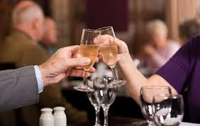
15
WHEN DRINKING
  USE YOUR LEFT HAND
  DON’T OVER INDULGE
  GLASSES NOT BOTTLES
  COASTERS WHEN PROVIDED
BUSINESS ETIQUETTE TOOL KIT™
Notes:
Let’s talk beverages. Having a drink in your hand is a great way to appear more relaxed at a business mixer.
Demonstrate holding a glass. When greeting people, hold your drink in your left hand. You always want to keep your right hand free to make it easier to shake hands and avoid greeting people with cold and clammy hands.
If you’re drinking alcoholic beverages, don’t over indulge. Know your personal limit and stick to it.
When drinking beer, request a glass if they are available rather than drinking it from the bottle. If you are at a casual event, like a company barbeque, drinking a beverage from the bottle may be expected. At a more formal event, beer and soft drinks should be served in a glass rather than in a bottle or can.
When drinking any kind of beverage, use a coaster if they are provided.

Slide 16
SCHMOOZING
16
BUSINESS ETIQUETTE TOOL KIT™
Notes:
We talked about how to make a good impression while eating and drinking. Now, let’s talk about how to meet new people.
When you approach people, approach them either standing on their own or in groups of 3 or more. If you approach a group of two, you may be interrupting a private conversation and it could feel very awkward and uncomfortable for you and them.
When you approach someone, make eye contact, smile, greet them, introduce yourself with your first and last name, and shake hands. Repeat the person’s name during the greeting. For example, you might say something like, “Hello, Mary it’s nice to meet you.” And, if appropriate, state your relationship to the host.
So, we have talked about approaching people either standing on their own or in small groups. But for some of you, approaching a group of people may feel a bit uncomfortable. A skilful way to make your way into a conversation is to smile as you approach the group and extend your hand to the person closest to you and say something like, “Hello I’m first and last name. May I join you?”
Make sure you say hello to the others as well. or they may feel left out. Make eye contact and extend your hand to each person in the group. Don’t shake hands with just one person.
If you are an individual standing in a group, when someone approaches, be open to the new person approaching. Consider how you would feel standing on your own. You never know, this might turn out to be a very important contact for you.
Minding Your Manners Everyday Matters: page 26

Slide 17
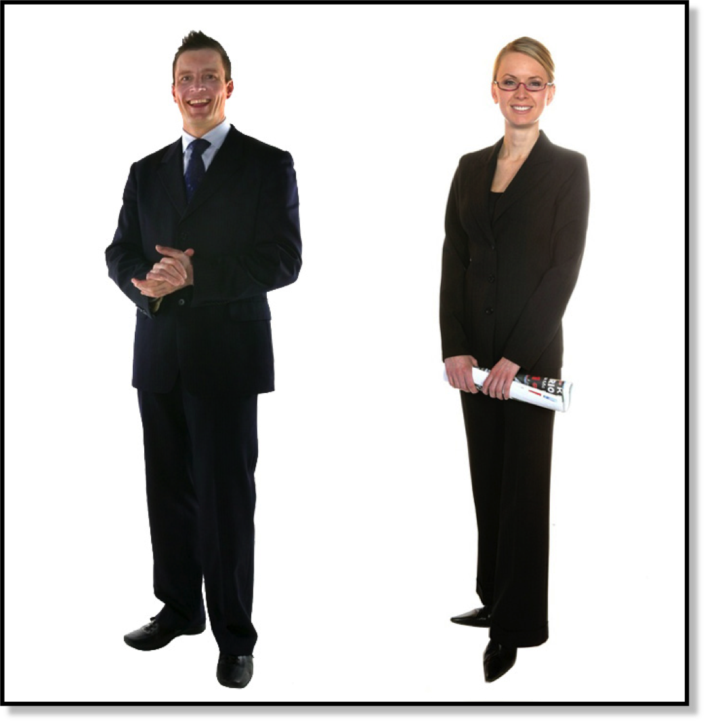
PRESENCE
17
BUSINESS ETIQUETTE TOOL KIT™
Notes:
The way you carry yourself can influence people’s impressions of you.
Ask participants: I would like you to look at the man and woman in this photo. What are some of the messages and attitudes you intuit based their posture? [ON A FLIP CHART MAKE TWO COLUMNS AND RECORD PARTICIPANTS ANSWERS IN ONE COLUMN. MESSAGES INCLUDE: CONFIDENCE, COMPETENCE, DECISIVENESS, APPROACHABILITY, AND RELAXED ENERGY.]
This man and woman in this photo both have similar postures and send similar messages.
Ask participants: What are the posture cues that communicate these messages? [RECORD RESPONSES IN THE SECOND COLUMN. POSTURE CUES INCLUDE: EARS, SHOULDERS AND ANKLES ALIGNED, FEET ARE PLACED COMFORTABLY APART, WEIGHT IS EVENLY DISTRIBUTED, HANDS ARE VISIBLE AND RELAXED.]

Slide 18
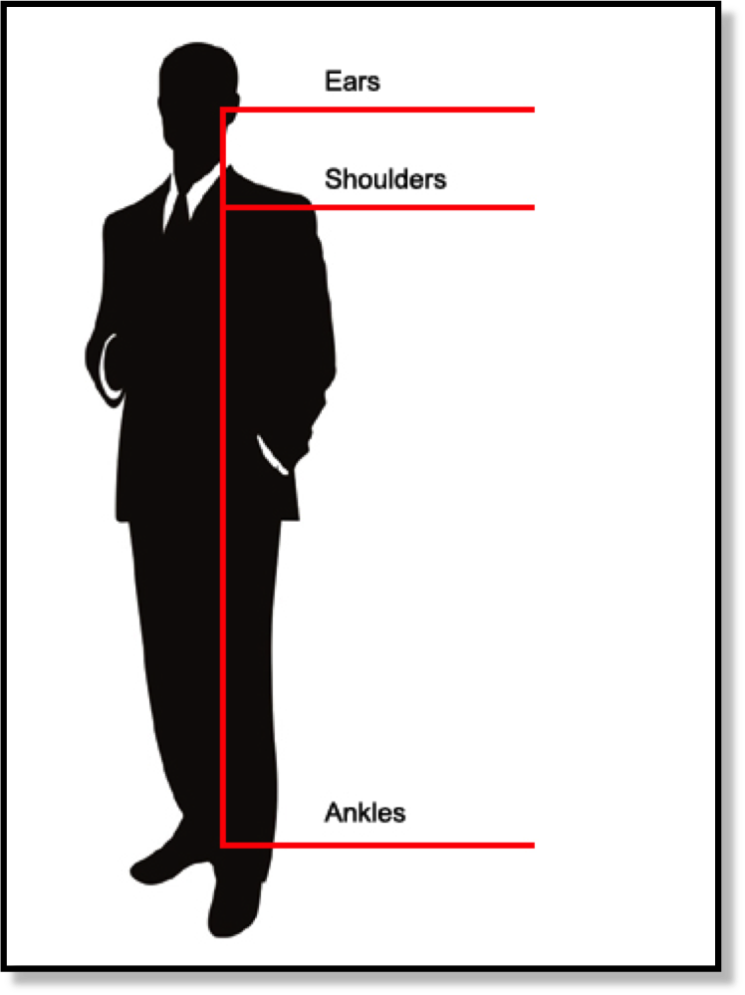
18
GOOD POSTURE
  EARS, SHOUDERS, ANKLES ALIGNED
  STOMACH IN
  CHEST LIFTED
  HEAD UP
  FEET APART
  WEIGHT DISTRIBULTED
Notes:
So, what is good posture? This illustration spells out what it means to have a good posture. Stand with your ears, shoulders and ankles in alignment. Keep your stomach muscles in a state of relaxed tension. You want to support your back and upper body while remaining tension free. Your chest should be lifted and supported. Hold your head up, with its weight comfortably on the top of the spinal column. Feet should be spaced about 12 to 18 inches apart with one foot slightly in front of the other. Your weight should be evenly distributed.

Slide 19
19
PETER A. ANDERSON PHD
HOW ONE STANDS IS VITAL.
STANDING TALL WITH AND ERECT POSTURE IS THE BODY LANGUAGE OF COMPETENCE, CONFIDENCE AND POWER.
BUSINESS ETIQUETTE TOOL KIT™
Notes:
In “The Complete Idiot’s Guide to Body Language,” Peter A. Andersen states, “How one stands is vital. Standing tall with an erect posture is the body language of competence, confidence and power.” It has also been proven that when you change your stance, you not only change what you communicate, you also change how you feel.

Slide 20
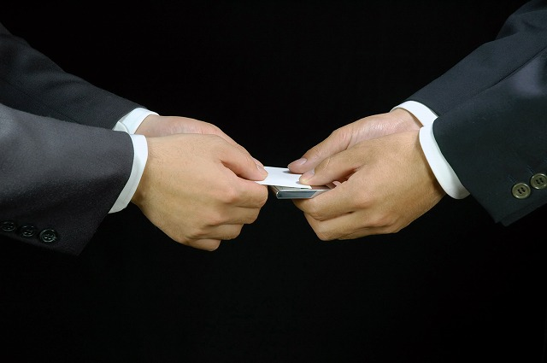
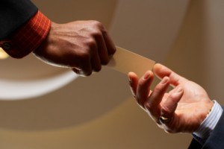
20
BUSINESS CARDS
BUSINESS ETIQUETTE TOOL KIT™
Notes:
As a representative of your company, business cards are an important part of your identity package, so they should be carried in a business card case to keep them protected and in good condition for presentation. Never offer someone a business card that is in poor condition.
North Americans tend to adopt the customs of other cultures. When it comes to the business card exchange, it is no different. When giving and receiving business cards, you want to be very respectful. There are two globally accepted ways to exchange business cards: the Japanese way and the European way.
Hold the business card up to show participants how to hold a business card when offering it to someone. When offering your business card, present it so it can be read with the print facing the person receiving the card.
Ask a volunteer to help you demonstrate giving and receiving business cards. Demonstrate giving and receiving business cards using both the Japanese and European methods.
The Japanese, or Asian business card exchange, as it has become known, is universally considered to be the most formal method. It is widely used in Asian cultures and internationally in formal settings. The business card is held with both hands on the top corners of the card. Your thumbs will be on top. The card is received the same way, holding the business card on the bottom corners.
From a global perspective, the European method for business card exchange is considered a little less formal than the Japanese method. However, it is still considered correct. The business card is held in your right hand with your thumb on the top left corner of the card facing the person receiving the card. Receive the business card with the right hand on the bottom right corner of the card.
With either method, when receiving a business card, take a moment to look at the card before putting it away.
Now, you may find that at some events, business cards are handed out freely upon greeting another person. However, business cards should never be passed around like flyers. Automatically handing your business card out to everyone you meet will make you appear pushy and unprofessional.
If a person’s business is of interest to you, ask for his or her business card. You might say something like, “I would be interested to learn more about your business, may I have your business card?”
If someone does ask for your business card, the correct response would be to ask for their business card in return.
When someone hands you a business card, hold it respectfully and take a moment to look at it before putting it away.
Writing comments on the business card can help you remember details. But, if you need to write notes on the card, wait until later. Also, when making notes, write on the blank side of the card, not the printed side.
Minding Your Manners Everyday Matters: page 27

Slide 21

NAME TAGS
21
BUSINESS ETIQUETTE TOOL KIT™
Notes:
Often in a business setting or at a business mixer, you will be required or invited to wear a name tag. The name tag shows that you are a professional and there for a reason. Wearing a name tag can also be helpful for clients and those you meet to remember your name.
As you can see, nametags are worn differently in this photo: some on the right, some on the left, some higher, and some lower. However, unless stated in the dress code as part of a uniform, nametags should be worn on the high right shoulder. This is the best place because, when you extend your arm to shake hands, the eye is automatically drawn to that area.
Minding Your Manners Everyday Matters: page 26

Slide 22
22
SMALL TALK
POLITE CONVERSATION ABOUT MATTERS OF LITTLE IMPORTANCE, ESPECIALLY BETWEEN PEOPLE WHO DO NOT KNOW EACH OTHER WELL.
BUSINESS ETIQUETTE TOOL KIT™
Notes:
Let’s talk about conversation. Conversation can be very difficult for many of us when meeting people for the first time. And small talk can be especially difficult. However, small talk is an important skill. When initiated correctly, it helps to break the ice and puts others at ease.
The definition of small talk from the Encarta World Dictionary is “Polite conversation about matters of little importance, especially between people who do not know each other well.”
In other words, small talk is what people talk about when they want to be polite. And, for many of us, it doesn’t come easy. But it is a skill that can be worked on and will become easier with practice.

Slide 23
CONVERSATION TOPICS
23
  THEIR JOB
  THEIR INTERESTS
  POSITIVE NEWS
  NEW MOVIES, TV
  LOCAL EVENTS, ENTERTAINMENT, SPORTS
BUSINESS ETIQUETTE TOOL KIT™
Notes:
One of the questions I am asked a lot is “What do I talk about?” One way to keep topics fresh in your mind is to stay informed about current events. Reading a newspaper or watching the news every day can help keep you up-to-date on what’s happening in your hometown, nationally and around the world. When going to a business event, it’s always a good idea to be prepared in advance with 3 or 4 timely topics that may come up in conversation.
When you meet people, ask others about themselves before speaking about yourself. You can do this by focusing on the person you are talking to. Ask questions that will help you discover who they are and what they’re interested in. If you can find common interests, it will make the conversation more memorable and it will be easier to talk with them the next time you see them. Asking questions is a great way to start a conversation. Asking open-ended questions that allow the other person to elaborate on the answer.
Ask participants: So, what are open-ended questions? [QUESTIONS THAT START WITH, ‘WHO, WHAT WHEN, WHERE, WHY AND HOW’ ALLOWS THE PERSON ANSWERING TO ELABORATE ON THE ANSWER. THIS ADDS TO THE FLOW OF THE CONVERSATION.]
So, if you were talking to someone at a trade show, a good example of an open-ended question might be something like, “What was the best exhibit you saw today?”
Some good conversation starters are asking questions about: their job, their interests, and good news about mutual friends or acquaintances, positive news about the economy, a recent documentary or television show, a play or movie you recently saw, an upcoming local event, or news items that are light, interesting, and easy to talk about.
When asking a question, don’t interrupt or finish a person’s sentence. Interrupting a person while they are speaking is considered rude. Even though you may think you are being helpful, finishing someone’s sentence will make you come across as impatient.
Don't talk about yourself unless asked. Nobody enjoys a conversation in which one person monopolizes it. Listen carefully to what people are saying and think before you speak. Pauses and silence show that you are thoughtful and paying attention.
Some subjects should never be discussed in a business setting.
Ask participants: Can anyone give me an example? [TOPICS THAT MIGHT BE CONTROVERSIAL OR PERSONAL.]
Minding Your Manners Everyday Matters: page 8, 28, 29

Slide 24

24
TABOO TOPICS
  RELIGION
  POLITICS
  SEX
  MONEY
  HEALTH
BUSINESS ETIQUETTE TOOL KIT™
Notes:
Taboo topics include anything that might be controversial or personal. Examples of this would be religion, politics, sex, money, and health.
So, stay away from questions or discussion about things like health diet, relationship status, sexual orientation, money such as: “How much money do you make?” or “That is a really nice suit, how much did you pay for it?”
I think at one time or another, we have all gone through that embarrassing experience of either saying the wrong thing or being on the receiving side of the wrong thing being said. Like: “Are you pregnant?” or “You look so young to be in your position.”
Start the discussion by sharing one of your experiences. It could be a personal experience or one you heard about that someone else experienced. [GIVE PARTICIPANTS 5 MINUTES (AS TIME ALLOWS) TO SHARE THEIR EXPERIENCES.]
These are just a few examples of how we need to be careful about what we say or questions we ask when we don’t know the facts. And even if we do know the facts, we need to stay away from topics that could be perceived as personal or controversial.
Minding Your Manners Everyday Matters: page 8, 29

Slide 25
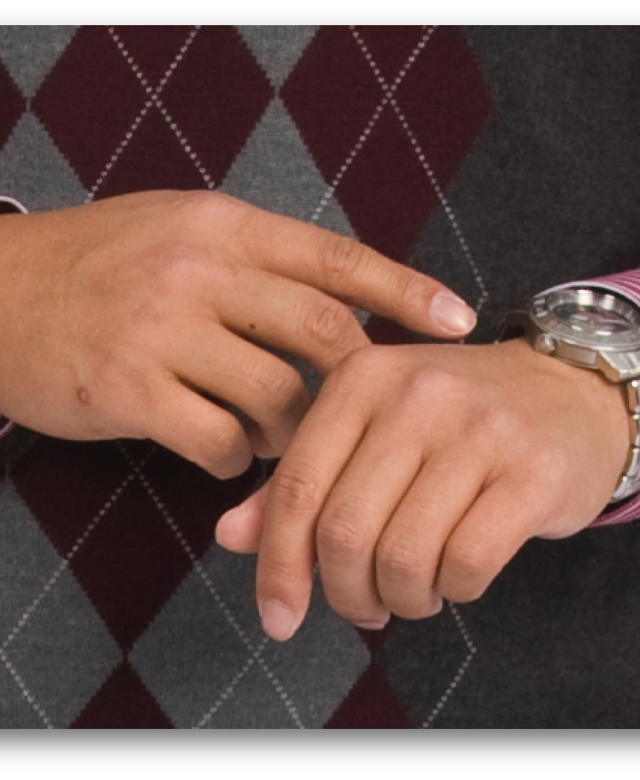
25
10
MINUTES
MAX
BUSINESS ETIQUETTE TOOL KIT™
Notes:
When you are at a business mixer, since your purpose for being there is to meet people, you need to be conscious of your time. The general rule is that you should not spend more than about 10 minutes with each person.
However, sometimes you may be in the situation where you know it is time to move on, but the person you are talking to doesn’t want to stop talking.
In that situation, you might say something like, “It was wonderful to meet you, but I need to catch Jane Smith and John Clemens from ABC company before they leave. I hope we see each other again.”
Always make sure you close a conversation before walking away from the person you are talking with.
If the gathering is a small group, try to circulate to meet as many people as possible. This will help make your presence known.
If it is a large gathering, focus on the key people that you would like to meet. One way to make your presence known and to come across as confident is to act like you belong in the setting. But remember, networking isn’t about selling. It’s about building relationships.
Minding Your Manners Everyday Matters: page 26

Slide 26
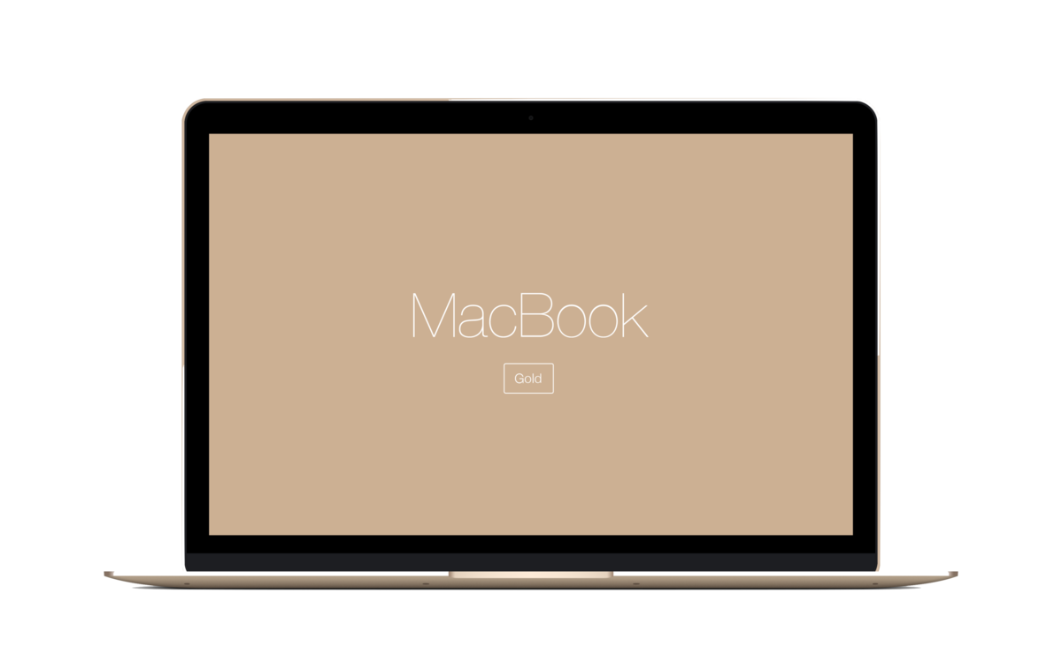
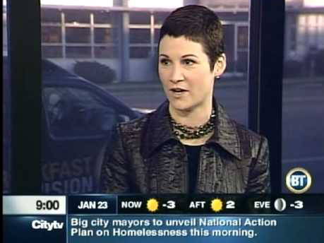
26
NETWORKING ETIQUETTE
BUSINESS ETIQUETTE TOOL KIT™
Notes:
Here is a video on the topic of networking etiquette. [START EMBEDDED YOUTUBE VIDEO]
https://www.youtube.com/watch?v=gKKoIEex3U4

Slide 27
GREETINGS &
HANDSHAKES
Notes:
When meeting people for the first time, the entrance you make is one of the most important aspects of how you will be perceived.
This includes your posture, the way you introduce yourself and how you make yourself known to others. There are three steps to a confident introduction. The first step is to make eye contact.

Slide 28
28
IITTI INTERNATIONAL STANDARD
MAINTAINING EYE CONTACT BETWEEN 40 - 70%
OF THE TIME DEMONSTRATES CONFIDENCE AND SINCERITY.
BUSINESS ETIQUETTE TOOL KIT™
INTERNATIONAL WORKPLACE ETIQUTTE
Notes:
Eye contact and the expression on your face are the first things that will establish communication and demonstrate your level of confidence.
Eye contact is considered very important in most western cultures. Good eye contact is a very powerful communication tool. And according to the IITTI international standard, maintaining eye contact between 40 – 70% of the time demonstrates confidence and sincerity. It will help you establish rapport. It communicates honesty, integrity, focus and interest. It’s been shown that when you maintain eye contact eye contact with a person you are speaking with, you actually become more confident. So, good eye contact has the added benefit of boosting your self-confidence.
Maintaining eye contact is also an essential part of listening. When you look another person in the eyes, you let them know that they have your full attention.
Minding Your Manners Everyday Matters: page 7

Slide 29
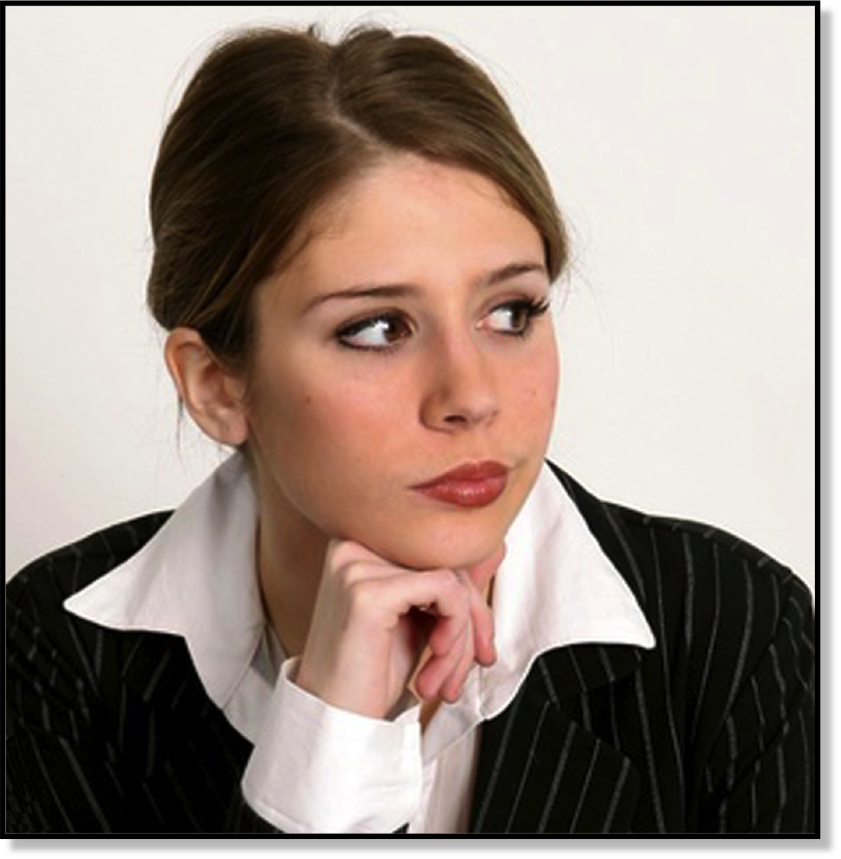
29
POOR EYE CONTACT
  INDIFFERENCE
  BOREDOM
  SHYNESS
  LACK OF CONFIDENCE
  DISHONESTY
BUSINESS ETIQUETTE TOOL KIT™
Notes:
Here is an example of poor eye contact. Poor eye contact can be unsettling and can communicate indifference, boredom, shyness, lack of confidence, dishonestly or nervousness. Poor eye contact includes looking down at the floor.
Minding Your Manners Everyday Matters: page 7, 35

Slide 30
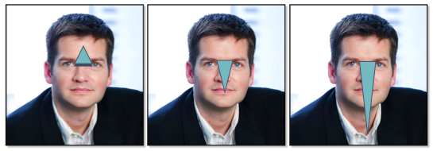
EYE CONTACT
30
BUSINESS ETIQUETTE TOOL KIT™
Notes:
One way to maintain good eye contact is by visualizing a triangle on the other persons face between the eyes and the centre of the forehead. By keeping your gaze directed at this area, you will create a serious atmosphere and the other person will sense that you mean business.
During business interactions, by keeping your gaze in the area of the eyes and forehead, you can maintain better control during your interactions with others. It will also indicate that you are paying attention. However, if there is too much eye contact or if your eyes are in the wrong place, it can be invasive or appear that you are putting someone on the spot.
Gazing below the other person’s eye level, as shown in the centre image and the one on the right side of the slide, may be interpreted as social interaction rather than business. And, as the eyes go lower and focus on other parts of the body, it becomes increasingly intimate, which can make people uncomfortable.
Maintaining contact with the eyes will demonstrate to the other person that you are listening and helps to hold their attention. It also focuses attention on the individual, making him or her feel important.
Minding Your Manners Everyday Matters: page 7, 35

Slide 31
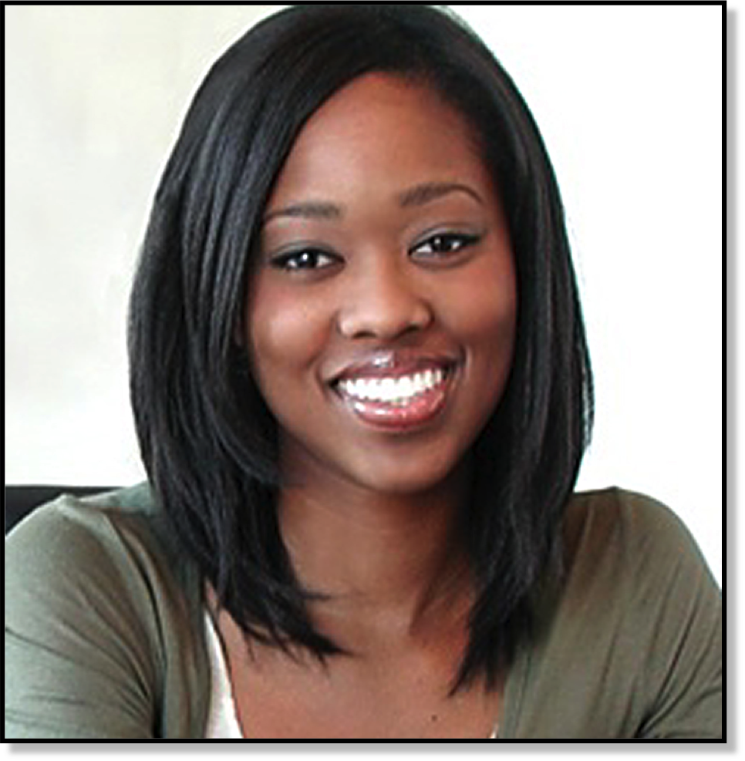
31
FACIAL EXPRESSION
BUSINESS ETIQUETTE TOOL KIT™
Notes:
While making eye contact, it is also important to smile. According to Susan Bixler and Lisa Scherrer Dugan in the book “5 Steps to Professional Presence,” “A smile is one of the most important business tools we have, and the one most frequently forgotten to use.” A warm and relaxed smile can communicate enthusiasm, warmth, pleasure, interest, a sense of connection and focus.
Minding Your Manners Everyday Matters: page 7, 35

Slide 32
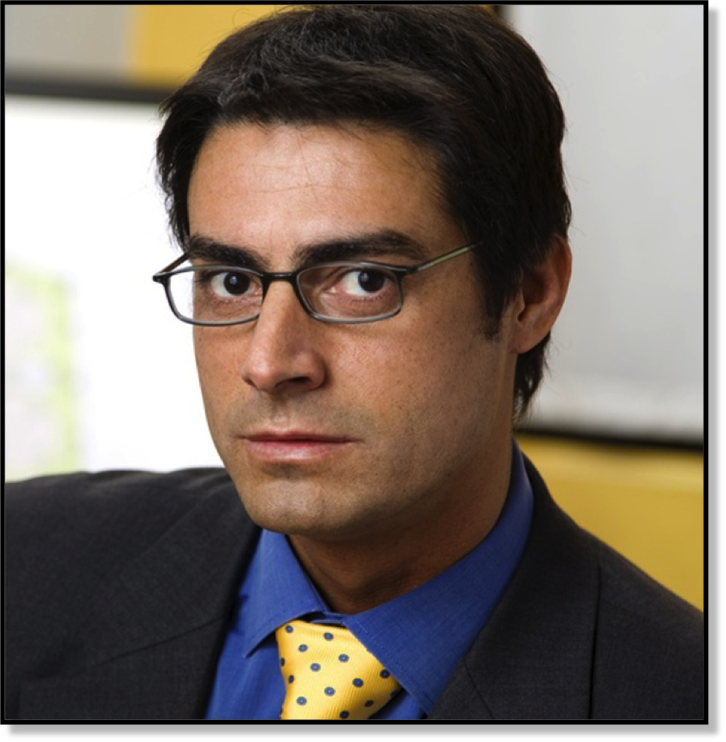
32
FACIAL EXPRESSION
BUSINESS ETIQUETTE TOOL KIT™
Notes:
Your facial expression is responsible for much of what you communicate non-verbally.
Ask participants to describe the attitude or disposition of the man in the photo, based on his facial expression. Is his expression blank or animated? [MESSAGES INCLUDE: LAZY, BORED, ARROGANT, DISAPPROVING, INDIFFERENT, and DISINTERESTED]
Men by nature are often less emotive than women and this can make them reluctant to smile frequently. Smiling, however, is a way to connect with others. It is a universal and positive body language signal.
Minding Your Manners Everyday Matters: page 7, 35

Slide 33
33
PROTOCOL SCHOOL OF WASHINGTON
A NAME IS A LABEL USED TO DISTINGUISH ONE PERSON FROM ANOTHER.
BUSINESS ETIQUETTE TOOL KIT™
Notes:
After making eye contact with and smiling at the person you wish to meet, approach the person and introduce yourself. The way you introduce yourself to others is important for establishing presence and rapport.
If I initiated the introduction, I would make eye contact, smile, approach the person and I might say something like, “Hello my name is your first and last name.” When introducing yourself, always introduce yourself with your first and last name.
It is very important to listen carefully to a person’s name during an introduction.
According to the Protocol School of Washington, “A name is a label used to distinguish one person from another.” Since most of us use the name we were given at birth, it makes sense that we may be very attached to our names. When listening to another person’s name, make sure you have heard the name clearly and are able to pronounce it properly. If you need to, ask for clarification. If you accidently pronounce their name incorrectly or use the wrong name when making an introduction, apologize and say their name correctly.
Minding Your Manners Everyday Matters: page 10, 11, 12

Slide 34
FORMAL ADDRESS
34
TITLE AND SURNAME
  “Mr. Smith” or “Ms. Jones”
  “Dr. Kam”
BUSINESS ETIQUETTE TOOL KIT™
Notes:
The most formal way to address someone is with their title and surname.
For example: Mr. Smith or Ms. Jones. In a business setting, the correct honorific or title for a woman is ‘Ms.’ regardless of what she calls herself in a personal setting. So, in a business setting you would say, Ms. Jones rather than Miss Jones or Mrs. Jones, which is the honorific for a married woman.
Even though in western culture, it may seem that we have become fairly casual with how we address people, the person with the highest rank should be the one who initiates the use of first names. If the first name is used, both parties should then use them.
For example, if your doctor uses his or her first and last name in the introduction and calls you by your first name, you may call them by their first name. An example might be if my doctor’s name was Dr. Paul Kam, and he said, “Hello my name is Paul Kam, it’s nice to meet you Kimberly.” That would be giving me permission to call him Paul.
When people introduce themselves, it is really important to listen to what they say and use their name in the same way they use it in their introduction. For example:
[SHARE ONE OF YOUR EXPERIENCES WHERE A NAME WAS SHORTENED OR A NICKNAME WAS USED WITHOUT PERMISSION I.E. ROBERT/ ROB/ BOB]
Never shorten names or use nicknames without asking permission first.
Minding Your Manners Everyday Matters: page 10, 11, 12

Slide 35
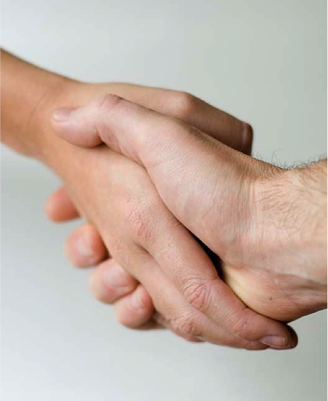
35
THE
PROFESSIONAL
HANDSHAKE
BUSINESS ETIQUETTE TOOL KIT™
Notes:
Each individual culture has local customs and interpretations of the ultimate greeting. However, most cultures would agree that a handshake is an important ritual and the most universal greeting in a business setting. So, now we are going to talk about the final step in a great personal introduction, the handshake.
The handshake is appropriate in any business setting when greeting, finalizing business negotiations, or parting company. Because of this, it is important to take the time learn how to shake hands properly and understand the etiquette that surrounding the handshake during business interactions.
The person who extends their hand first has a distinct advantage. He or she will be seen as being direct, taking initiative and establishing control.
Because of this, if it is obvious that one person is higher in rank, the higher-ranking person should initiate the handshake. In western culture, in a business setting, gender is not taken into consideration, so either a man or woman may initiate the handshake.
Ask participants: We are going to do an exercise. I would like you to stand. Then approach 3 different people that you don’t already know well. I would like you to greet each of them. Introduce yourself using your first and last name, and then shake hands with them. Once you have introduced yourself to 3 people, I would like you to return to your seat. [GIVE PARTICIPANTS 5 MINUTES MAXIMUM FOR THIS EXERCISE. THEN HAVE THEM RETURN TO THEIR SEATS.]
Ask participants: Did you notice anything different about the handshakes? [PARTICIPANTS WILL LIKELY SAY THINGS LIKE: SOME WERE HARD, SOME WERE VERY SOFT, ETC.]
Demonstrate handshakes. Choose participants from the audience. Ask them to help you demonstrate various handshakes. Demonstrate a correct handshake.
Shake hands firmly (web to web) while making eye contact. Lean into the handshake. Your hands should be vertically parallel. Although the number of handshake pumps will vary depending on culture, a handshake of 2-4 pumps is most universal. This shows confidence and sincerity
Demonstrate the bone-crusher (*carefully* clasping a hand too tight). Some people have no idea how strong their grip is. Any aggressive clasp should be avoided.
Demonstrate the limp handshake. The limp handshake, sometimes called the rubber handshake or the dead fish, gives a less-than-confident, wishy-washy impression. It can also be perceived as weakness.
Demonstrate the power grip. The power grip is when someone grips your hand with their palm down on top of yours. In body language, this indicates that the person whose hand is on top perceives him or herself as more important or superior.
Demonstrate the fingertip squeeze. Another one to avoid is the fingertip squeeze. The fingertips are squeezed when you softly grab the fingertips only. This handshake is not unusual in some cultures. However, in most western cultures, web-to-web hand contact is preferred. You may have experienced a handshake when you clasped someone’s hand and mistakenly grabbed the fingertips instead of the full hand. This can happen when your thumb is curled rather than held straight up. It may be perceived as a lack of self-confidence. Women should be especially cautious of this because they are sometimes accused of having a handshake that is too soft, limp wristed or a fingers-only handshake.
Shaking hands also shouldn’t feel like an arm wrestle. Handshakes should be firm, meaning not overly aggressive or too soft.
Minding Your Manners Everyday Matters: page 7, 8

Slide 36
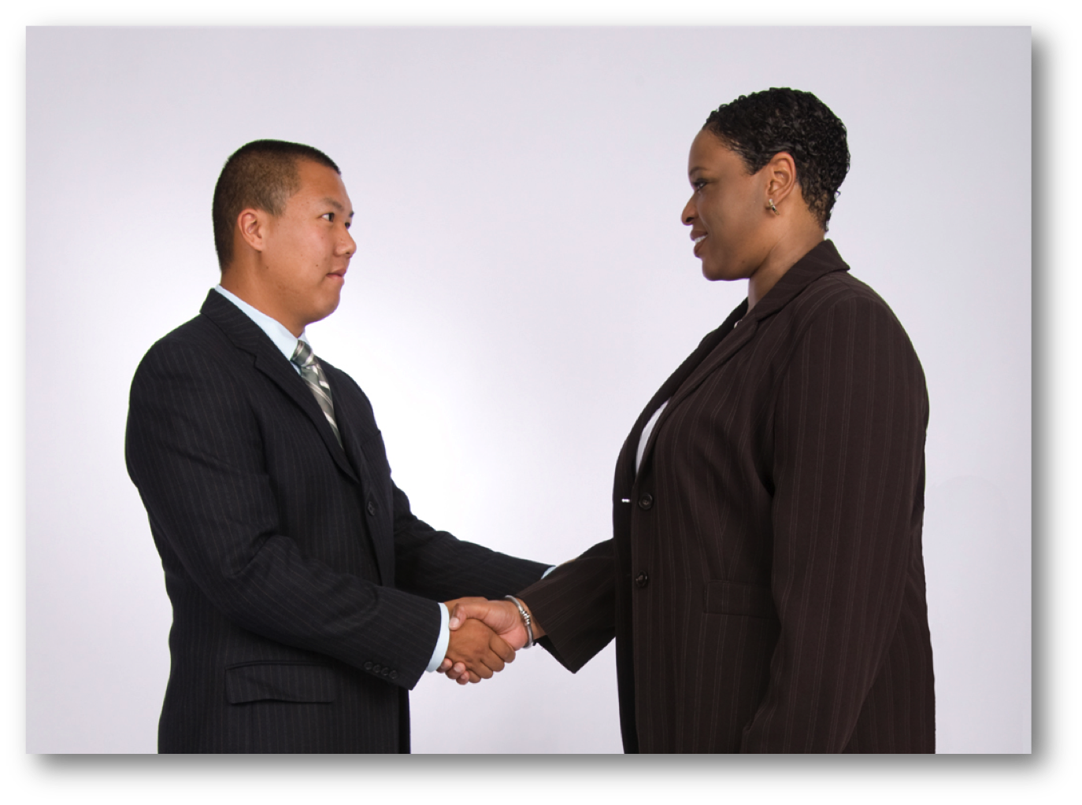
THE HANDSHAKE
36
BUSINESS ETIQUETTE TOOL KIT™
Notes:
Ask participants: Let me ask you this. Would you be comfortable if you were the woman in this situation? [MOST PARTICIPANTS WILL SAY “NO”.] What message do you feel the man is sending? [OPEN DISCUSSION]
We see this more often with men than with women or mixed genders. However, again this form of handshake is a little too friendly in a business setting, unless you know the person very well and you know that the other person considers you to be a friend outside of business. In a business setting, it may be considered invasive and, in some situations, it could be interpreted as sexual harassment. Keep your non-shaking hand to yourself. Avoid shaking hands while holding the other person's elbow or shoulder. This is too friendly for business.
Business handshakes should remain formal, unless you have developed a social relationship with the person you are greeting. Another example of a handshake that is more acceptable for social interactions with friends and family is the 2-handed clasp.
Demonstrate the 2-Handed Clasp The 2-handed clasp is when you cup both hands around the other person’s hand. Two-handed handshakes are generally not appropriate in the workplace. The reason for this is because it implies a degree of intimacy or emotional expression that is generally reserved for the personal interaction. It is generally perceived as very comforting and friendly. In a business environment may be considered too friendly and may even be perceived as condescending. I would reserve it for friends and relatives.
Minding Your Manners Everyday Matters: page 7, 8

Slide 37
37
THE PROFESSIONALHANDSHAKE
  EXTEND YOUR RIGHT HAND
  FULL PALM TO PALM GRIP
  SHOULDERS SQUARE
  LEAN IN
  SHAKE FIRMLY
BUSINESS ETIQUETTE TOOL KIT™
Notes:
Demonstration a good handshake. Just to recap, a good handshake consists of these steps:
Extend your right hand with the thumb up and fingers out. This lets the person’s hand connect properly for a good handshake.
Your hand should meet the other person’s hand with full palm-to-palm and web-to-web contact. Hands should be vertically parallel.
Shoulders should be square at a shoulder-to-shoulder stance.
Lean into the handshake by moving your right foot slightly forward and bending your knee slightly.
Shake hands firmly from the elbow not the wrist. The wrist should not be in motion during a handshake. Your handshake should be firm in order to convey confidence.
Although the number of handshake pumps will vary depending on culture, a handshake of 2-4 pumps is considered most universal. Some cultures, including Americans, tend to use fewer pumps when shaking hands and some other western cultures, such as Canadians, tend to use more. So, 2 to 4 pumps is considered universal. This shows confidence and sincerity.
Minding Your Manners Everyday Matters: page 7, 8

Slide 38
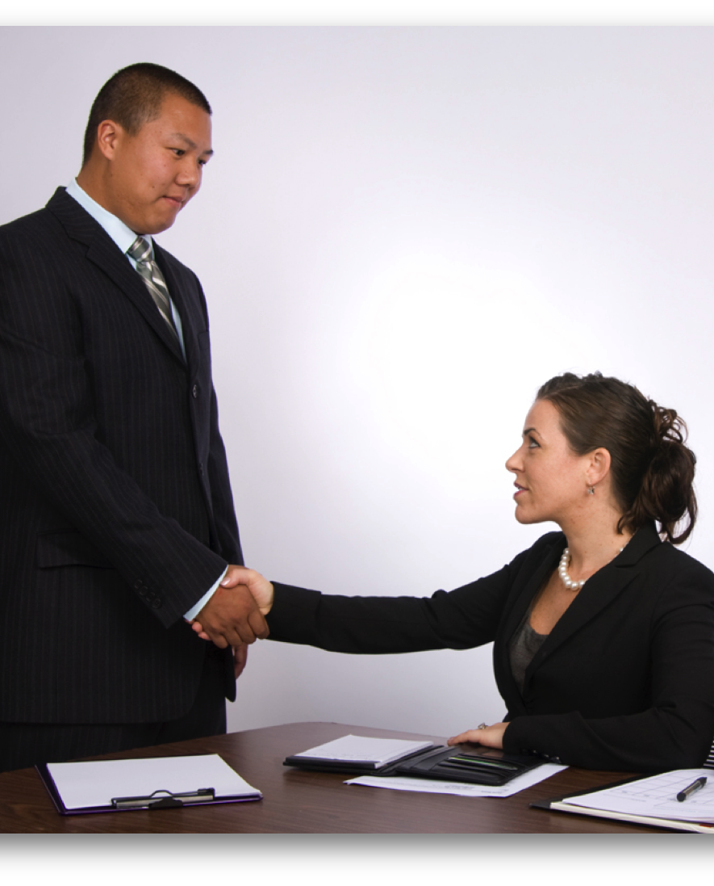
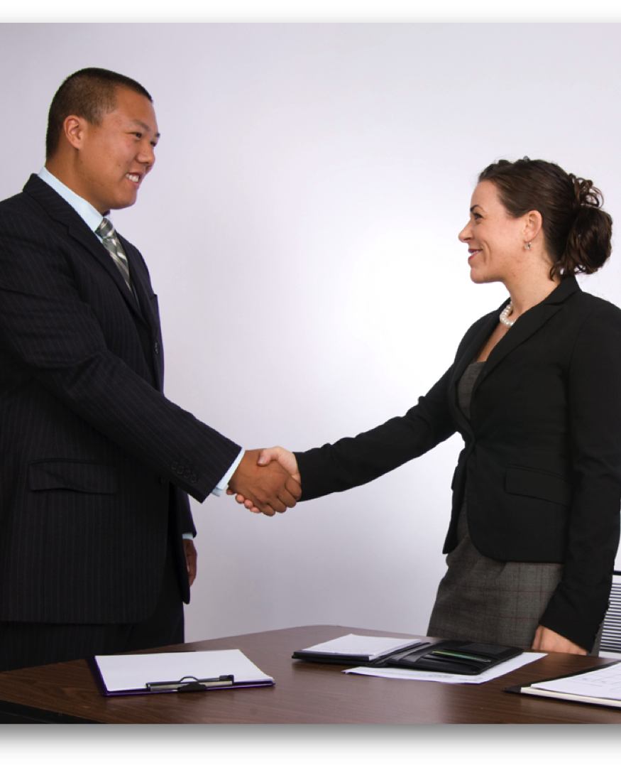
38
THE PROFESSIONAL HANDSHAKE
BUSINESS ETIQUETTE TOOL KIT™
Notes:
If you are sitting when someone approaches you, for example when a guest enters your office or when someone greets you in a restaurant, stand to greet them. Standing to shake hands is always a sign of respect. Additionally, it puts the two of you on even footing. Being closer to the same height also makes it easier to make and sustain good eye contact during the handshake.
If you are sitting at a table, don’t lean across a table and reach over it to shake hands. Stand and walk around the table or desk. Then shake hands, unless it is impossible to do so. In social situations, it is appropriate for a woman to remain seated when shaking hands. However, in business, women should follow the same rules as their male counterparts.
Sometimes, you may be in a situation where you are unable to shake hands. Examples of this might be when your hands are dirty, you have a cold, or you are holding something that you can’t put down. If you are unable to shake hands, acknowledge the person and apologise for not shaking hands. You might say something like, “I’m very pleased to meet you; I’m sorry I am not able to shake your hand. I was just eating hors d'oeuvres and was on my way to the restroom to wash my hands.”
Minding Your Manners Everyday Matters: page 7, 8

Slide 39
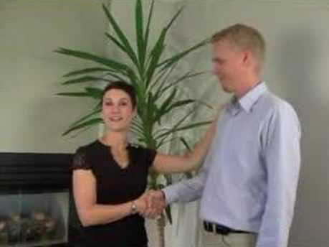
39
PROFESSIONAL HANDSHAKE
BUSINESS ETIQUETTE TOOL KIT™
Notes:
Here is a video that demonstrates some of the handshakes we talked about. [CLICK ON EMBEDDED YOUTUBE VIDEO LINK] https://www.youtube.com/watch?v=-k6FaKXSdlY&feature=channel_page
Minding Your Manners Everyday Matters: page 7, 8

Slide 40

WORKPLACE DECORUM
Notes:
We’ve talked about business etiquette outside the office. Let’s talk about interacting with colleagues, co-workers and clients inside the workplace.
Office decorum is based on common sense and courtesy. But, as our workplaces becomes busier and more pressured, these guidelines are often forgotten. What we say and what we do speaks volumes about us. When we treat our colleagues, co-workers and clients with respect, we, in turn, earn their respect. We also make them feel valued and appreciated.
The workplace has changed a lot in recent years. But, now more than ever, employers recognize the role of teamwork in building company success. In other words, the better you get along with your co-workers and are accepted by your employer, the better your experience at work will be. Workplace etiquette is really about remembering to treat others with respect. That includes presenting yourself appropriately and showing respect for your work environment, your co-workers, your clients, and the public as a representative of your company. The office is not a place to be seen as aggressive, hostile, controversial or uncooperative.

Slide 41

41
WORKPLACE DECORUM
  RESPECT FOR DIGNITY
  RESPECT FOR WORKSPACE
  RESPECT FOR PRIVACY
  RESPECT FOR TIME
BUSINESS ETIQUETTE TOOL KIT™
Notes:
We have all heard the saying, “Do unto others as you would have them do unto you.” This is a rule to live by in every aspect of our lives, including the workplace. Treat everyone you work with, with respect and dignity. Never do or say anything that may embarrass people or make them feel uncomfortable.
That includes criticizing others. Don't criticize anyone, publicly or in front of others. If you disagree with a position anyone has taken or have a concern about a co-worker, request a private meeting where you can ask for clarification and, if appropriate, express your concerns. Never say something that will purposely embarrass or hurt someone.
That also includes office gossip. You will gain the respect of your boss and your colleagues by keeping your mouth shut and not getting involved.
It’s also important to show respect for your co-workers’ workspaces and areas within the organization that may be authorized for specific uses or may be off limits and require authorization to access.
For example: In some companies, employees tend to think that the reception areas is a place to mingle around and chat with co-workers while forgetting that the reception area is where the receptionists greet clients and guests. The receptionist is also likely the person answering the phone and has his or her own work requirements. When co-workers hang around the reception area, it can be distracting to the receptionist and others coming into the office.
Other examples include following company rules regarding where food and beverages may be consumed. Many companies provide designated eating areas, such as lunchrooms, and do not allow food to be consumed at desks or in view of the public. When using common fridges and other storage areas, do not take someone else’s food and make sure to follow other company rules, such as smoking only in designated smoking areas and not wearing fragrance in fragrance free working environments.
Also, be sensitive to your colleagues' need for privacy. For example: If you need to speak to someone and you can see that they are busy or in a meeting, don’t interrupt or hover at the door waiting. One way that you could let a person know that you would like to speak with them without interrupting would be to leave a message on their voicemail requesting a meeting.
Ask participants: Can you think of any other ways we can be more respectful in our workplaces? [OPEN DISCUSSION AS TIME ALLOWS]
Minding Your Manners Everyday Matters: page 29, 30

Slide 42
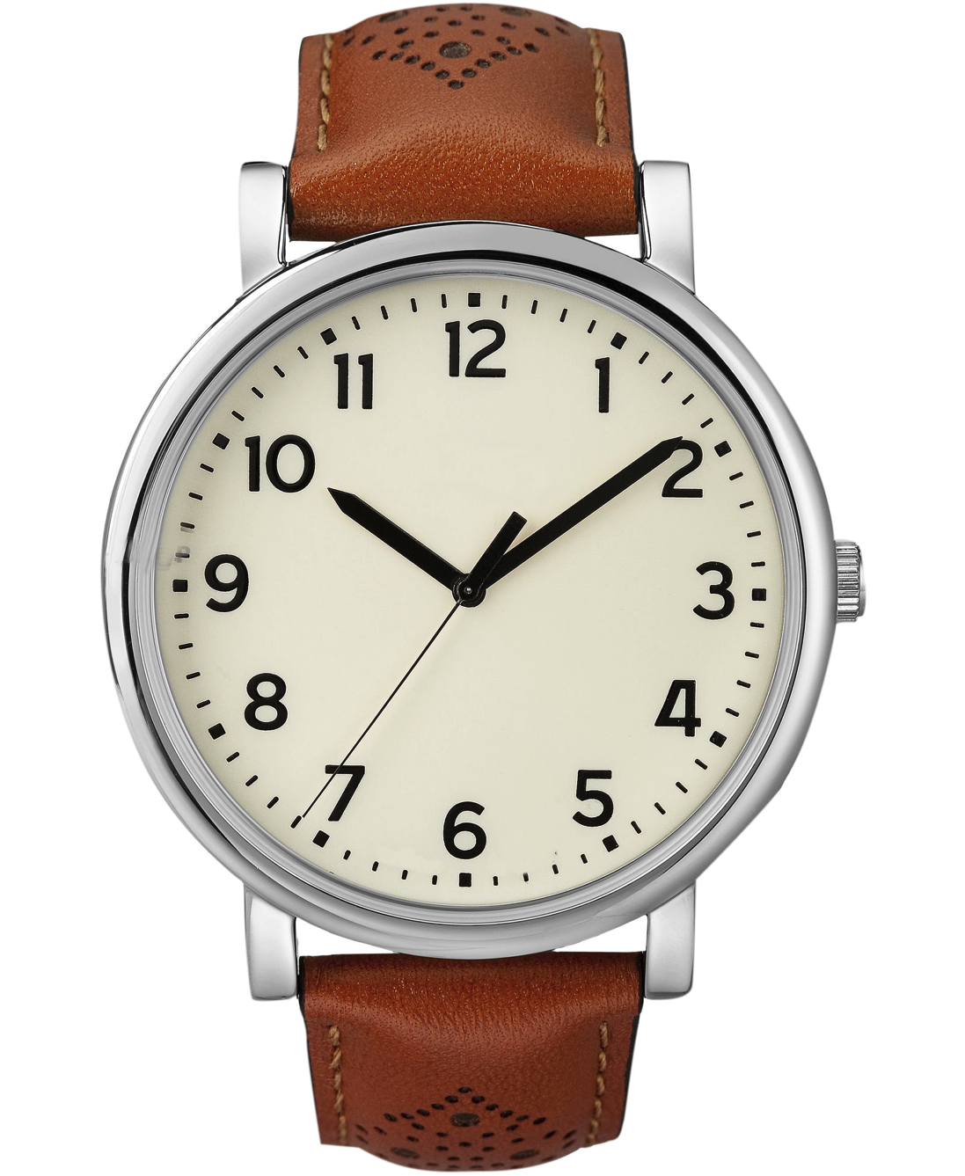
42
RESPECT FOR TIME
  SENSITIVE
  PUNCTUAL
  DEADLINES
  RESPOND
BUSINESS ETIQUETTE TOOL KIT™
Notes:
One thing that has become real issue, and I believe this is a world-wide problem, is that everyone feels pressured. “There never seems to be enough time,” is a complaint I hear every day. So, it is more important than ever to be sensitive to other people’s time and show respect. Never assume that any of your co-workers, clients or suppliers are less busy or stressed than you are. Here are some ways that you can show respect by being sensitive to time.
Be punctual. Arrive on time for work and meetings. Start on time, end on time. Be available when you say you’ll be available.
Stick to pre-established timelines and complete work in a timely manner. If you say you will follow-up or complete a task by a certain time, you should do your best to stick to timelines. If something unexpected comes up that will cause a delay, communicate that there will be a delay as soon as you know about it. Apologize for the delay and let the person know what they can expect.
If someone is expecting a response to an email or a phone call and you don’t have the information you need for the response, don’t postpone your response. Let them know when they can expect a response with the information requested.
Minding Your Manners Everyday Matters: page 25, 29, 30

Slide 43
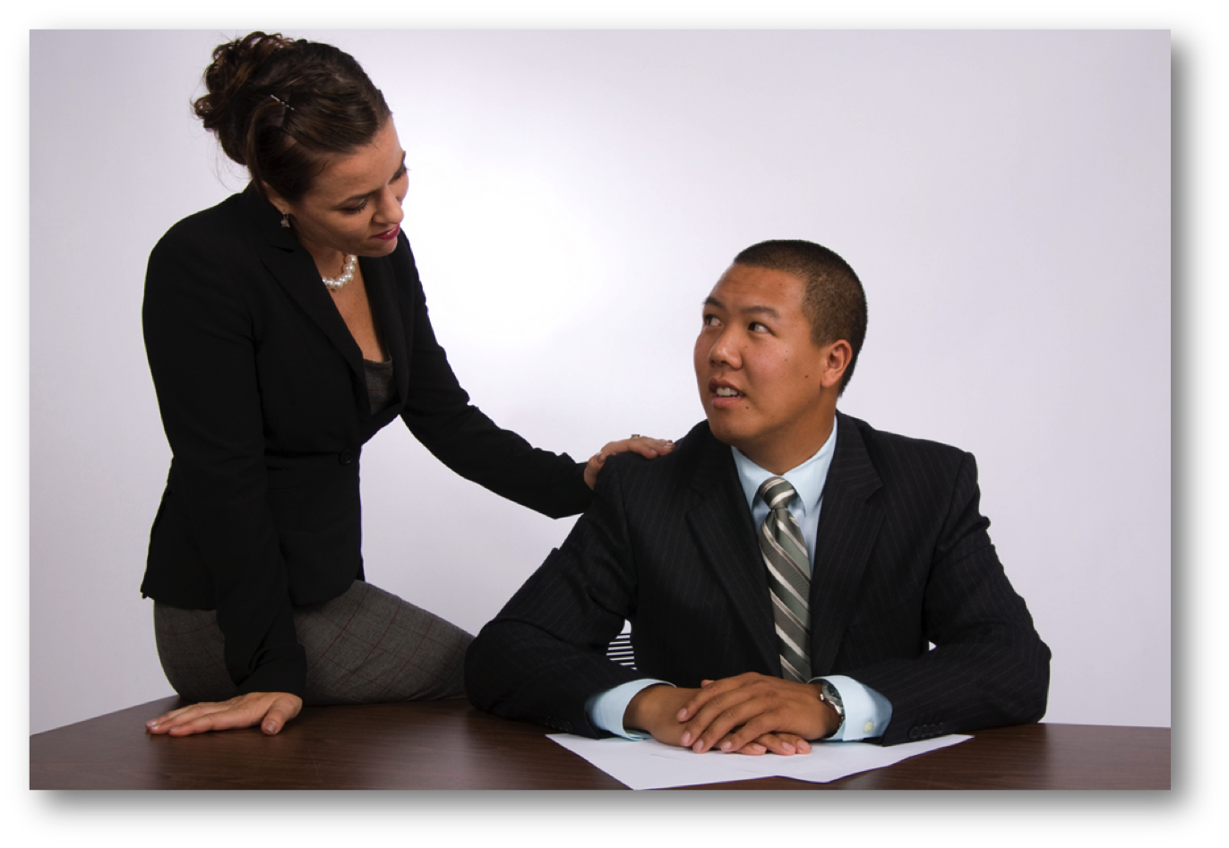
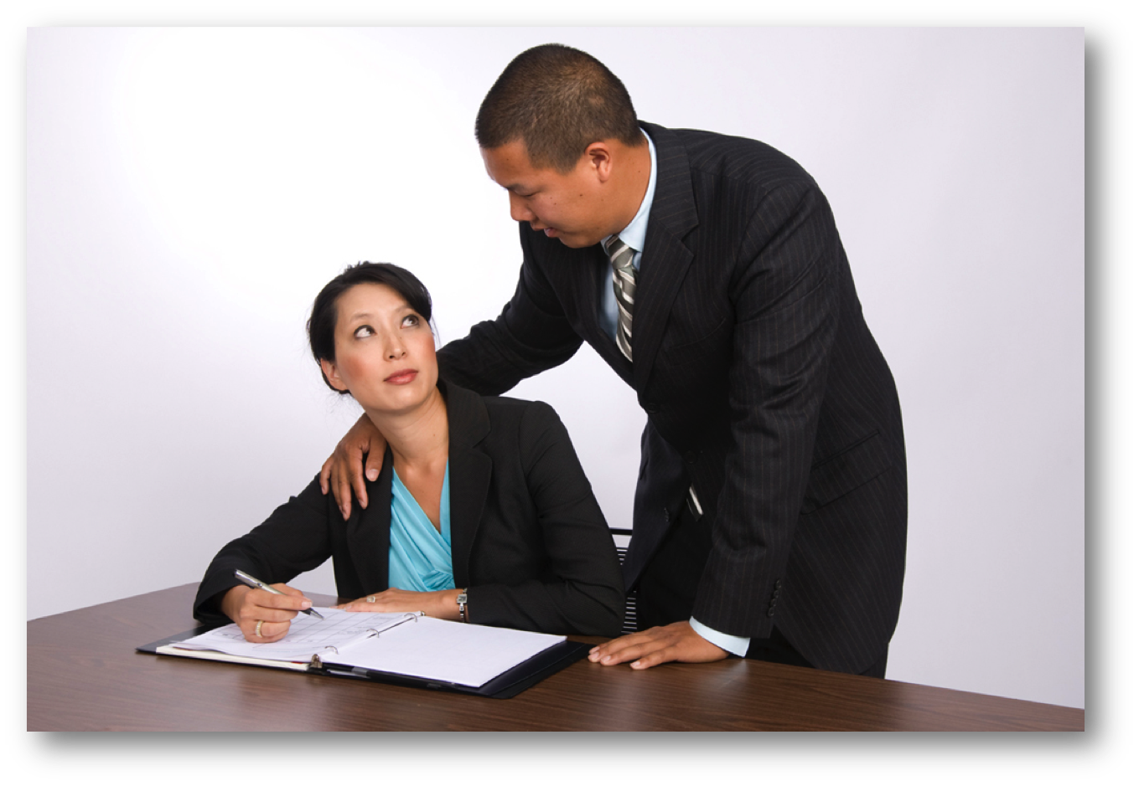
43
INTERPERSONAL SPACE
BUSINESS ETIQUETTE TOOL KIT™
Notes:
Often, we are in close quarters with others, whether we are at work or at a business event. But how close is too close? Good business etiquette requires you to always avoid actions, words or expressions that may be misinterpreted. In these photo’s it is clear that the person is crossing the line and their actions could be interpreted as sexual harassment.
Minding Your Manners Everyday Matters: page 30, 36

Slide 44
INTERPERSONAL SPACE
44
  PUBLIC SPACE – MORE THAN 2 ARM LENGTHS
  SOCIAL SPACE – 1 TO 2 ARM LENGTHS
  PERSONAL SPACE – 1 ARM LENGTH
  INTIMATE SPACE – CLOSER THAN 1 ARM LENGTH
BUSINESS ETIQUETTE TOOL KIT™
Notes:
Acceptable personal space differs from one country to another and region to region. However, the general guidelines for Canada and the USA are: Public space – is more than 2 arm lengths. Social space – is within 1-2 arm lengths. Personal Space – is about 1 arm length. Any closer than a ½ arm length is considered intimate and far too close for a business setting.
Minding Your Manners Everyday Matters: page 30, 36

Slide 45
FORMULA FOR INTRODUCTIONS
45
  WRONG
  “Mr. Senior Executive, I would like you to meet Mr. Junior Executive.”
  RIGHT
“Mr. Senior Executive, I would like to introduce Mr. Junior Executive.”
“Mr. Senior Executive, I would like to introduce to you Mr. Junior Executive.”
BUSINESS ETIQUETTE TOOL KIT™
Notes:
Let’s move on to how to make an introduction. Introductions are part of everyday business. It’s essential that you come across as comfortable and confident when making introductions or being introduced by others.
One of the questions I am often asked is whose name to say first when making an introduction.
Business introductions made are based on rank and precedence. Gender is not taken into consideration. Women are introduced according to rank, not chivalry.
When making an introduction, the person who holds the highest position in the organization takes precedence over others who work there. In most cases that is the CEO.
A lower-ranking person is always introduced to a higher-ranking person. So, when making introductions, it’s the junior or less important person who would be introduced to the senior or more important person.
Demonstrate 3rd party introductions. Ask for two volunteers to help with the demonstration. [CHOOSE ONE VOLUNTEER TO ACT AS THE SENIOR PERSON AND THE OTHER VOLUNTEER TO ACT AS THE JUNIOR PERSON.]
The easiest way to remember how to do this is to stand facing the higher-ranking person and look at him or her. Say their name and then turn to the lower ranking person as you are making the introduction. For example: “Mr. Senior Executive, I would like to introduce Mr. Junior Executive, from the Toronto branch office. Mr. Senior Executive is our Director of National Brands.”
Remember to say the name of the senior or more important person first. The name of the lower ranking person or one with less authority is spoken last.
When making an introduction, it is always a good idea to give more information than just their name and title. This can act as a conversation starter and it makes both parties feel more comfortable.
Minding Your Manners Everyday Matters: page 7, 8, 9, 10, 11, 12

Slide 46
46
BUSINESS INTRODUCTIONS
  JUNIOR TO SENIOR
  NON-OFFICIAL TO OFFICIAL
  LESS IMPORTANT TO MORE IMPORTANT
BUSINESS ETIQUETTE TOOL KIT™
Notes:
So, let’s review the formula for order of precedence:
The senior executive receives a junior executive. The name of the senior executive is spoken first. The name of the junior executive is spoken last.
A government official receives a non-official. For example: “Mr. Mayor, may I introduce Ms. Smith one of the provinces leading exporters.” When it comes to introducing government officials, every country and often regions within a country a may be different in the way government officials are addressed. It is really important to do your research ahead of time to learn the correct customs for address. There are many ways to do this. You might check the internet. There are also many resource books on this topic.
When introducing a client to someone from an organization that is providing them a service, the client’s name comes first. For example: “Jane Jones, I would like to introduce Jim Smith, our department manager. Jim, Jane is our client from Seattle, she is doing very well there with our product line.”
Minding Your Manners Everyday Matters: page 7, 8, 9, 10, 11, 12
What about every country here?

Slide 47
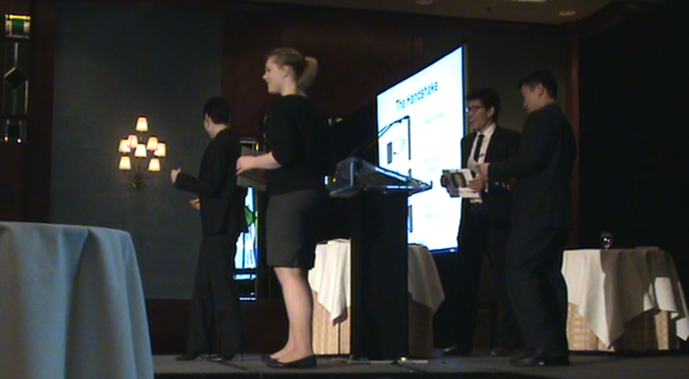
47
BUSINESS INTRODUCTIONS
BUSINESS ETIQUETTE TOOL KIT™
Notes:
Here is a video that demonstrates the formula for making introductions: [CLICK TO PLAY EMBEDDED VIDEO]
Video: Style in the City - Introductions & Behaviour.MPG
Minding Your Manners Everyday Matters: page 7, 8, 9, 10, 11, 12

Slide 48
FORMAL BUSINESS MEETINGS
48
  THE CHAIR PLANS AND LEADS
  DISTRIBUTE AGENDA BEFORE THE MEETING
  STAY ON TRACK
  END ON TIME
  FOLLOW-UP WITH MEETING OUTCOMES
BUSINESS ETIQUETTE TOOL KIT™
Notes:
There are many different reasons for having a meeting. It may be a sales call, a job interview or even a formal board meeting. However, even though office meetings may sometimes seem Informal and relaxed, professionalism is still required. When meeting formally, there will be a designated Chair. The Chair is usually the person who called the meeting. Being the Chair of a meeting like being the host at a party. It’s up to you to plan it, lead it and keep everything running smoothly.
For a formal meeting, there should always be an agenda. The agenda is prepared by the meeting Chair and should be sent out to the participants at least 3 work days prior to the meeting, or earlier if more time is needed for the participants to be able to prepare for their role in the meeting. The meeting agenda should have a clear purpose. It should also indicate how long the meeting will last, the specific amount of time allotted for each topic and what is expected of the participants.
At the beginning of the meeting, the Chair makes introductions and sets the ground rules for how the meeting will be conducted. During the meeting, the Chair also makes sure that everyone stays on track so that the meeting goals are accomplished.
The meeting should end on time, with the Chair summarizing the agenda items and any plans of action. Try to end the meeting on a positive note by thanking everyone for their contributions.
The Chair should follow-up with the participants in writing and include the items discussed, decisions reached, and actions to be taken.
Minding Your Manners Everyday Matters: page 31, 32

Slide 49

49
MEETING PARTICIPATION
  BE PUNCTUAL
  FOLLOW THE LEADER
  BRING REQUIRED MATERIALS
BUSINESS ETIQUETTE TOOL KIT™
Notes:
As a meeting participant, always be punctual. Arrive on time, prepared for the meeting. Keeping people waiting is considered poor etiquette. It is rude and a waste of everyone’s time.
Follow the lead of the Chair just like you would a host if you were going into someone else’s home.
Bring only the materials required for the meeting. Never bring food or drinks into a meeting unless indicated in the meeting agenda.
Minding Your Manners Everyday Matters: page 31, 32, 33, 34

Slide 50
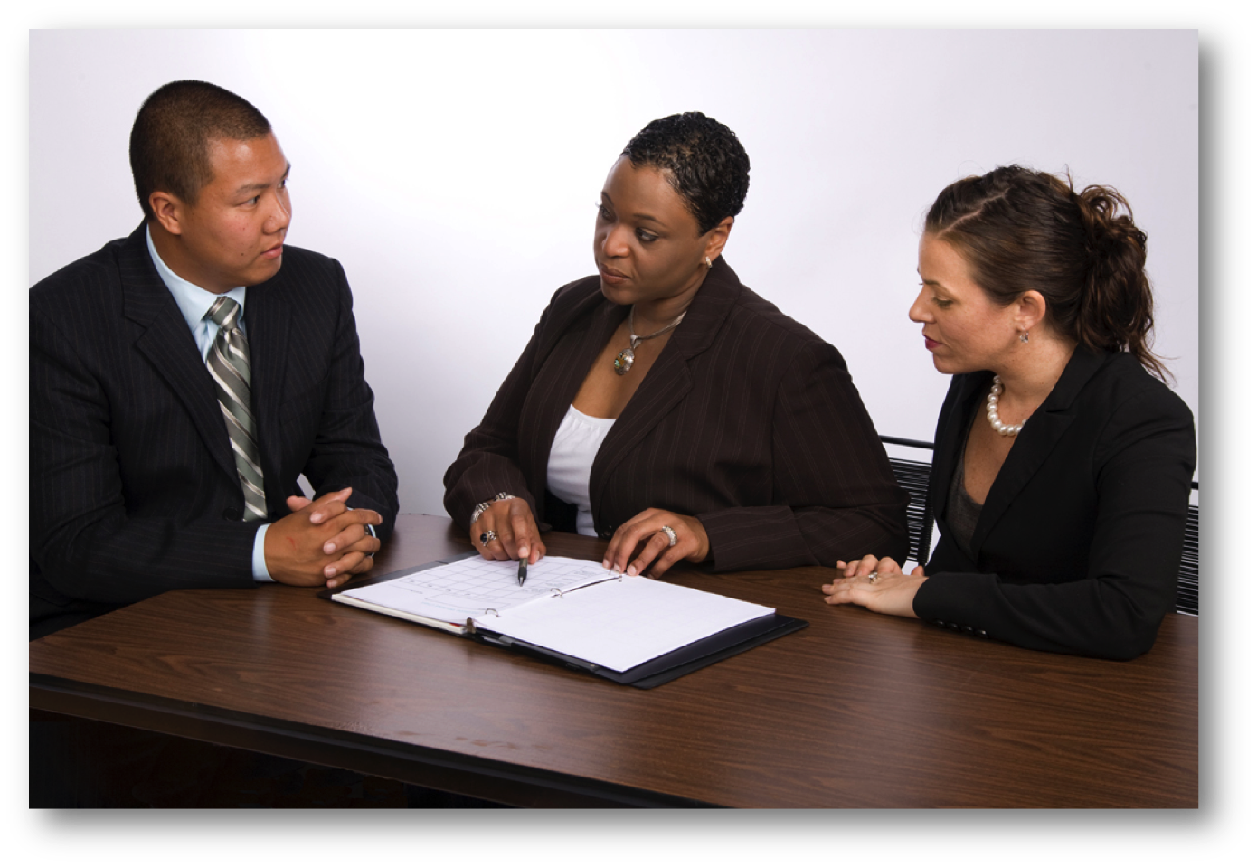
BE SEATED WHERE?
50
BUSINESS ETIQUETTE TOOL KIT™
Notes:
Seating arrangements at a meeting can affect interactions and the outcome. Here is an example of three people at a meeting to discuss an upcoming event. The woman in the middle is the meeting planner and the man and woman seated on either side of her are being tasked with various responsibilities. The success of the event will be largely dependent on how well they perform the various tasks they’re being given.
Ask participants: Do you notice anything awkward in this picture? [IF THE PARTICIPANTS HAVE DIFFICULTY, REMIND THEM THAT WE’RE EXPLORING HOW WHERE YOU ARE SEATED CAN AFFECT THE MEETING OUTCOME.]

Slide 51
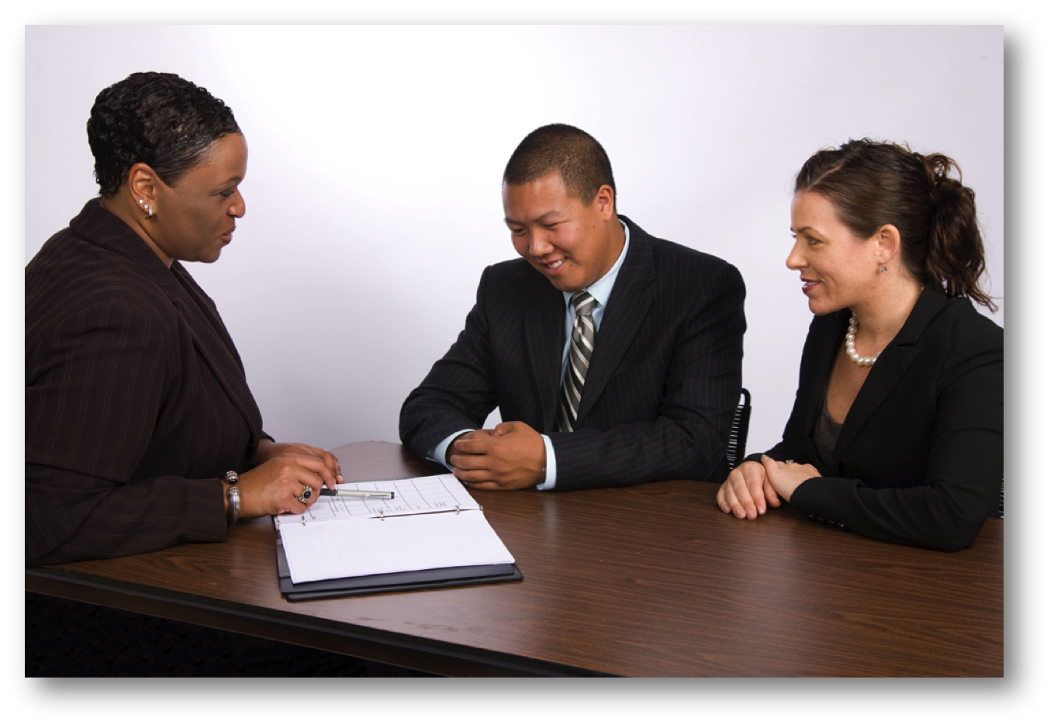
51
BE SEATED WHERE?
BUSINESS ETIQUETTE TOOL KIT™
Notes:
The photo on the right is a repeat of the same scenario pictured in the previous photo, but now the meeting planner has taken a seat to the side rather than between her two assistants.
When meeting in groups of three, this seating arrangement allows for smoother and more efficient communication. Previously, the coordinator would have found it necessary to continually turn her head to look at first one and then the other assistant. Now she can look at them both at the same time. This is more inclusive for all participants.

Slide 52

ELECTRONIC COMMUNIATION
Notes:
So far, we have talked about interacting face-to-face. In this section, we are going to talk about electronic communication. Electronic communication includes any way in which we communicate through technology. In today’s world this includes telephone, email, text messaging and social media.

Slide 53
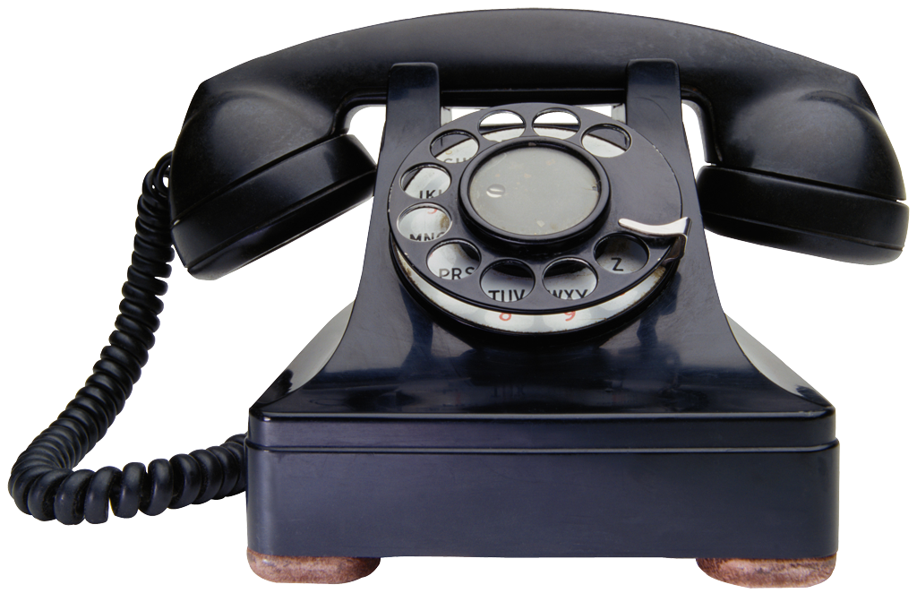
53
MAKING A PHONE CALL
  IDENTIFY YOURSELF AND YOUR BUSINESS
  BE PREPARED
  STATE YOUR PURPOSE
BUSINESS ETIQUETTE TOOL KIT™
Notes:
For many of us, the telephone is still the primary source of communication on a day-to-day basis. But with no visual clues, your words and the tone of your voice are extremely important. A little telephone courtesy can go a long way toward making you stand out, whether you are using a landline or a mobile device. When making a phone call, identify yourself and, if applicable, the name of your business. Be prepared with a clear objective. State the purpose of your call and stay on track with this. If the call will take some time, ask if it’s a convenient time to talk or if it would be better to schedule the call for another time.
Minding Your Manners Everyday Matters: page 13, 14

Slide 54
ANSWERING THE TELEPHONE
54
  ANSWER WITHIN THREE RINGS
  GREET THE CALLER
  SMILE!
  ASK BEFORE PLACING ON HOLD
  DON’T EAT OR CHEW GUM
  DON’T USE SPEAKER PHONE
BUSINESS ETIQUETTE TOOL KIT™
Notes:
The way you answer your company's phone will form your customer's first impression of your business . Here are some ways that will help you make a great impression.
Always follow company policies for answering the telephone. If there isn’t a policy, answer all incoming phone calls before the end of the third ring to ensure that the caller doesn’t get tired of waiting.
Nobody should every have to guess if they called the correct business. When answering the phone, welcome callers and identify yourself and your organization. For example, "Good morning. your company name, this is your first and last name speaking. How may I help you?"
When answering the phone, smile! The caller can hear it in your voice. Speak slowly and clearly in a warm and enthusiastic tone so your caller feels welcome and can understand what you are saying. 70% of the impression you make through the telephone depends on your voice quality and attitude. So, enunciate carefully and think about the tone of your voice.
Always ask the caller if it's alright before putting them on hold. If needed, give progress reports every 30 to 45 seconds. Never leave someone on hold longer than 45 seconds. If you think it will be a while before you can return to the call, offer to call the caller back instead.
When transferring calls, ask first and always tell the caller to whom they are being transferred. Make sure you are transferring them to someone who can help them. Always give the caller choices in this situation. If you think the caller will need to remain on hold for a longer period of time while being transferred to the right person, offer to have them receive a call back instead.
Don’t eat or chew gum while on the telephone. The caller can hear it through the phone.
Always give the caller your undivided attention. So, no multitasking or carrying on secondary conversations while speaking with someone.
Don't use speakerphone unless absolutely necessary. Using speakerphone gives the caller the impression that you are not fully concentrating on the call and that the call isn't private. The only time speakerphones should be used is when you need more than one person to be in on the conversation at your end. When using speakerphone technology, always make sure the person on the other end of the call knows that they are on a speakerphone and who is listening in on the call.
Minding Your Manners Everyday Matters: page 13, 14

Slide 55
TAKING MESSAGES
55
  GET THE…
  CALLER’S NAME AND SPELLING
  COMPANY NAME
  CALLERS TELEPHONE NUMBER
  DETAILED MESSAGE
  RECORD DATE AND TIME
BUSINESS ETIQUETTE TOOL KIT™
Notes:
When taking messages, be sure to write down the caller’s full name spelled correctly to make sure the person receiving the message can identify the caller. Include the caller’s company name, if applicable, the caller’s telephone number, and a detailed message including the time and date of the call so that the person the call was intended for can prepare appropriately for the call back.
Minding Your Manners Everyday Matters: page 13, 14

Slide 56
VOICEMAIL
56
  OUTGOING MESSAGE
  BE PROFESSIONAL
  UPDATE YOUR MESSAGE
  RETURN CALLS PROMPTLY
  LEAVE SUFFICIENT INFORMATION
  INCLUDE YOUR PHONE NUMBER
  SUGGEST CALL BACK TIME
BUSINESS ETIQUETTE TOOL KIT™
Notes:
Voicemail systems are used in most businesses around the world. They are considered an important timesaver for callers.
If you use voicemail to answer calls when you can't, make sure that you have a professional outgoing message recorded that provides the caller with pertinent information. It should be short and to the point, providing information such as your name, your company name and when you will be returning the call.
Update your outgoing voicemail message as needed. If you include the date in your outgoing message, make sure you update your message daily so that you don’t leave your callers feeling confused or uneasy while listening to the previous week’s date and information on the outgoing message.
Don’t keep callers waiting. Return your calls within one business day. This will leave a good impression and make sure that the caller doesn’t get tired of waiting and go elsewhere.
When leaving a message on voicemail, leave sufficient information to cut down on “telephone tag.” Never assume that the person you are calling has your number. You should always include it when leaving a message on a business line.
If you anticipate that you will be difficult to reach, indicate several options of when and how to return your call.
Minding Your Manners Everyday Matters: page 13, 14

Slide 57
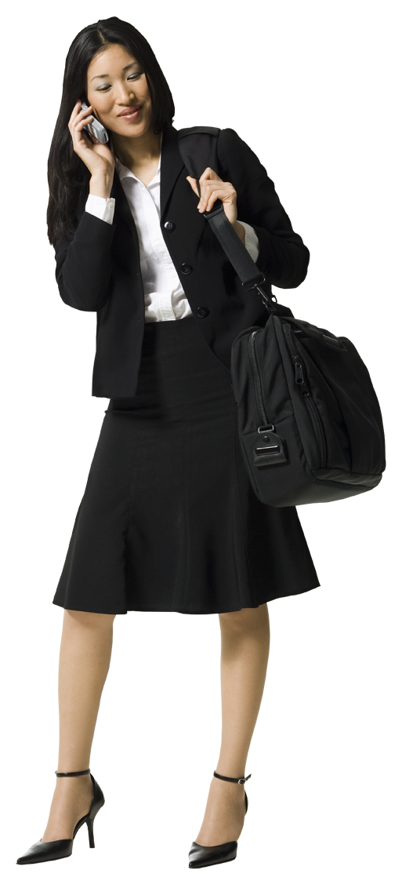
57
MOBILE DEVICES
BUSINESS ETIQUETTE TOOL KIT™
Notes:
Now we are going to talk about mobile phone etiquette. The smart phone is a great tool. It frees us up to be more mobile and helps us to get more done while on the go. However, because smartphones are everywhere and used all the time, smart phone decorum has become an issue.
Over the past few years, smartphone use and misuse has increased dramatically. They now cause everything from general disturbances to road-rage. A little techno-courtesy and common sense can make the technology experience more pleasant for you and the people around you.
Minding Your Manners Everyday Matters: page 15, 16

Slide 58
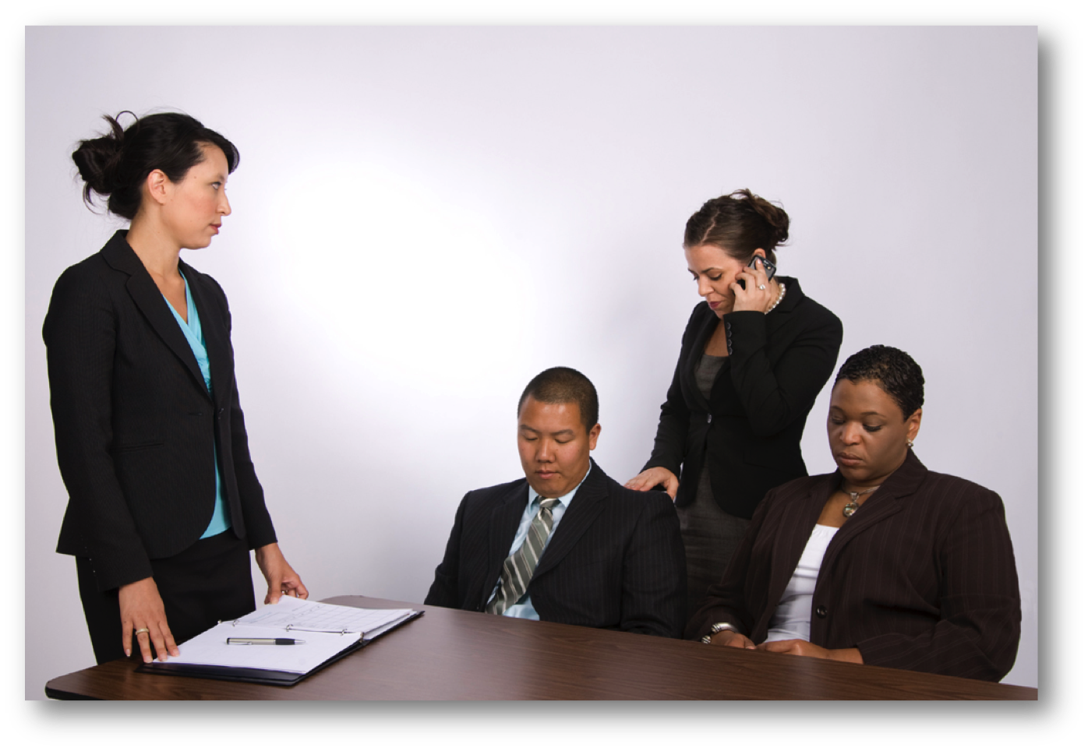
SMARTPHONES
58
BUSINESS ETIQUETTE TOOL KIT™
Notes:
Here is an example of what we often see. We are in a meeting, at a restaurant, or in conversation with someone, and their cell phone rings or they receive a text message. Immediately, the person you are talking with interrupts your conversation to answer their phone or check the message.
Ask participants: So, how would you feel if someone dropped a conversation with you to answer their phone and then proceeded to leave you waiting so that they could have a conversation on their phone that wasn’t urgent or important? [OPEN DISCUSSION]
Most of us would feel disrespected, insulted, angry, hurt or unvalued. Leaving someone to wait while you make an unimportant call is both hurtful and disrespectful.
Minding Your Manners Everyday Matters: page 15, 16

Slide 59
SMARTPHONES
59
  BUSINESS…
  BE COURTEOUS
  DON’T YELL
  KEEP YOUR DISTANCE
  AVOID QUIRKY RING TONES
  USE HANDS FREE OPTIONS WHILE DRIVING
BUSINESS ETIQUETTE TOOL KIT™
Notes:
For many, cell phones have become an important source of communication for business. But, as with a landline, there are no visual cues to look for. So, your words and the tone of your voice are extremely important.
Use the same level of courtesy that you would on a business landline. When answering the phone, smile! The caller can hear it in your voice. Greet the caller professionally with your name. Speak slowly and clearly so your caller can understand you easily.
Keep the tone of your voice at a moderate level. Mobile phones generally have great reception, so there is no need to yell into the phone. However, it is best to avoid noisy background interference whenever possible to make it easier for the person you are speaking with to understand you.
Keep your distance. Don’t disturb people around you while talking. Keep calls quick and to the point. Chat on cell phones when you are alone, not in public.
Personal matters are personal. The public doesn’t need to hear your discussions with a client or a loved one. Also, don’t forget that personal cell phones should be turned off while at the office.
In a business setting, business means business. Quirky ring tones can be very annoying. When in a public place or in a shared business setting, put phones on silence, vibrate, or use a traditional ringtone, preferably on a quiet setting.
In many cities in North America and other parts of the world, it is illegal to drive while talking or texting. Use hands-free devices while driving, for your safety and to alleviate the aggravation of those driving next to you.
Minding Your Manners Everyday Matters: page 15, 16

Slide 60
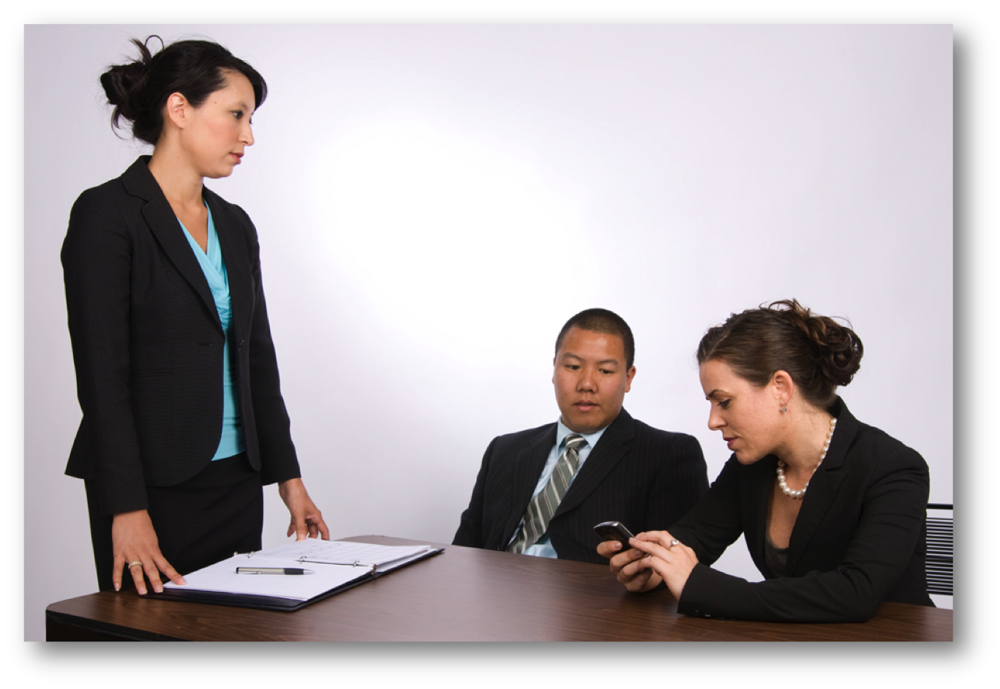
60
TEXT MESSAGING
BUSINESS ETIQUETTE TOOL KIT™
Notes:
When text messaging anyone for the first time, identify who you are as they may not have your contact information saved in their mobile device. Text messaging for businesses purposes should be reserved for only the most casual communication and should be kept brief and to the point. Remember, just because it is portable, it doesn’t mean you should use it at any time.
Ask participants: Can anyone give us an example of a time when your mobile device should be turned off? [OPEN DISCUSSION]
Mobile devices should be turned off during meetings at public events, like while watching a movie, play, or any kind of performance; in places of worship or at weddings & funerals; at lectures or in classrooms; in restaurants, unless you are alone and your phone is on silent so you don’t disturb other patrons; in someone else’s home or office, never abandon your host or guest to check your phone; in hospitals or any public places where you may disturb others, such as public transportation or elevators. Avoid, talking, checking and responding to email, text messaging, or planning your day on a portable device at any time that may be disturbing to others.
Minding Your Manners Everyday Matters: page 16

Slide 61
BUSINESS EMAIL
61
  INCLUDE SUBJECT
  USE FORMAL SALUTATION
  AVOID SENSITIVE INFORMATION
  BE CLEAR ABOUT DATES & TIMES
  CHECK SPELLING & GRAMMAR
  USE BLIND COPY FOR PRIVACY
  RESPOND ASAP
  INCLUDE SIGNATURE
BUSINESS ETIQUETTE TOOL KIT™
Notes:
For centuries, handwritten letters delivered by messenger or post were the only form of written correspondence. Over time, typewriters became the norm, but the delivery system remained the same.
Now, with the explosion of email, correspondence is sent and received at lightning speed. However, although electronic correspondence can be a real time-saver, it is still a form of written correspondence. Business correspondence should be written with the same formality as a business letter.
The subject stated in the “subject” box should reflect the content of the email. Keep it short, concise and clear. When corresponding over several emails, change the subject as the subject of the content changes.
When writing business emails, always use a formal salutation like: ‘Greetings’, ‘Dear’, or ‘Hello’. Address people by their title, such as Mr. or Ms., unless you have been introduced with their first name or they use their first name in their correspondence. A greeting like ‘Hey, bro,’ just doesn’t cut it.
Don’t send sensitive information by email. Accidents do occasionally happen. Also, be respectful of those receiving your emails. Don’t send junk mail, email chain letters or jokes.
Be clear about dates and times when referring to them. 2:00pm on Tuesday in Vancouver is not the same as 2:00pm on Tuesday in New York or Mumbai.
It’s easy to send off a quick email, but remember that emails should be brief, to the point and grammatically correct. Pay attention to spelling and grammar so that you are clearly understood. When emailing for formal business purposes, do not use text message abbreviations or emojis.
If you are sending an email to a group, and the individuals do not need to know who else is receiving the email, use the “blind copy” box for the recipient’s email addresses. This prevents peoples' email addresses from being shared with others.
Always respond to emails in a timely manner. Respond either right away or, if it will take longer to obtain information, reply within 48 hours to let the sender know that you received their email and it will take more time to obtain the required information. Again, be sensitive to time. Don’t keep people waiting.
Minding Your Manners Everyday Matters: page 16, 17, 18

Slide 62
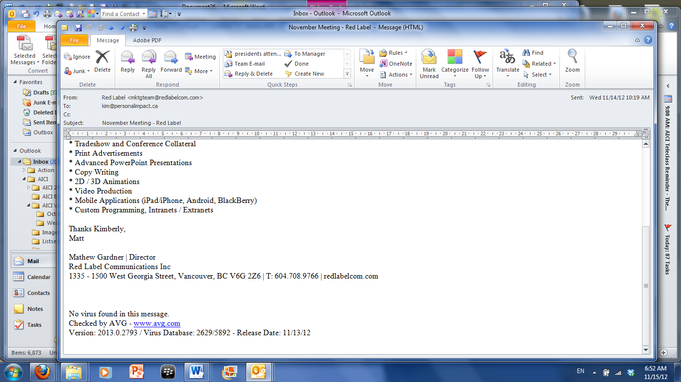
BUSINESS EMAIL
62
BUSINESS ETIQUETTE TOOL KIT™
Notes:
Your email signature is a vital part of a business email. It takes the place of the return address in a letter or on company stationery. As shown in this example, it should include: your name, title, company name, company telephone number or direct line. Make sure your email signature is attached to email replies as well as the original email. This will keep your contact information at the receiver's fingertips. This is a great example because it contains enough information to establish itself as a legitimate business to allow the receiver to easily contact the sender if they wish.
Minding Your Manners Everyday Matters: page 16, 17

Slide 63
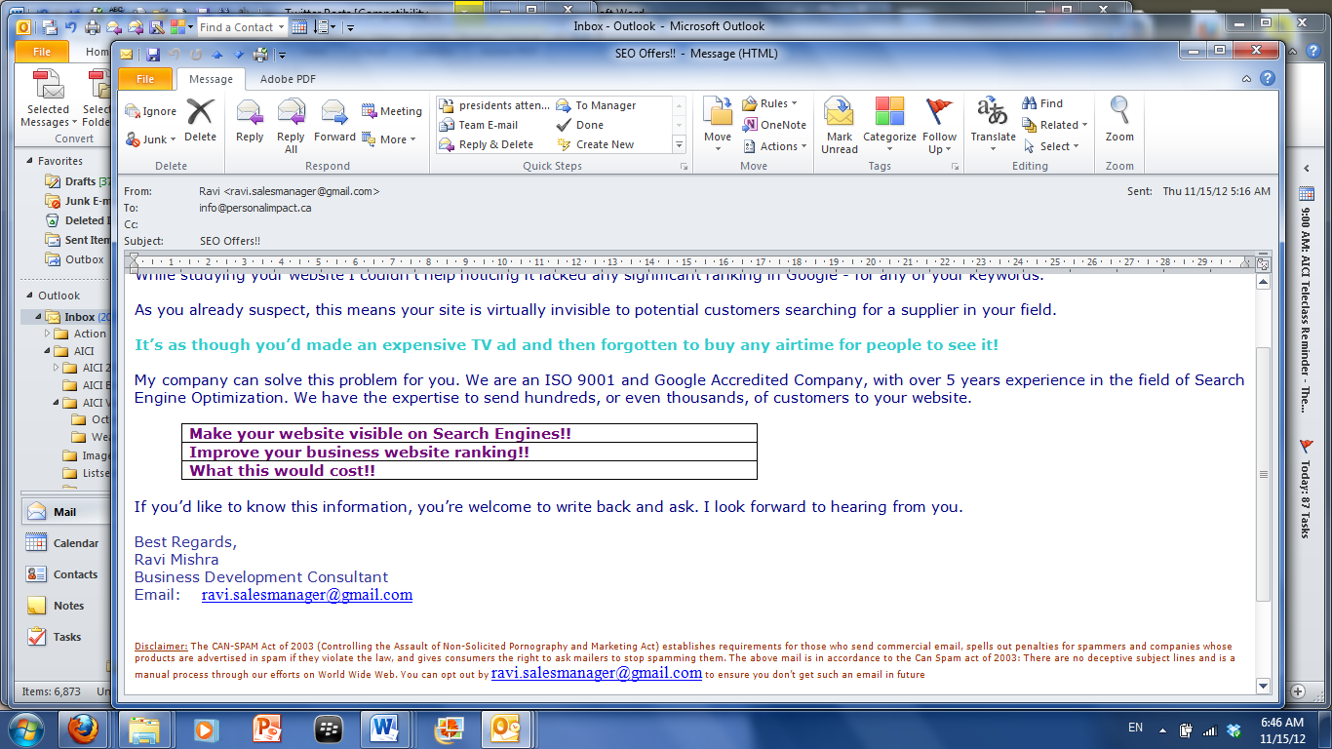
BUSINESS EMAIL
63
BUSINESS ETIQUETTE TOOL KIT™
Notes:
This second email signature makes me questions its legitimacy. No company information is included and the email address is a Gmail account rather than a company email address. It also does not contain the company name or website information, which would allow the person receiving the email to learn more about the company and check that the company is legitimate.
Minding Your Manners Everyday Matters: page 16, 17

Slide 64
64
SOCIAL MEDIA
FACEBOOK
LINKEDIN
GOOGLE HANGOUT
INSTAGRAM
YOUTUBE
TWITTER
ETC.
BUSINESS ETIQUETTE TOOL KIT™
Notes:
Let’s move on to the newest form of electronic communication, social media. There are many forms of social media. These are just a few examples of social media platforms and the list continues to grow daily. Social media should be treated as an open display of information that is accessible by anyone at any time.
Minding Your Manners Everyday Matters: page 17

Slide 65
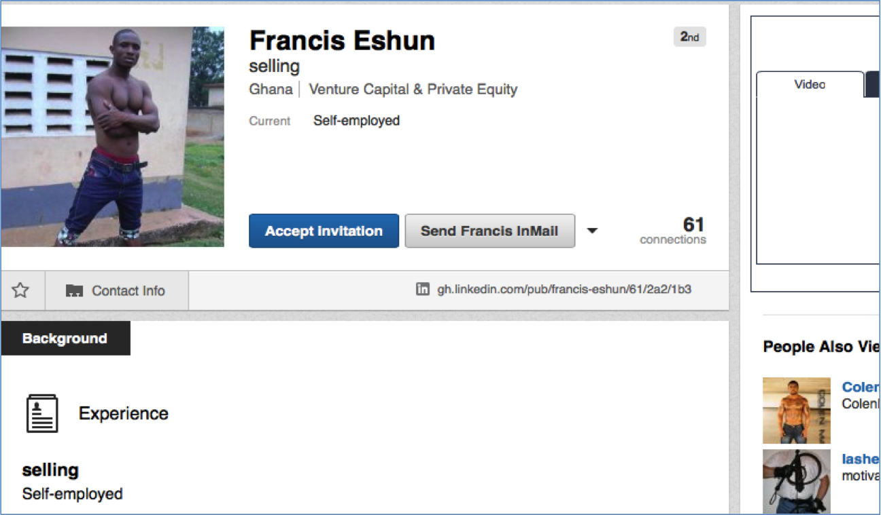
SOCIAL MEDIA
65
BUSINESS ETIQUETTE TOOL KIT™
Notes:
Ask Participants: Looking at this example from LinkedIn, would you hire this man to handle your finances based on his profile? [OPEN DISCUSSION]
I know we’ve all seen really bad examples like this and many of us have gotten into trouble by innocently posting the wrong thing. Social media does not discriminate, edit or protect. In today’s world, you are what you post. Even though it may seem harmless now, it may damage your reputation and turn out to be harmful to you or others, now and in future. Think before you post, and refrain from posting anything that you wouldn’t want your current employer, future employer, grandmother or children to read about you or anyone you associate with.
Posts on professional sites like ‘LinkedIn’ should be business-oriented. All pictures should appear business-like, professional and credible.
Minding Your Manners Everyday Matters: page 17

Slide 66
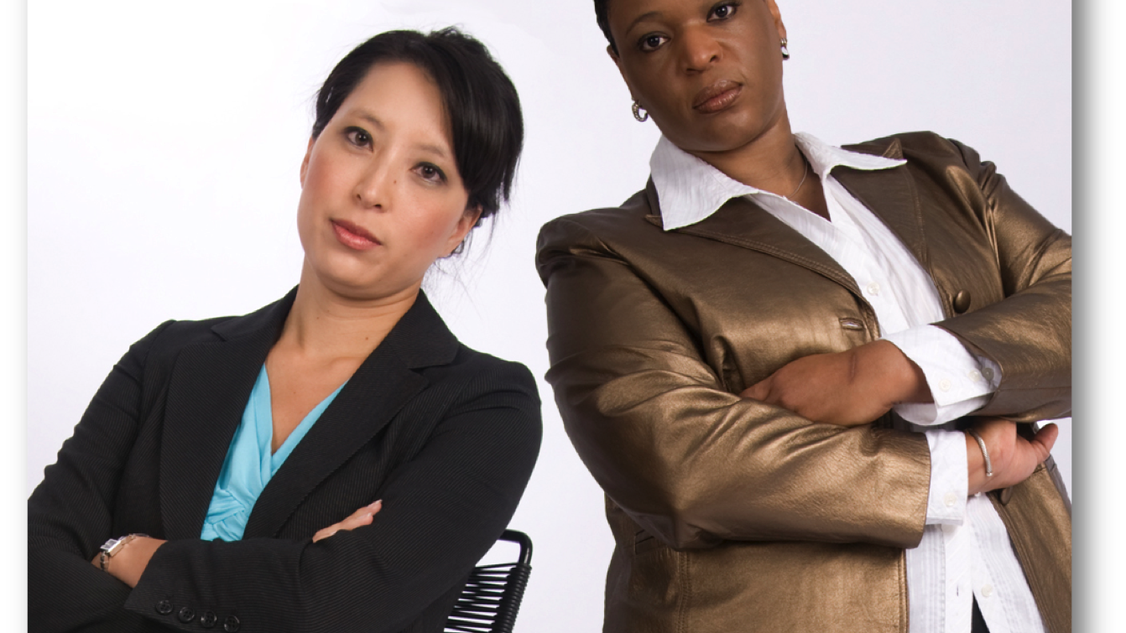
NON-VERBAL COMMUNICATION
Notes:
Let’s move on to body language. When we meet someone face to face for the first time, our first impression is usually based on what we see. So, the way you communicate non-verbally can be important to your success in your business and personal life. It can either help you achieve your goals or undermine your efforts. When you understand the messages your body is sending, you’ll be in a position to manage those messages and send messages that are congruent with what you are trying to communicate.
Body language is particularly important when you’re meeting someone for the first time, for example, during a job interview or when meeting a new or potential client. It is also important when you’re trying to influence others, for example, during a meeting or when you’re trying to sell a product, service or idea.

Slide 67
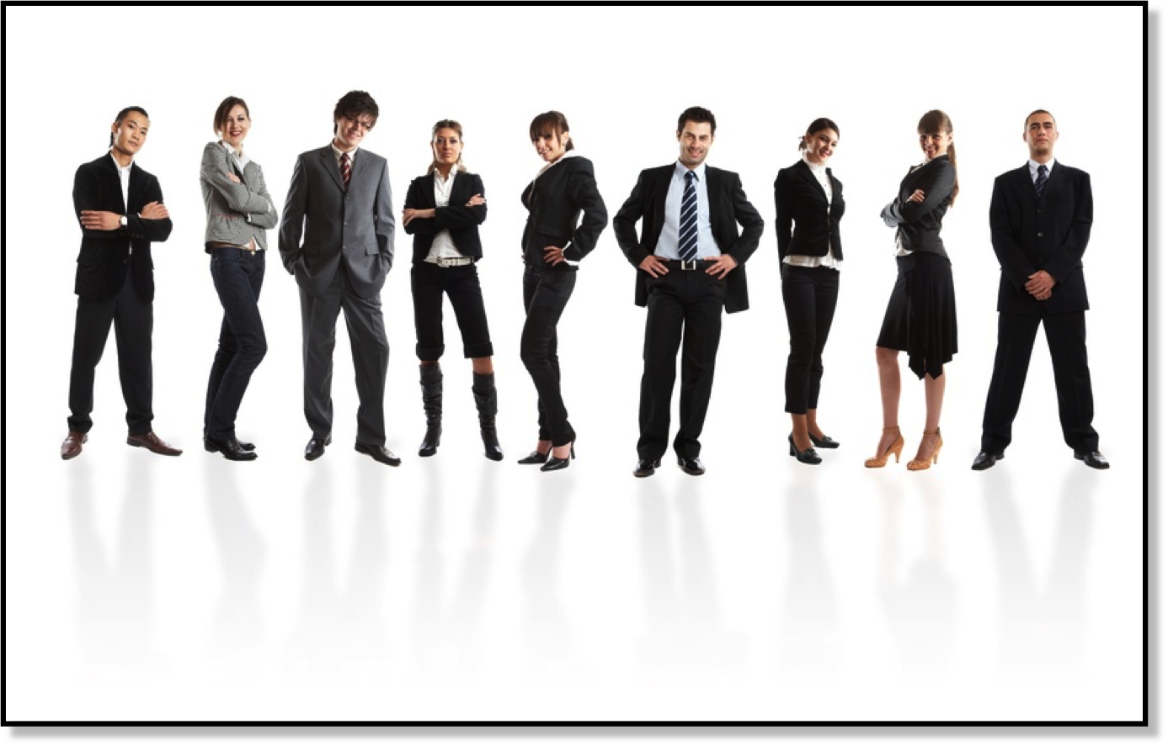
BODY LANGUAGE
67
BUSINESS ETIQUETTE TOOL KIT™
Notes:
Ask participants: To prove my point, I would like you to look at the individuals in this photo. Looking at this picture, what are some of the non-verbal messages being sent out? [ASK THE PARTICIPANTS TO RELATE SPECIFIC BODY LANGUAGE CUES THEY SEE AND THE MESSAGES THEY IDENTIFY.]
I think we would all agree that a picture paints a thousand words. And without saying a word, each of us create our own picture of who we are, as well as our feelings and attitudes. In this example, all of the people in this picture are dressed in business clothing and appear to be well groomed. The one thing that differs is their body language.
Minding Your Manners Everyday Matters: page 35, 36

Slide 68
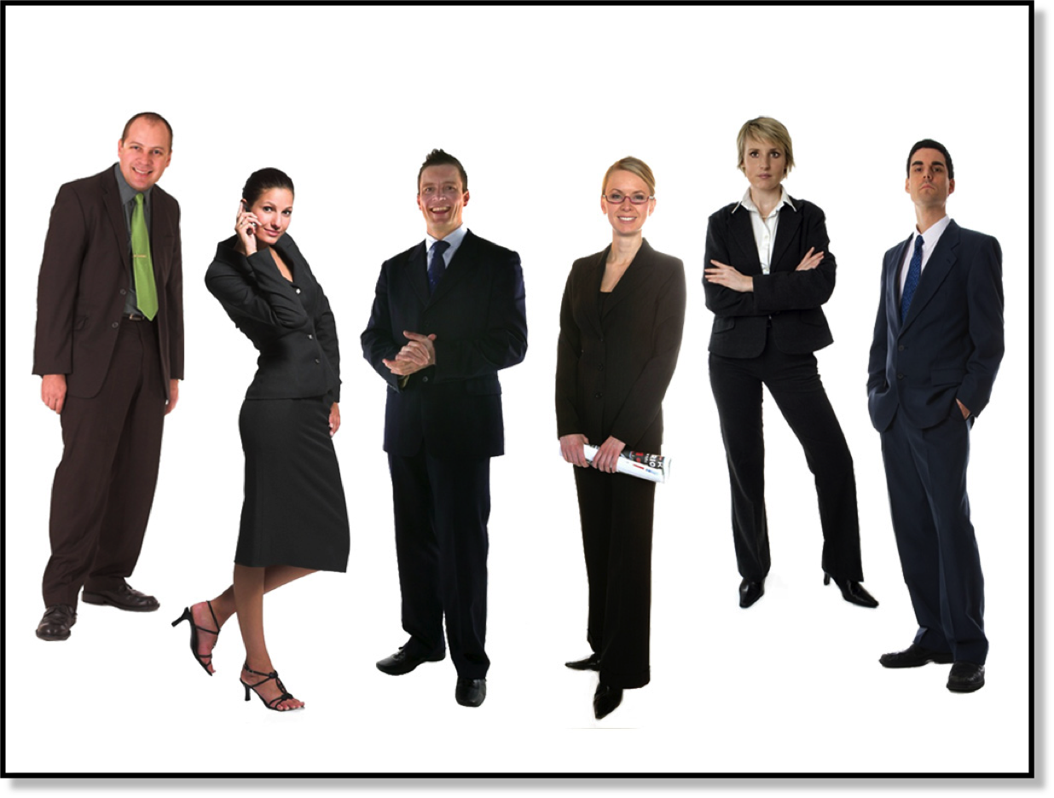
68
BODY LANGUAGE
  MOVEMENT
  FACIAL EXPRESSIONS
  POSTURE
  GESTURES
BUSINESS ETIQUETTE TOOL KIT™
Notes:
Body language includes all of the ways that we communicate non-verbally. These include: movement, facial expressions, posture and gestures.
Just because you’re not talking doesn’t mean you’re not communicating. In fact, a large part of what you communicate is actually said through body language cues.
Ask the participants to name some of the body language cues they think they use. [ON A FLIP CHART MAKE FOUR COLUMNS, ONE FOR EACH OF THE FOUR CATEGORIES OF BODY LANGUAGE. RECORD IN EACH COLUMN THE VARIOUS BODY LANGUAGE CUES THE PARTICIPANTS IDENTIFY. (I.E. MOVEMENT, FACIAL EXPRESSION, POSTURE, AND GESTURES)]
Body language is often subconscious. You may or may not even be aware of the messages you are sending. We are continually sending messages using body language. Even when we think our body is at rest, subtle changes in facial expression can communicate strong reactions, thoughts or feelings. It is important to become more aware of the messages you’re sending and more sensitive to the messages you’re receiving from those around you. So, as we go through this section, I want you to think about some of the body language cues that you use and how they might be interpreted.
In business, your body language can play a huge role in your success or failure in the workplace. It can either help you achieve your goals or it can undermine your efforts.
Today, we have already talked about eye contact, posture, a good handshake and personal space, all of which are important aspects of how we communicate non-verbally using body language. Now we are going take it a step further by identifying some important body language pitfalls to avoid.
Minding Your Manners Everyday Matters: page 35, 36

Slide 69
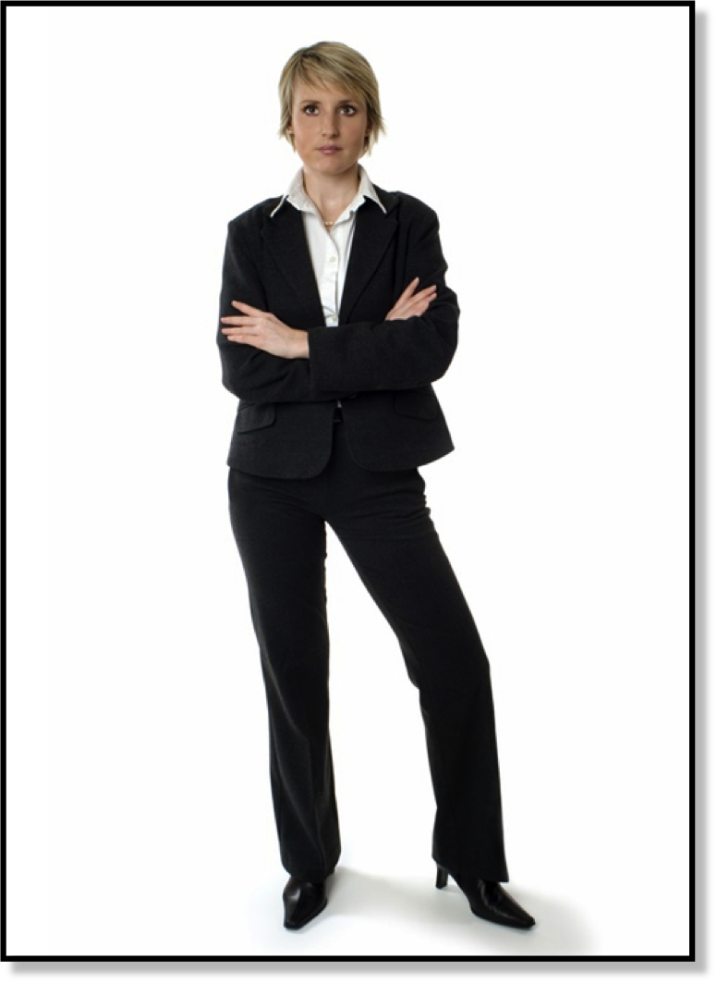
69
BODY LANGUAGE
BUSINESS ETIQUETTE TOOL KIT™
Notes:
Now that you have a clear idea of what good posture looks like, let’s take a closer look at some examples of posture that may not be sending the intended message.
Ask participants to look at the woman in this photo. [ON A FLIP CHART MAKE TWO COLUMNS.] Ask participants to identify the messages and attitudes they read. [RECORD THESE IN ONE COLUMN. MESSAGES MAY INCLUDE: AN UNRECEPTIVE OR CLOSED ATTITUDE, HOSTILITY, DEFENSIVENESS, ANGER, ETC.]
Ask the participants to identify the posture and other cues that communicate these messages. [RECORD THE RESPONSES IN THE SECOND COLUMN. CUES INCLUDE: WIDE STANCE, HIPS THRUST TO ONE SIDE, AND ARMS FOLDED ACROSS CHEST, FACIAL EXPRESSION.]
Minding Your Manners Everyday Matters: page 35, 36

Slide 70
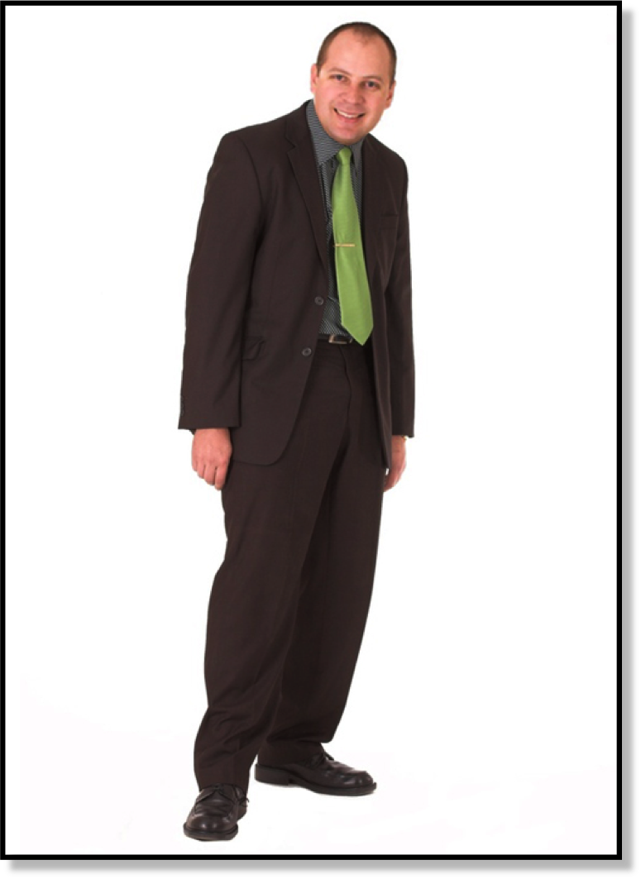
70
BODY LANGUAGE
BUSINESS ETIQUETTE TOOL KIT™
Notes:
Let’s take a look at another example.
Ask participants to look at the man in the photo. [ON A FLIP CHART MAKE TWO COLUMNS.] Ask the participants to identify the messages and attitudes they read in his posture. [RECORD ANSWERS IN ONE COLUMN. MESSAGES MAY INCLUDE: INDECISIVENESS, TIMIDITY, LACK OF LEADERSHIPS SKILL, AND SHYNESS.]
Ask the participants to identify the posture cues that communicate these messages. [RECORD THOSE RESPONSES IN THE SECOND COLUMN. POSTURE CUES MAY INCLUDE: ARMS HANGING LIMPLY BY HIS SIDES, SHOULDERS ARE HUNCHED, ROLLED FORWARD AND IN, AND HEAD IS FORWARD AND DOWN, COMPRESSING THE CHEST.]
In this example, the non-verbal messages tell us that he is timid, lacks confidence and may even be a bit indecisive. Probably not a good leader.
Minding Your Manners Everyday Matters: page 35, 36

Slide 71
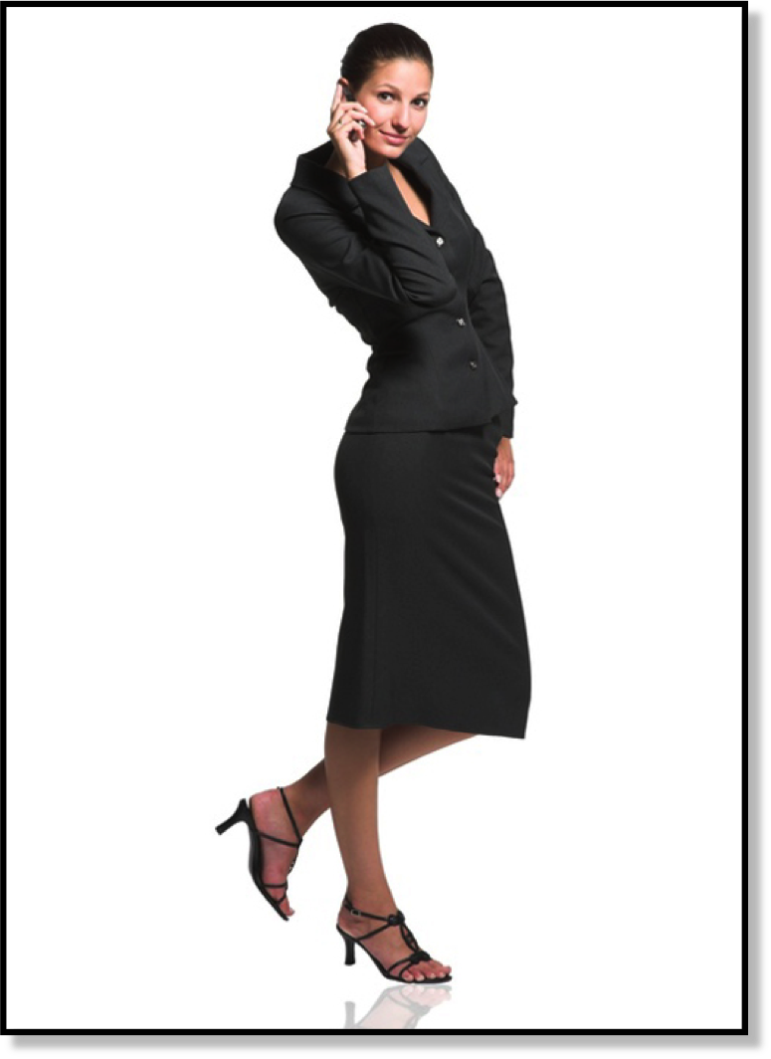
71
BODY LANGUAGE
BUSINESS ETIQUETTE TOOL KIT™
Notes:
Ask participants to look at the woman in the photo and identify the messages and attitudes they read in her posture. [ON A FLIP CHART MAKE TWO COLUMNS AND RECORD THESE IN ONE COLUMN. MESSAGES MAY INCLUDE: FLIRTATIOUSNESS, SEXUALITY, AND NOT SERIOUS ABOUT WORK]
Ask the participants to identify the posture cues that communicate these messages. [RECORD RESPONSES IN THE SECOND COLUMN. POSTURE CUES INCLUDE: EARS, SHOULDERS, AND ANKLES ARE NOT ALIGNED, WEIGHT IS NOT EVENLY DISTRIBUTED, HIP IS THRUST TO ONE SIDE, SHOULDERS ARE UNEVEN, HEAD IS TILTED, AND SHE IS TOUCHING HER EAR.]
I think in this picture we all agree that there is a disconnect between what she is wearing and her body language. Most would say she looks flirty or like she is more interested in getting a date than working.
The visual cues for this impression are that her hip is thrust to one side along with her shoulders being uneven, which creates an S shape that may be considered seductive. Her head is tilted down with her eyes up and she is touching her ear. Together, all of these signals appear flirtatious.
Minding Your Manners Everyday Matters: page 35, 36

Slide 72
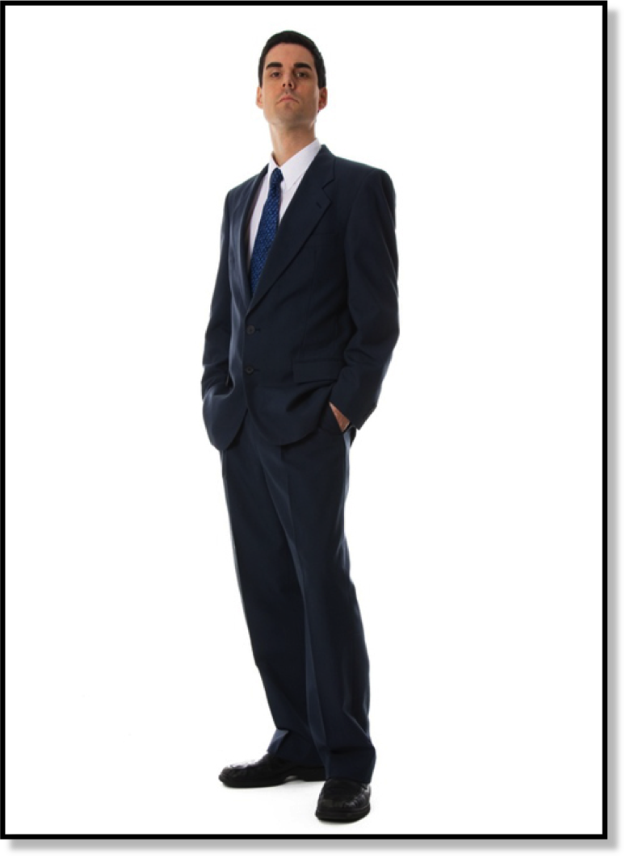
72
BODY LANGUAGE
BUSINESS ETIQUETTE TOOL KIT™
Notes:
Here is another example of non-verbal messages that you should avoid.
Ask participants to look at the man in the photo and identify the messages and attitudes they read. [ON A FLIP CHART MAKE TWO COLUMNS. RECORD ANSWERS IN ONE COLUMN. MESSAGES MAY INCLUDE: DISINTEREST, LACK OF ENTHUSIASM, UNRECEPTIVE ATTITUDE, UNAPPROACHABLE, and ARROGANT.]
Ask the participants to identify the cues that communicate these messages. [RECORD RESPONSES IN THE SECOND COLUMN. POSTURE CUES INCLUDE: HEAD IS TIPPED BACK AND AWAY, RAISED EYEBROWS, HANDS ARE IN HIS POCKETS, AND HIS BODY IS LEANING BACK AND AWAY.]
Minding Your Manners Everyday Matters: page 35, 36

Slide 73
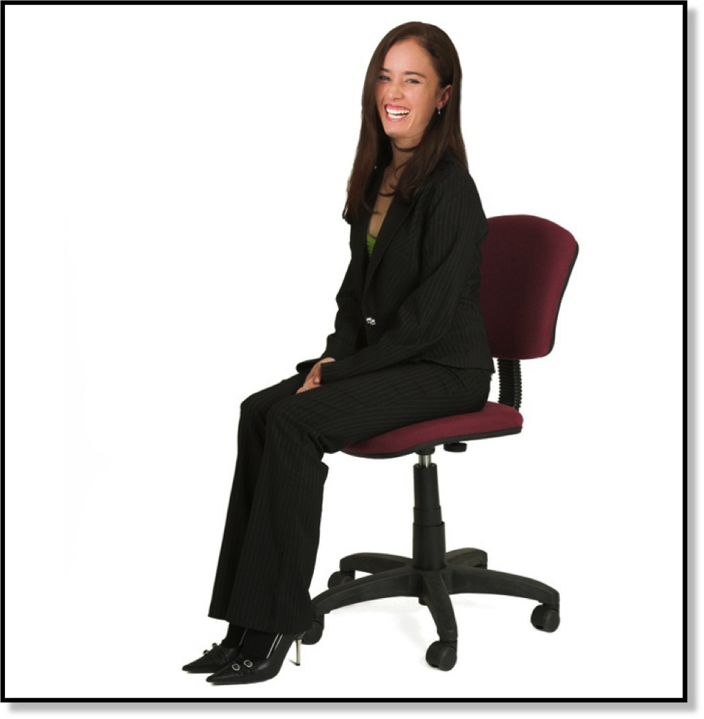
73
BODY LANGUAGE
Notes:
Body language is important even when we are sitting. Let’s look at one more example.
Ask participants: Would you agree this woman’s posture appears grounded, formal and energized? [THE ELEMENTS THAT CONTRIBUTE TO THESE MESSAGES INCLUDE: STRAIGHT BACK, SITTING FORWARD IN THE CHAIR, FEET PLANTED ON THE FLOOR.]
Ask participants: Are there elements of her posture that could be improved? [OPEN DISCUSSION].
Ideally, her hands should be visible and relaxed. She could accomplish this by simply laying her hands in her lap. Also, her back seems quite straight and stiff. Relaxing a bit more would make her appear more comfortable and approachable.
Minding Your Manners Everyday Matters: page 35, 36

Slide 74
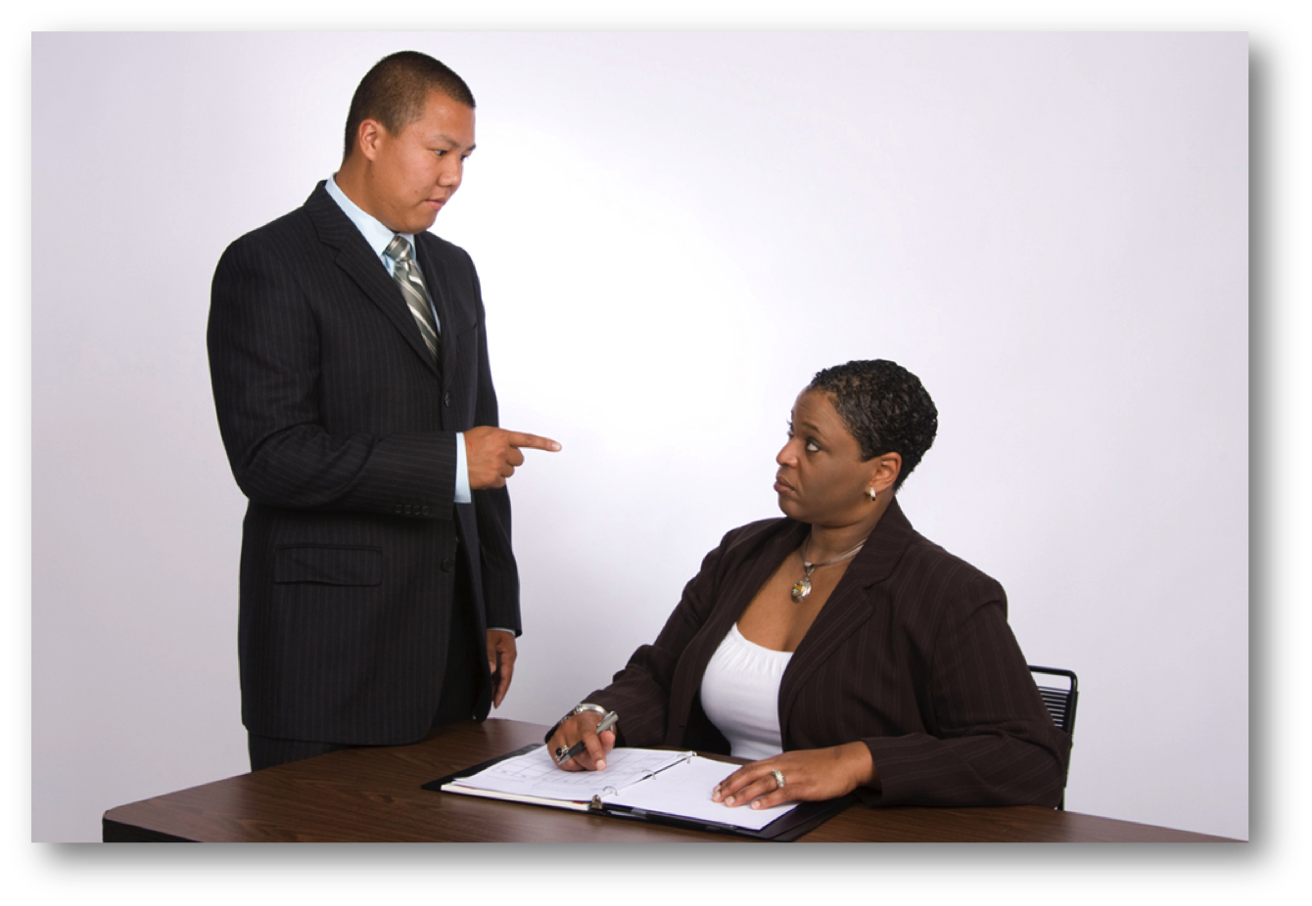
BODY LANGUAGE
74
BUSINESS ETIQUETTE TOOL KIT™
Notes:
Some people have really bad habits that they aren’t even aware of that can be distracting and annoying to others.
Ask participants: Can you think of any examples? [WHISTLING, MAKING JOKES THAT THEY THINK ARE FUNNY BUT ARE ACTUALLY INSULTING TO OTHERS, LEAVING PERSONAL CELL PHONES ON, TALKING REALLY LOUD, ETC.]
Your hands are an expressive part of your body, so it’s important to be aware of the messages your hand signals are sending. This photo is a good example. As you can see in this picture, pointing your finger at a colleague, co-worker or client is never acceptable.
Ask participants: Under what circumstances might it be acceptable to point your finger? [IN THE DIRECTION OF AN OBJECT AND IN THE DIRECTION OF A GROUP OF PEOPLE, BUT USE AN OPEN HANDED GUESTURE.]
Pointing your finger is a common gesture and can be entirely appropriate. For example, pointing to indicate a direction, an object at a distance, or a detail close at hand can be useful and imply no negative message. However, pointing your finger at another person, especially if you are angry, agitated or emotional, will likely be perceived as a sign of aggression.
Minding Your Manners Everyday Matters: page 35, 36

Slide 75
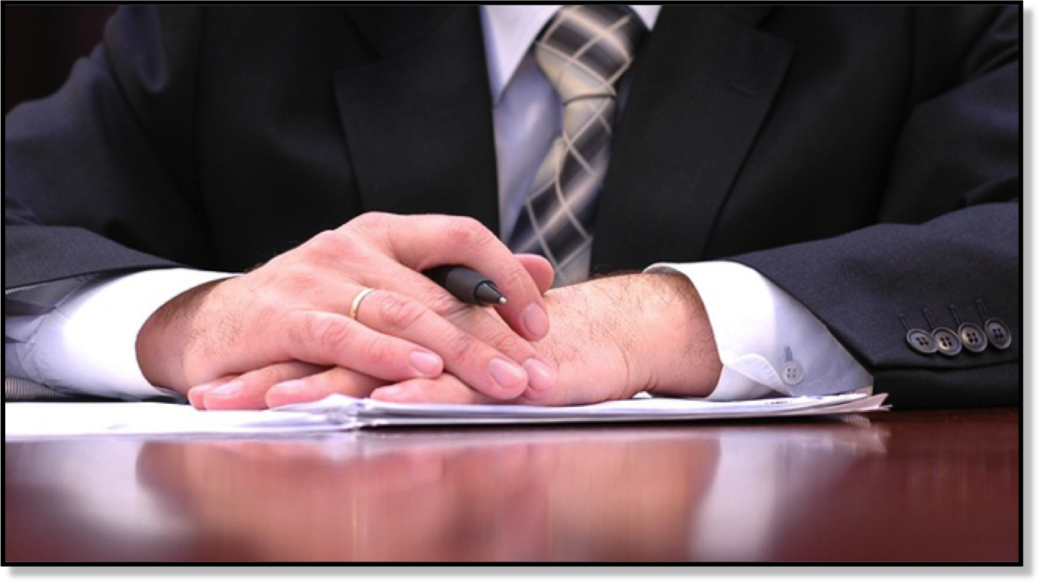
BODY LANGUAGE
75
BUSINESS ETIQUETTE TOOL KIT™
Notes:
When your hands are visible, relaxed, and your palms are open, your gesture will be perceived as open and inviting.
It’s also a good idea to place your hands where they are visible. When seated at a conference table, for example during a meeting, it’s better to put your hands on the table rather than in your lap.
The hands in this photo are an example of an open gesture. Open gestures put people at ease. They communicate a sense of cooperation and tell people you’re receptive and friendly.
Minding Your Manners Everyday Matters: page 35, 36

Slide 76
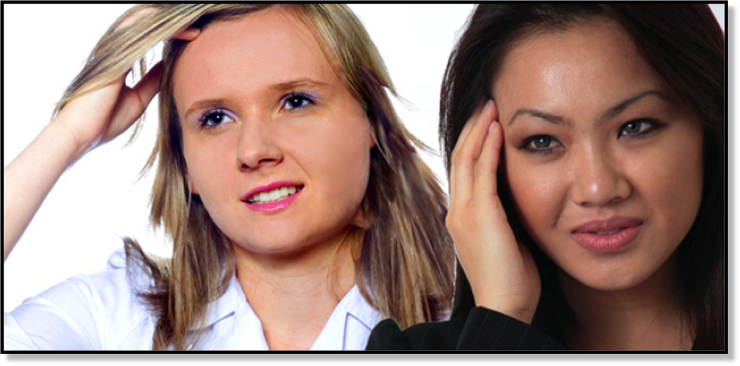
BODY LANGUAGE
76
BUSINESS ETIQUETTE TOOL KIT™
Notes:
If you’re distracted or absorbed in a task, it’s sometimes natural to repetitively touch some part of yourself, such as your hair or your face. If you’re nervous or anxious, repetitive self-touching can be a subconscious attempt to calm yourself or protect yourself. However, it’s best to avoid doing this in the workplace as it can give the wrong impression and make others feel uncomfortable.
Minding Your Manners Everyday Matters: page 35, 36

Slide 77
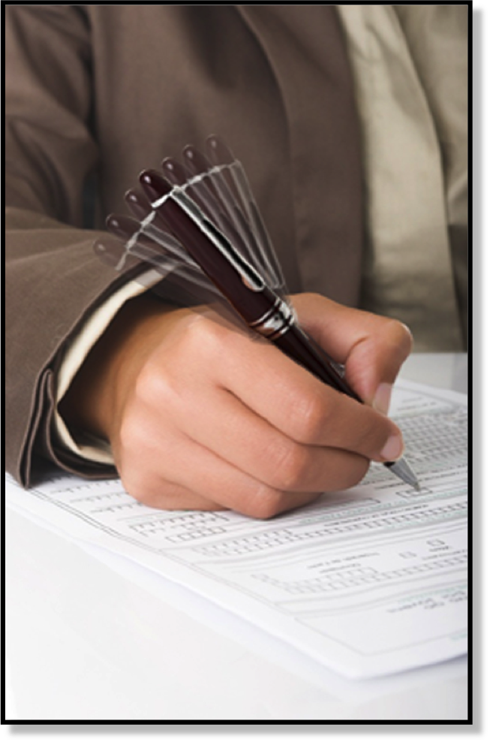
77
BODY LANGUAGE
BUSINESS ETIQUETTE TOOL KIT™
Notes:
Fidgeting, or moving around restlessly, nervously, or impatiently, can also be distracting and irritating to the people around you.
Ask participants to name some of the ways they’ve seen people fidget. [EXAMPLES: PICKING YOUR NAILS OR CUTICLES, REPEATEDLY ADJUSTING YOUR CLOTHING, TAPPING YOUR FINGERS, CLICKING YOUR PEN, TAPPING YOUR FOOT.]
Minding Your Manners Everyday Matters: page 35, 36

Slide 78
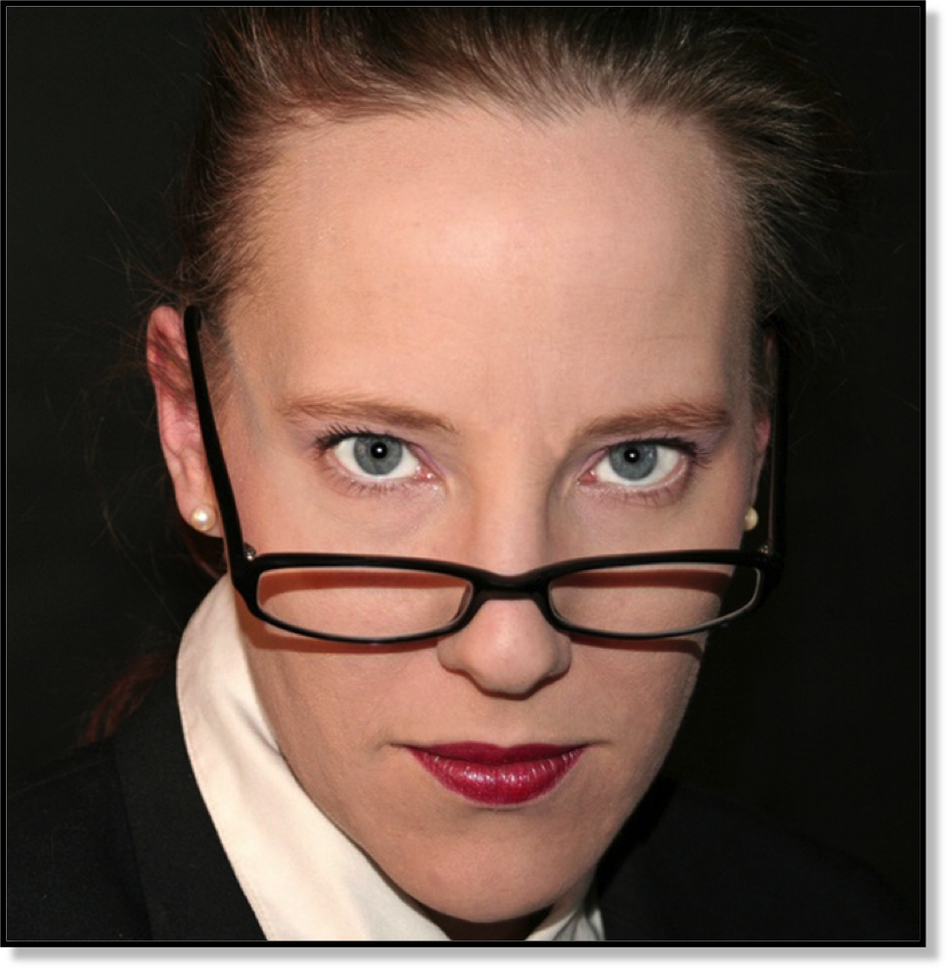
78
BODY LANGUAGE
BUSINESS ETIQUETTE TOOL KIT™
Notes:
If you wear glasses, don’t get in the habit of looking up over the top of the frames at people. This can communicate disapproval, arrogance or disdain. When your glasses slip down the bridge of your nose, it’s best to put them back where they belong. If they won’t stay put, visit an optometrist for an adjustment.
Minding Your Manners Everyday Matters: page 35, 36

Slide 79
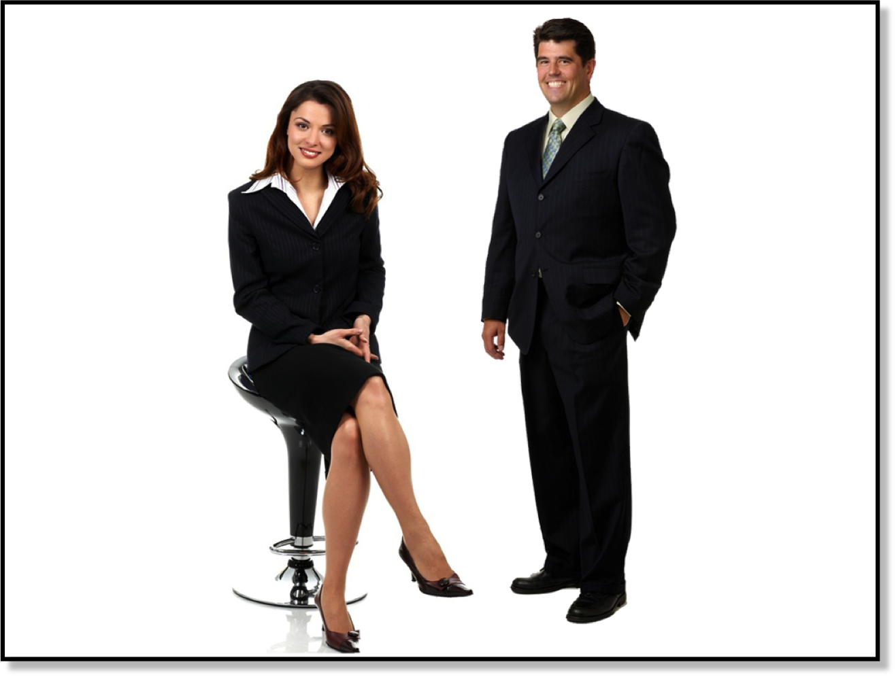
BODY LANGUAGE
79
BUSINESS ETIQUETTE TOOL KIT™
Notes:
If you want to be a more successful communicator, develop your awareness of body language and use your own body language as a tool to reinforce what you say. Always strive to send consistent messages.
Minding Your Manners Everyday Matters: page 35, 36

Slide 80

@Loremipsum
@Loremipsum
@Loremipsum
Notes:
In this workshop, we have covered many rules of business etiquette and strategies that will help you succeed at work. These soft skills will also help you appear more confident and appropriate in any professional environment. There are many more rules of business etiquette and, as technology evolves, new rules will continue to be established. When in doubt about appropriateness, always ask yourself what it would be like if everyone behaved that way? Then act accordingly.
The right image can make the difference between just getting by and really succeeding. Image isn’t about brown-nosing, or about being fake or artificial. It’s about being versatile and having the ability to make a good impression in any situation.
I’m sure that, in your work, you all make every effort to present your company’s products or services in the most professional manner possible. By mastering these business soft skills, you will make a positive statement in any business environment.
Call to Action: Here is your challenge. Be aware of how your actions, words, and gestures may impact others. Make a commitment to show respect to everyone you interact with, then focus on your work and enjoy the rewards.

