Slide 1

PROFESSIONAL POLISH
Dressing for Work
in the 21St Century
COPYRIGHT PERSONALIMPACTINT. 2018
Notes:
Welcome to Professional Polish. Dressing to Win in the 21st Century. My name is your name. I am title, credentials, etc. Let’s start out by reviewing what we will be covering in today’s workshop.

Slide 2

2
TODAYS WORKSHOP
WHY IMAGE MATTERS
DRESSING TO WIN IN THE 21ST CENTURY
Notes:
In this program we are going to start by discussing ‘Why image matters”. We’ll start by identifying the basic components of image and break them down. Then we will end this section by talking about the Power of Personal Appearance.

Slide 3
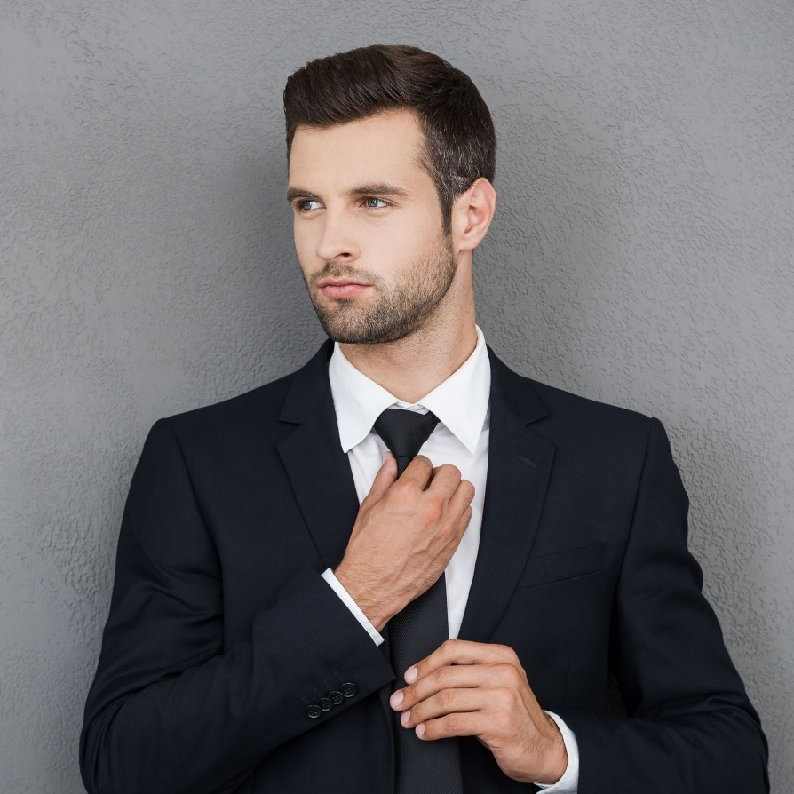
3
TODAYS WORKSHOP
COMPONENTS OF
BUSINESS ATTIRE
DRESSING TO WIN IN THE 21ST CENTURY
Notes:
Next, we are going to talk about the components of professional attire, in other words, what to wear, and when to wear it. We are going to identify the three most globally accepted categories of professional attire. Then, we are going to discuss how to appear more authoritative, credible, approachable, and relaxed. Finally, we will discovery which situations and job titles may be appropriate for each category of business attire.

Slide 4
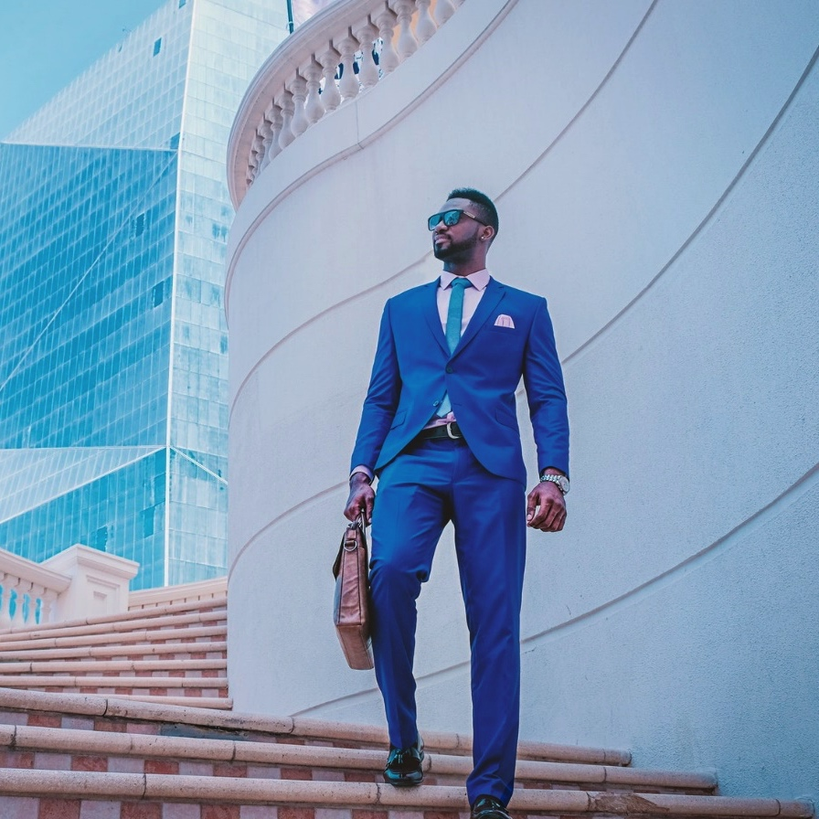
4
TODAYS WORKSHOP
THE POWER OF COLOUR
DRESSING TO WIN IN THE 21ST CENTURY
Notes:
We are going to talk about the power of colour, and how to effectively wear it for business. In this section, I will show you the most universally effective business colours. I will also provide suggestions on how and when to wear other colours.

Slide 5

5
TODAYS WORKSHOP
IMAGE MAKERS
DRESSING TO WIN IN THE 21ST CENTURY
Notes:
Then we will talk about image makers. Image makers are the details that make you look like a million-bucks in the business world. We are going to talk about the importance of tailoring and how to wear clothing appropriately for a classic professional look. Next, we’re going to cover appropriate accessories for work and how to identify them.

Slide 6
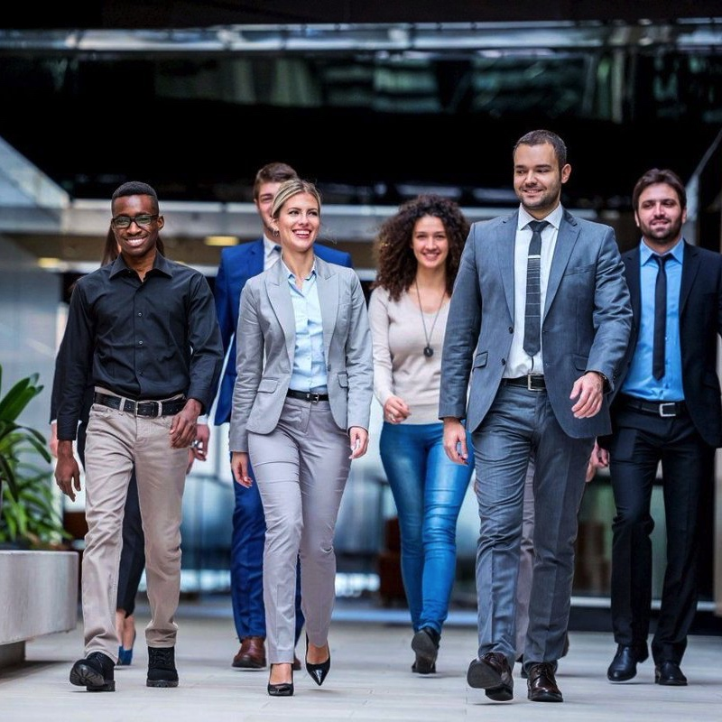
6
TODAYS WORKSHOP
IMAGE BREAKERS
DRESSING TO WIN IN THE 21ST CENTURY
Notes:
Then we will finish off image breakers. Image breakers are those costly mistakes that people make when dressing for work. I will show you how to avoid them. We will also talk about the importance of grooming, and hygiene, and how to get it right. So, let’s get started.

Slide 7

IMAGE?
Notes:
Ask Participants: When you hear the word ‘image,’ what does it mean to you? [DISCUSS THE DEFINITION OF THE WORD ‘IMAGE’].
The dictionary definition for image is “The concept of someone or something that is held by the public.” So, image is the overall impression that others have of you. Many different things contribute to your image, such as verbal communication, non-verbal communication, and visual communication. Verbal communications consists of the words you use and how you use them. Non-verbal communication comprises your body language and how you carry yourself. Finally, visual communication is your personal appearance, your grooming, what you wear and how you wear it. So, today we are going to be discussing the topic of visual communication.
Ask participants: I want you to think about a time when you saw a businessperson who looked very important. You had no idea who they were, but something about them made you think they were an important person. Thinking back, what was the first thing that stood out to you about that person that impressed you and made you believe they were important? [Open Discussion.]
If your thinking it was their personal appearance and how they were dressed, you are not alone.
When we meet someone for the first time, our first impression is usually based on what we see. It has been suggested that how we appear accounts for about 55% of the impressions that we make about people.
Dressing to Win in the Workplace: Page 4

Slide 8
8
DAVID SCHWARTS
How we look on the outside affects how we think and how we feel on the inside. It also affects how we act and how others react or respond to us.
©personal impact 2019
Notes:
According to David Schwarts, author of ‘Magic of Thinking Big,’ “How we look on the outside affects how we think and how we feel on the inside. It also affects how we act, and how others react or respond to us.”
Every time you meet someone new, you are evaluated by that person. They will look at your clothing, your hairstyle, and your accessories, and they will notice how you are groomed and how you carry yourself. And what happens is we tend to assess and then make judgments about each other.
We might make judgements about the kind of person they are based on whether we like the way they are dressed. We might think about how much money they make, how old they are, or even whether they should be trusted.
So, essentially, there is a correlation between how we package ourselves and how others perceive us.

Slide 9
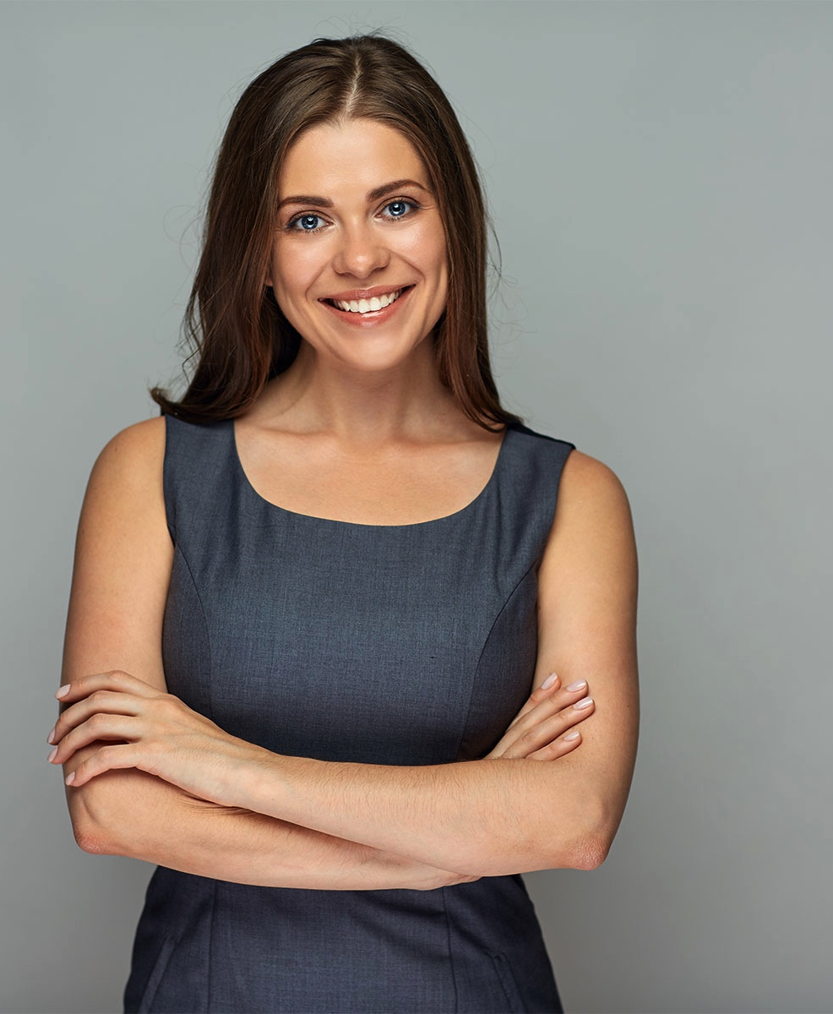
9
FIRST IMPRESSIONS
©personal impact 2019
Notes:
Tell participants: As an example, I am going to show you pictures of two women. I want you to look at each picture and think about the first thoughts or words that come into your mind when you see each woman. [Open Discussion.]
Ask participants: What are some of your first impressions of this woman? [PARTICIPANTS WILL SAY THINGS LIKE: YOUNG, PRETTY, FRIENDLY, NICE, EASYGOING, ETC.]
Now I am going to show you another picture.

Slide 10
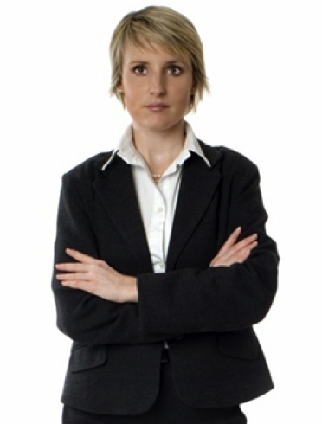
10
FIRST IMPRESSIONS
©personal impact 2019
Notes:
Ask participants: Now, think about your first impressions of this woman. Are they the same as they were for the first woman or are they different? [PARTICIPANTS WILL LIKELY SAY THINGS LIKE: FORMAL, NOT FRIENDLY, BAD MOOD, SNOB, STERN, INTIMIDATING, ETC.]
Even though we don’t know either one of these women, each of us will have developed our own opinions about them.

Slide 11

11
FIRST IMPRESSIONS
©personal impact 2019
Notes:
Ask participants: So, let me ask you this. If you just arrived in [NAME A CITY PARTICIPANTS WOULD BE FAMILIAR WITH BUT LIKELY HAVE NOT VISITED] and were feeling really jetlagged and dying for a coffee. While trying to find the nearest Starbucks, which one of these women would you be more likely to approach to ask for directions? [MOST PARTICIPANTS WILL SAY WOMAN #1]
In my experience, most of my clients would select the woman on the left. This is because the woman on the left appears more friendly, approachable, and easy-going compared to the woman on the right, who may be a very nice person, but comes across as more intimidating, less approachable and perhaps less receptive.
These appraisals are made constantly in both business and personal situations. Initially, even if you haven’t even spoken yet, within the first few seconds, people will have already formed their initial impressions about you. If your personal appearance has made a good impression, you will attract their attention and keep it. If you make a poor impression, you will either attract their attention for the wrong reasons or lose their attention, which is hard to get back.
This is true any time we meet people for the first time, including any professional setting.
Even though we would all like to be judged on our ability or on our personality, when meeting face-to-face, initially we are judged by what people see.
Now I am not saying that your personal appearance is everything in the process of selling your product or moving up the corporate ladder. However, it does go a long way during the selection process when clients or employers are making a decision. If you don’t look appropriate, your employer or potential client may assume that you don’t have what it takes.
Like it or not, your appearance may be considered an indication of the quality of your work. A shabby appearance may be interpreted as being careless. On the other hand, respecting your appearance is an indication that you respect yourself, and may imply that you care about the quality of your work.

Slide 12
12
JOHN MOLLOY
How one appears on the job is the single most important factor in a person’s professional success
©personal impact 2019
Notes:
According to another well-known author and consultant, John Molloy, author of the book series ‘Dress for Success,’ “How one appears on the job is the single most important factor in a person’s professional success.”
People who know how to use their image as a business tool have an immediate advantage over their competitors, with respect to bringing in new business and job effectiveness.
So, the question is about whether you like what your image says about you and whether your image is appropriate for your job and your goals. Any image is ok, as long as it helps you achieve your goals.

Slide 13
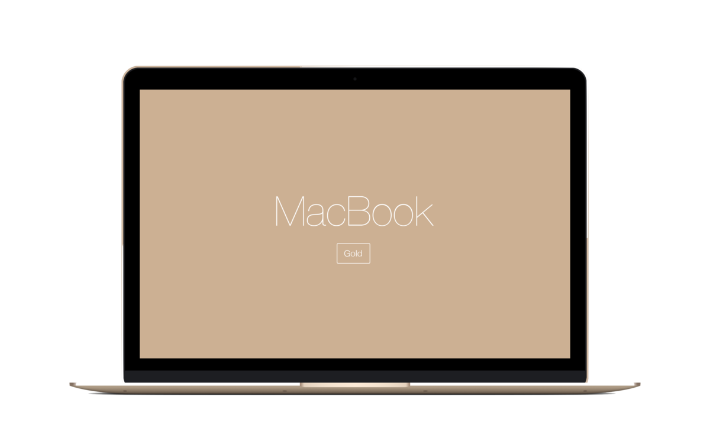
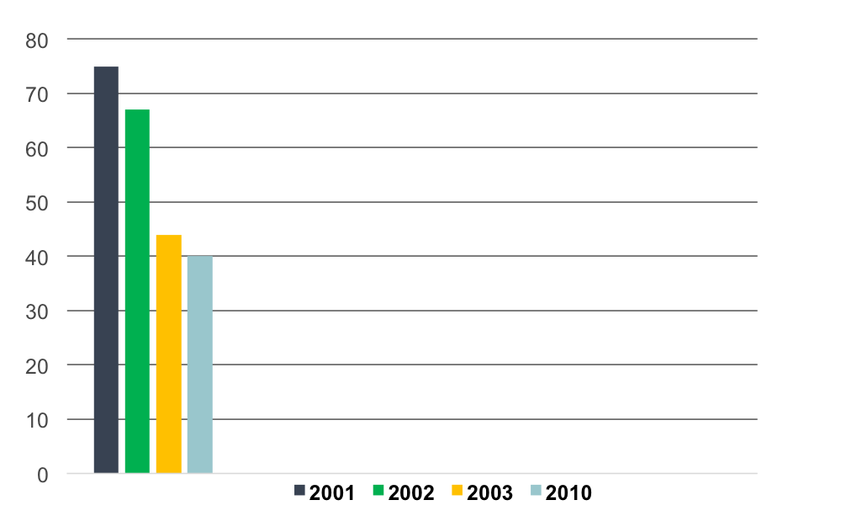
13
BUSINESS ATTIRE TREND
©personal impact 2019
Notes:
Before the 1990’s, dressing for success in the corporate world was easy. Men wore suits and ties. Women wore either a business suit or a skirt and blouse. Then along came Business Casual Attire. During the 1990’s in North America and other parts of the world, more and more companies began to allow their employees dress more and more casually, until this trend finally peaked in 2001. Since then, this trend has been slowly declining. Based on these and other statistics, the trend is continuing to move in the direction of a more formal approach to dressing for business. Expectations for a business casual wardrobe have become more formal than they were in 2001.
Still, many people are more confused then ever about what a business wardrobe should look like.

Slide 14
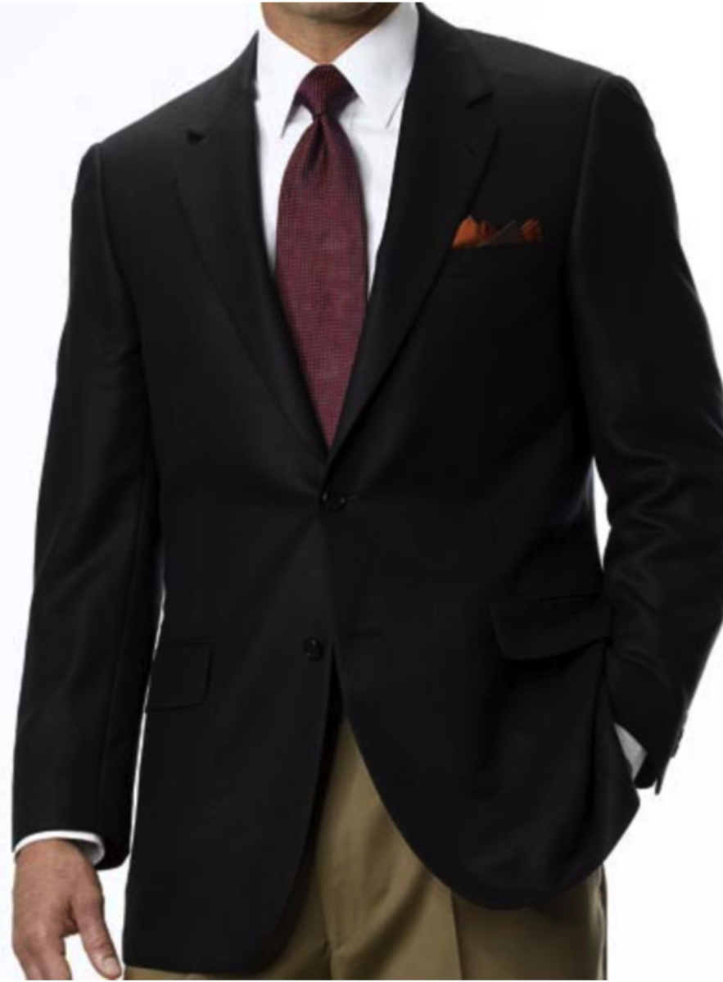
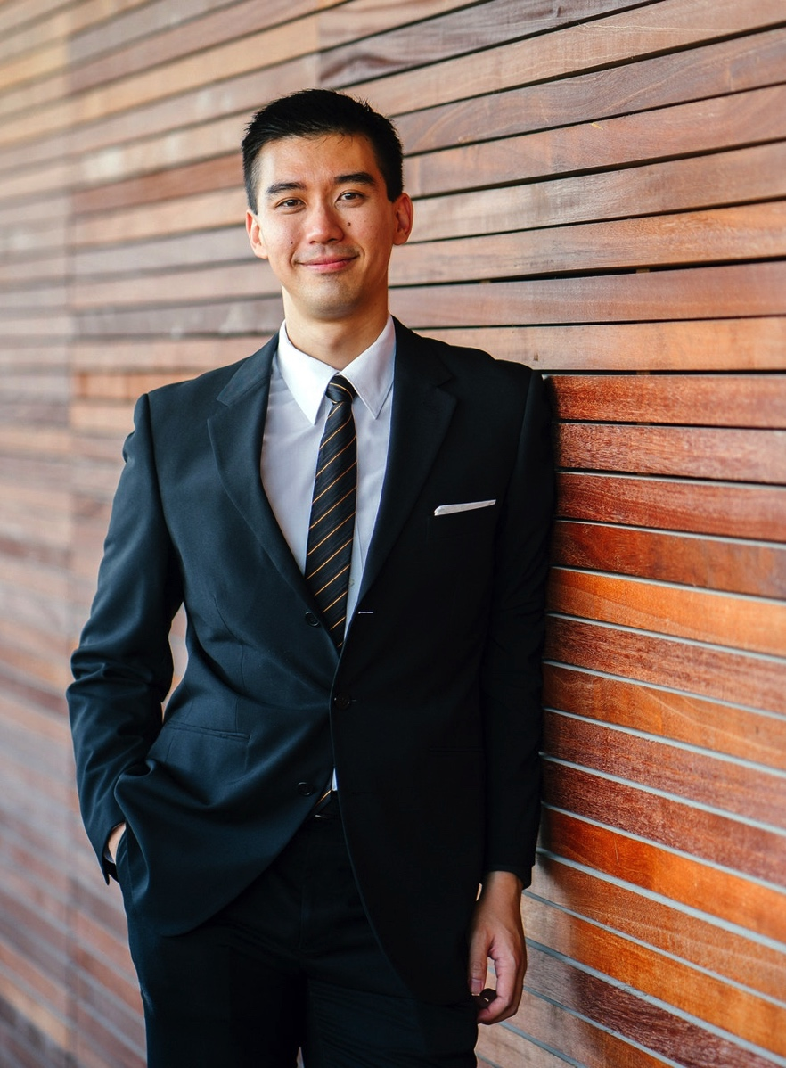

14
3 CATEGORIES PROFESSIONAL ATTIRE
©personal impact 2019
Notes:
Ask participants: Now I want you to think for a moment, if we think of these categories as a continuum from most formal to most informal, which of these dressing styles would you say is the most formal? The one on the left with a man in a tailored jacket and a bottom in a different colour and fabric; the one in the middle with the man in a matching tailored jacket and bottom; or the man on the right that is not wearing a jacket? [PARTICIPANTS WILL LIKELY SAY THE CATEGORY IN THE CENTRE WITH THE MATCHED SUIT.]
Most would agree that the category in the center is the most formal category. So, the matched business suit is the most formal, commonly known as Formal Business Attire.
Ask participants: So, we know that the most formal category is the matched business suit. Now let me ask you this – which category do you think is the most informal or casual? Would you choose the one on the left with the man in a tailored jacket and a bottom in a different colour and fabric; or the one on the right without a jacket? [PARTICIPANTS WILL LIKELY SAY THE CATEGORY WITHOUT THE JACKET.]
Most would agree that Informal Business Attire is the category on the right, with the man who is not wearing a jacket.
Dressing to Win in the Workplace: page 5-7

Slide 15
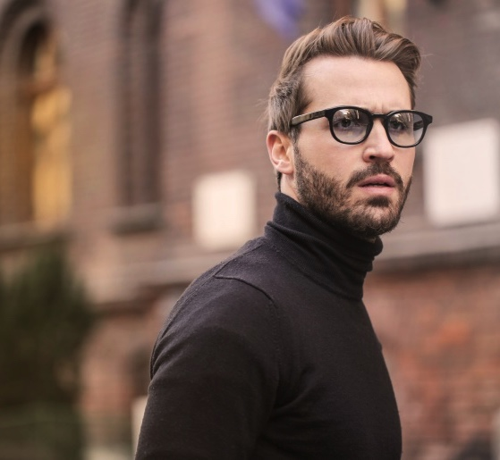
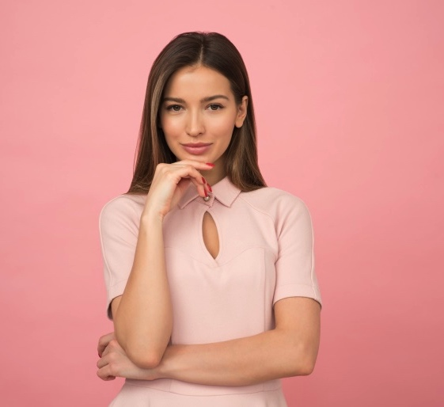
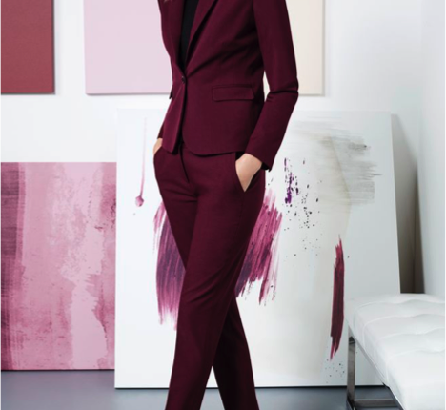
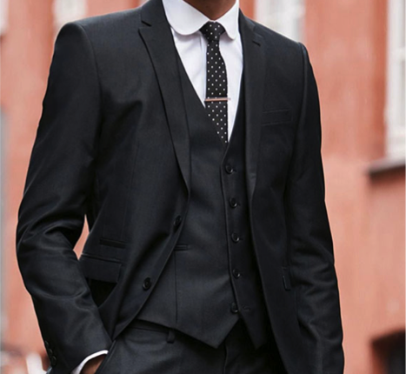
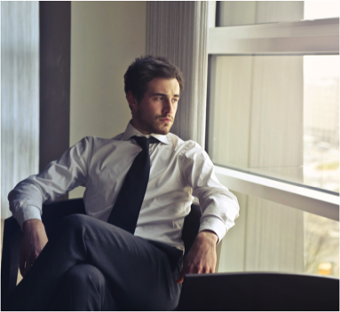
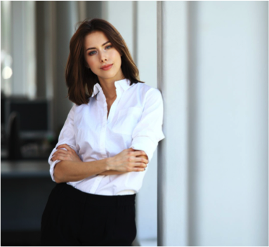
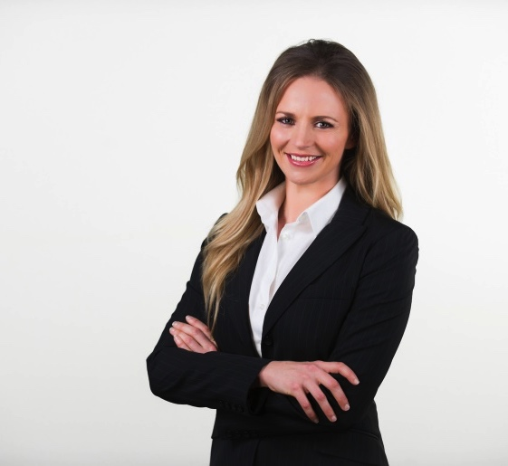
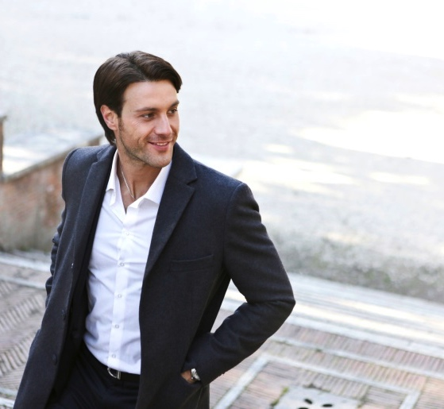
15
INFORMAL
FORMAL
©personal impact 2019
Notes:
So, lets compare these two categories. As you can see, the formal category consists of a matched business suit, which contains predominately tailored design details. Tailored details are form fitted. They appear structured, with straight lines, angular shapes, firm fabrics and smooth textures.
Dressing to Win in the Workplace: Page 5- 8

Slide 16
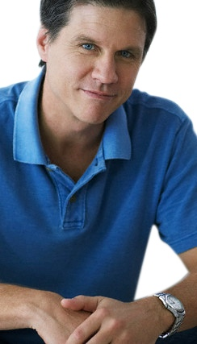

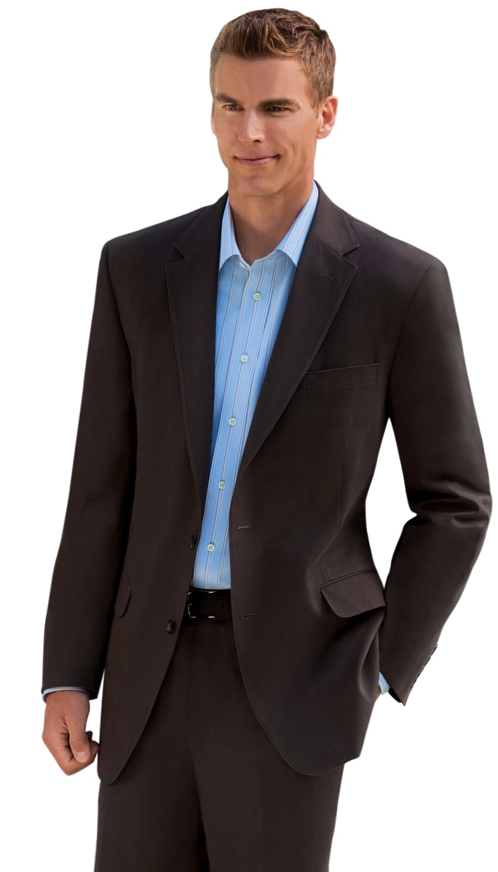
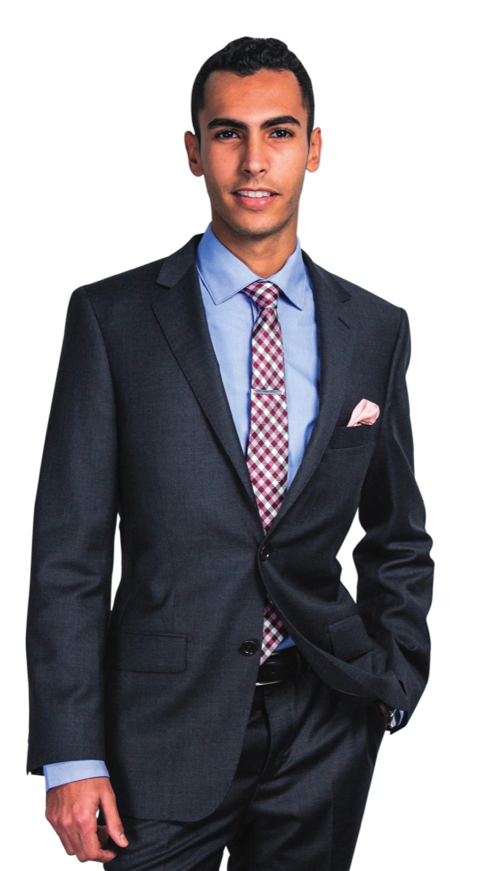
16
SHIRT COLLAR
©personal impact 2019
Notes:
In each category, men are wearing collared shirts. For a professional look, men should always wear a collared dress shirt, a knit shirt, or a lightweight sweater with a collar unless you know for sure an un-collared shirt is permitted in the company dress policy. For the most formal professional appearance in any category, men would wear a necktie.
Dressing to Win in the Workplace: Page 8 & 10

Slide 17
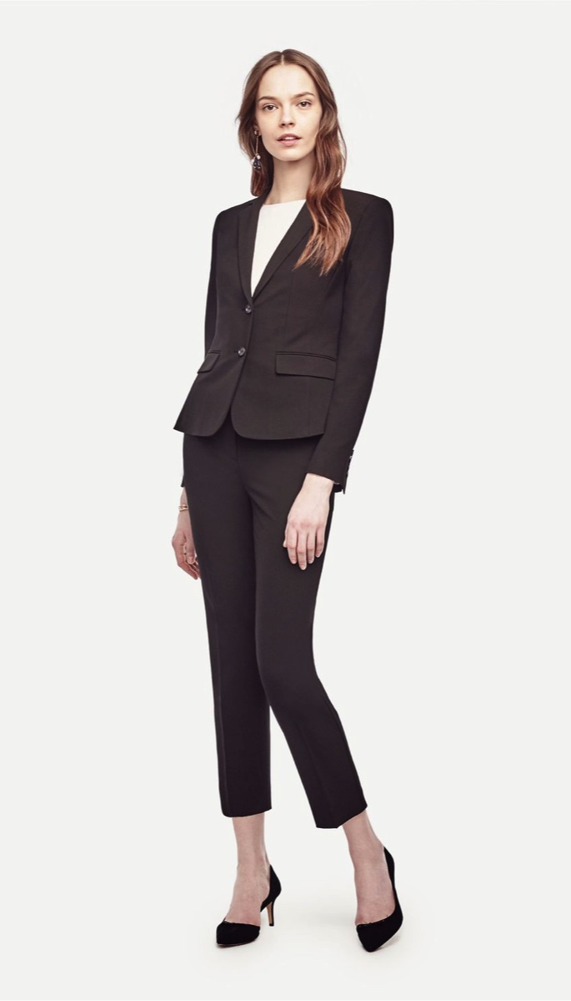
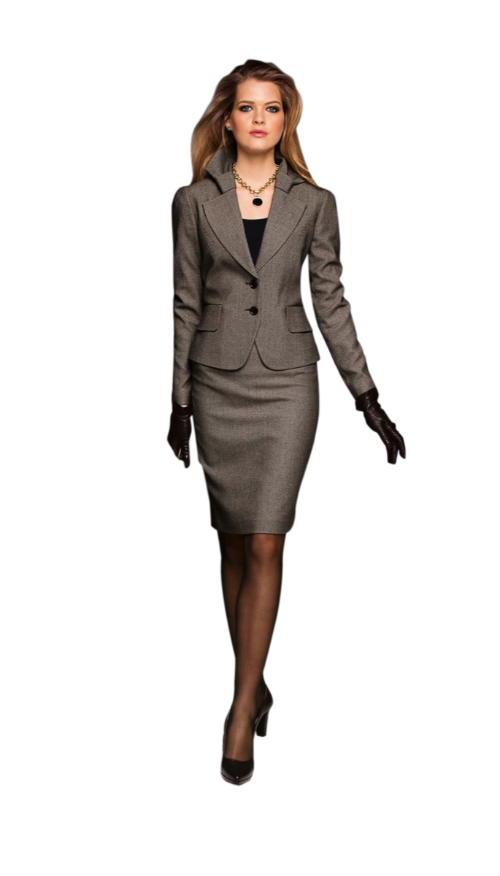
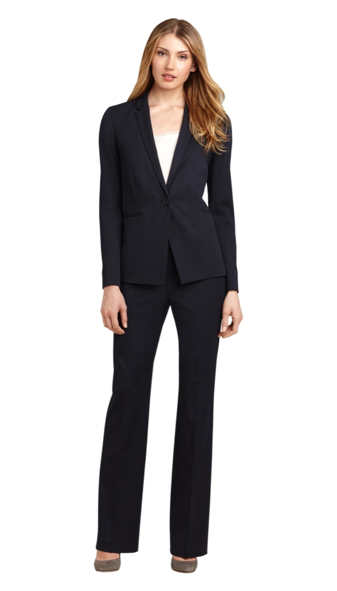
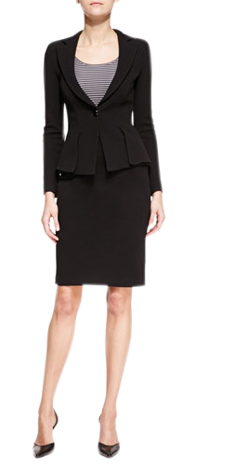
17
FORMAL BUSINESS ATTIRE
©personal impact 2019
Notes:
A women’s business suit should include a tailored style jacket with a matching skirt, dress pants or a matching dress. A blouse, shirt, or lightweight knit top are acceptable. As you can see, the top does not require a collar, but it is important that the top coordinates with the tailored details of suit. It should be classic in style and the fabric should be lighter-weight and refined.
Dressing to Win in the Workplace: Page 5 - 8

Slide 18
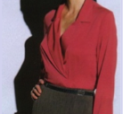
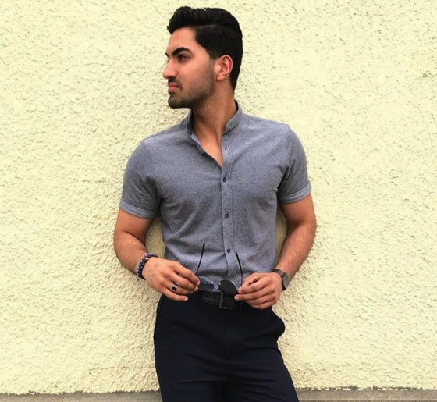
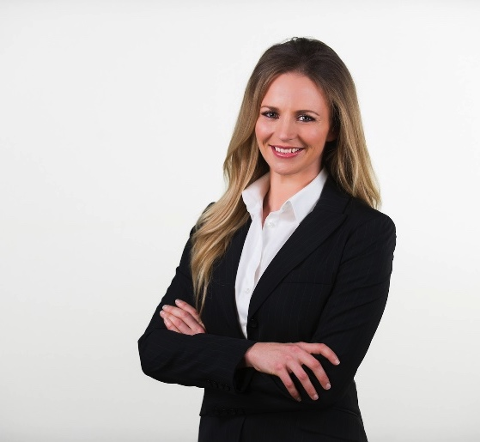
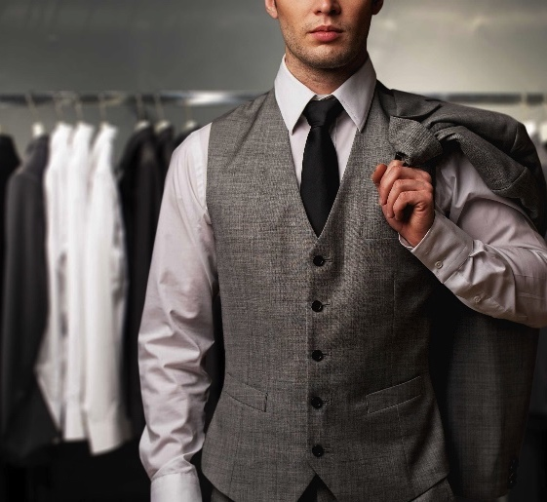
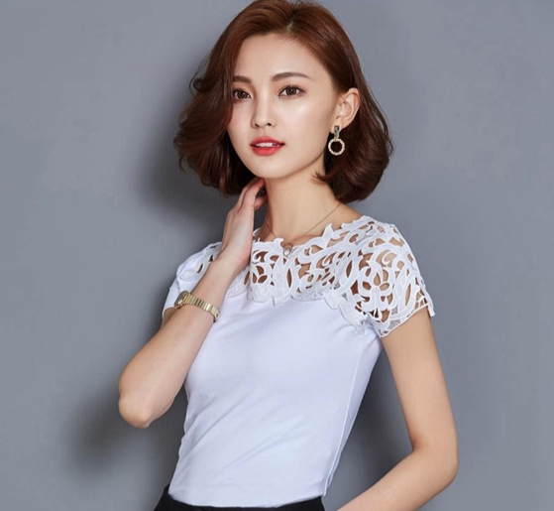
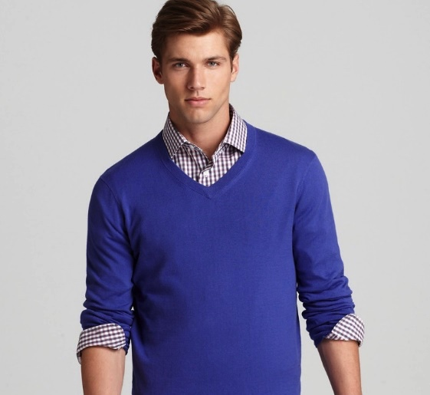
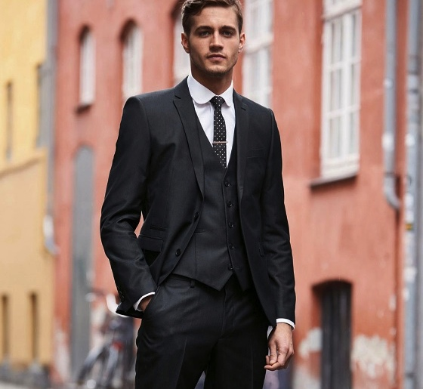
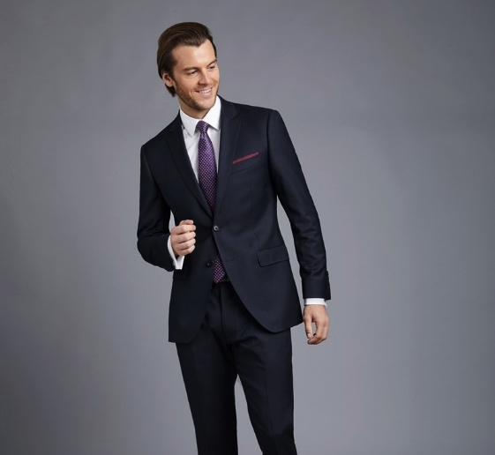
18
INFORMAL
FORMAL
©personal impact 2019
Notes:
Ask participants: I want you to think for a moment. What is it about the formal category with the matched suit that comes across as so much more formal than the informal category without the jacket? In other words, what visual messages do you think Formal Business Attire sends? [PARTICIPANTS WILL LIKELY SAY THINGS LIKE POWERFUL, SERIOUS, UNAPPROACHABLE, AUTHORITATIVE, PERSUASIVE, CONSERVATIVE, ETC.]
Dressing to Win in the Workplace: Page 8

Slide 19
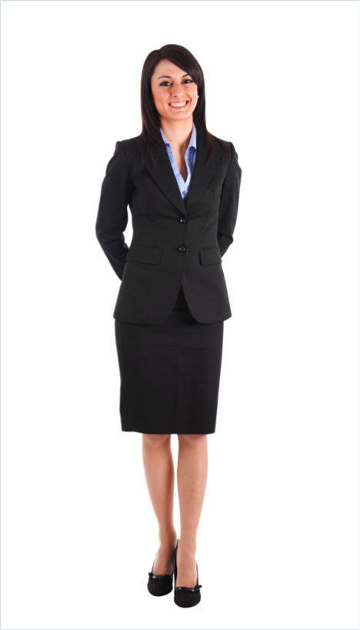
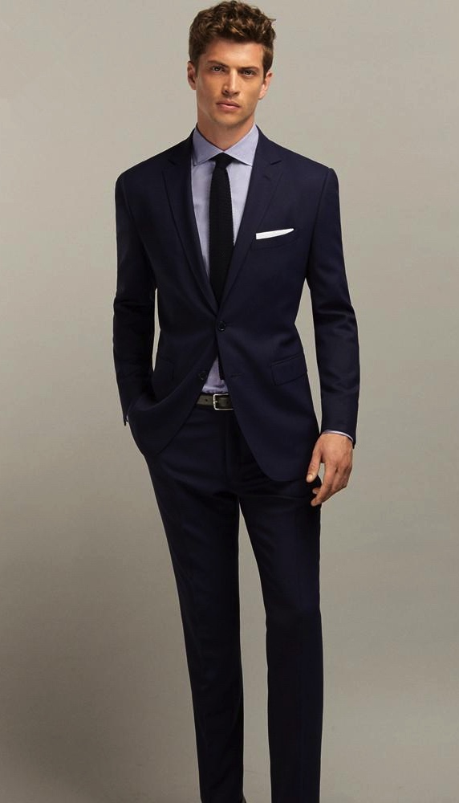
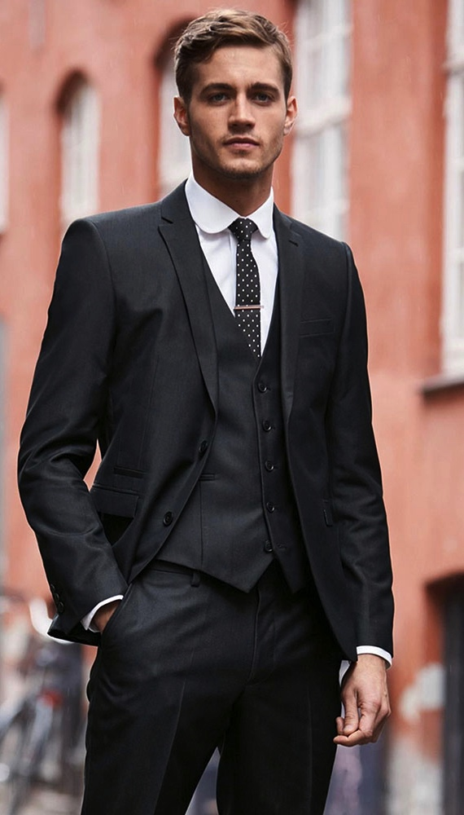
19
FORMAL BUSINESS ATTIRE
©personal impact 2019
Notes:
The matched business suit is an official look that sends a credible, stable, authoritative and persuasive message. It is influential, powerful, conservative, classic and precise. This is the most conservative category of professional attire. Again, it is called ‘Formal Business Attire’.
Ask participants: When do you think it would be appropriate to wear Formal Business Attire? [PARTICIPANTS WILL LIKELY SAY THINGS LIKE JOB INTERVIEWS, MEETINGS, ETC.]
Formal Business Attire is appropriate for any situation in which you want to position yourself as a leader or as an authority figure. It should be worn when the company expects Formal Business Attire, or when you need to match your client’s formality.
Dressing to Win in the Workplace: Page 8

Slide 20

20
FORMAL PROFESSIONS
Formal Business Attire may be suitable for professions such as:
  Executive positions
  Management
  Business Administration
  Finance
  Legal positions
©personal impact 2019
Notes:
A few of the positions for which Formal Business Attire may be suitable:
Executive positions, management, business administration, finance or legal positions.
Dressing to Win in the Workplace: Page 5- 8

Slide 21
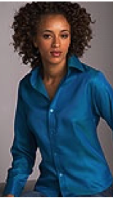
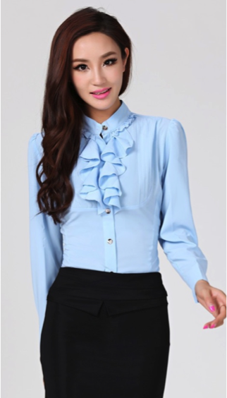
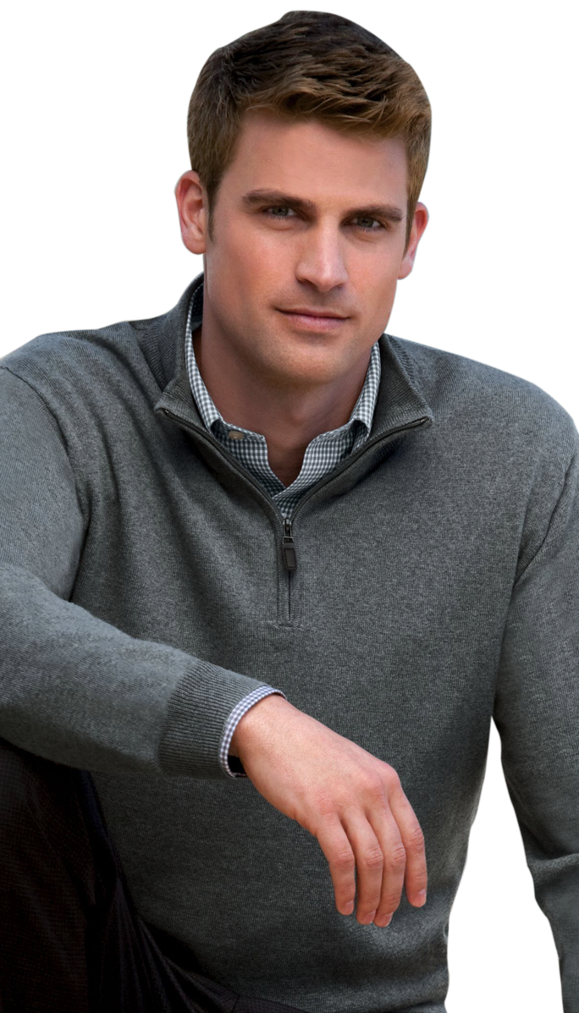
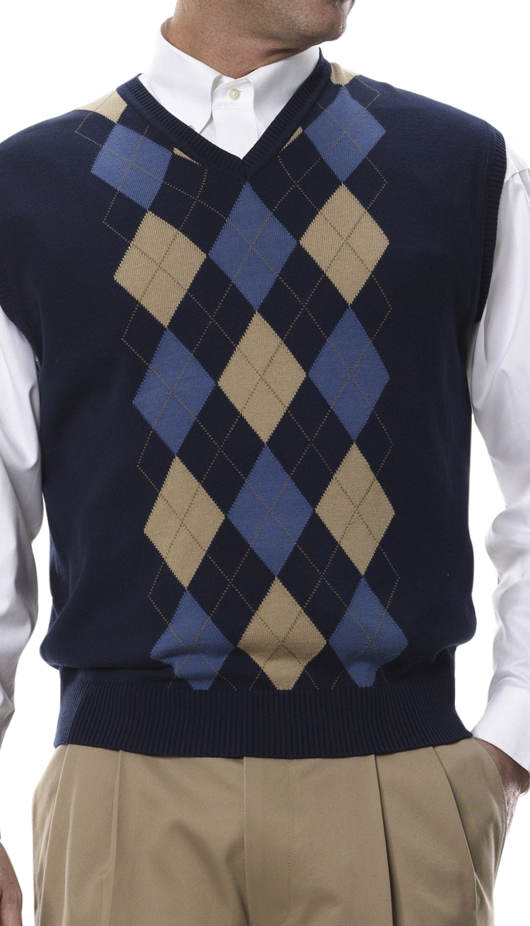
21
INFORMAL ATTIRE
©personal impact 2019
Notes:
As I mentioned, when no jacket is worn, this is considered Informal Attire. This category consists of one or more layers with predominately untailored details mixed with some tailored design details. Untailored details are less structured. They may have more texture or larger prints and patterns. The key garment detail in this category for a man would be the collar. Men should generally wear slacks with a collared dress shirt.
Although most companies prefer slacks, some companies will allow khaki’s, jeans or corduroy pants as long as they meet professional standards. Occasionally, cargo style pants may be permitted, but when permitted, they are generally part of a company uniform.
Dressing to Win in the Workplace: Page 5, 6, 7, 10

Slide 22
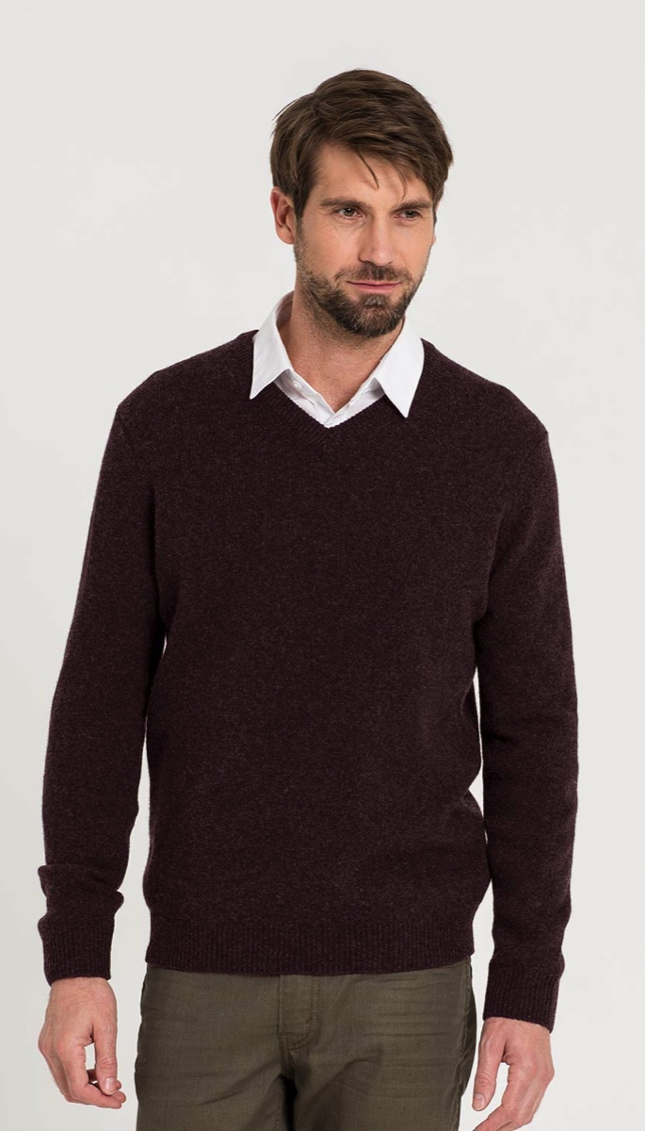
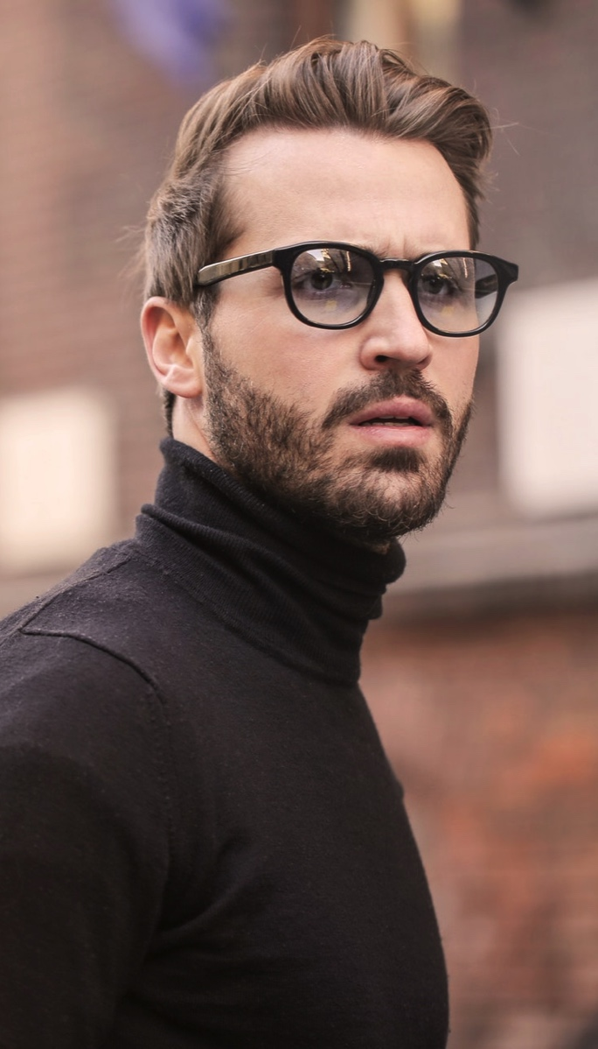
22
INFORMAL ATTIRE
©personal impact 2019
Notes:
For a more relaxed look, some companies may also allow a collared knit shirt or lightweight knit sweater. An example of this is a polo, golf style shirt or a turtleneck.
Some companies may require a tie for more formality while some may allow you to go without a tie.
A collared shirt may also be worn under a vest or sweater in some informal business environments.
Dressing to Win in the Workplace: Page 5, 6, 7, 10

Slide 23
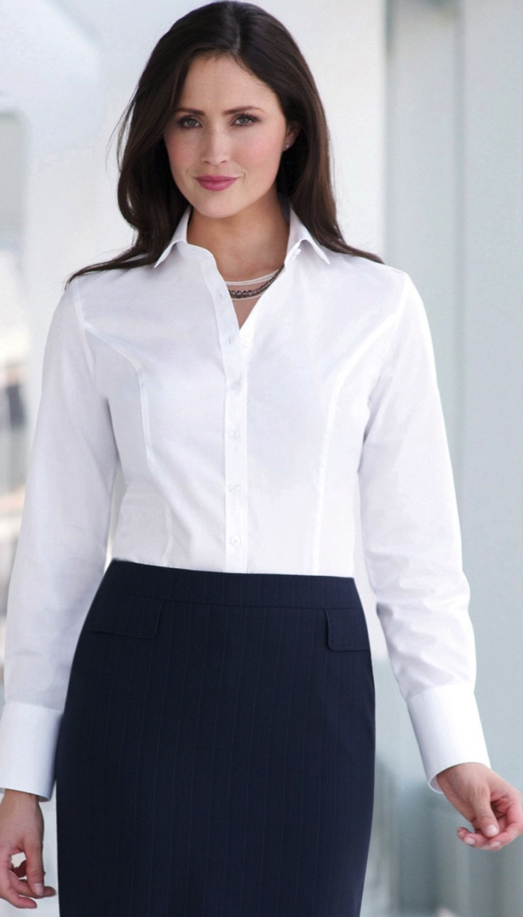
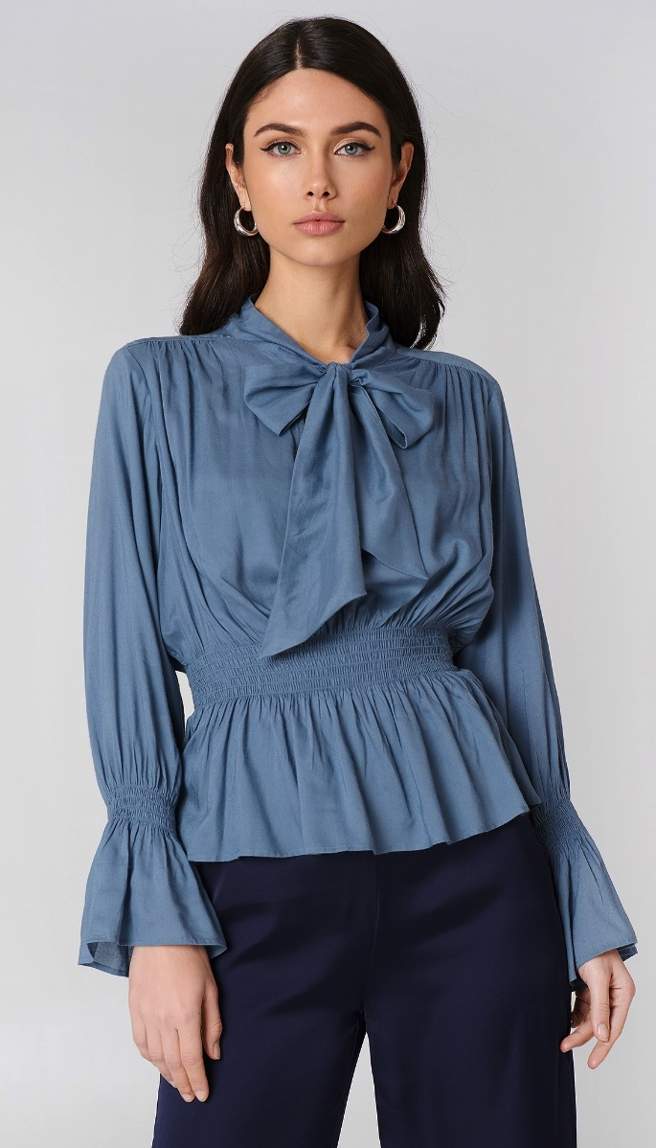
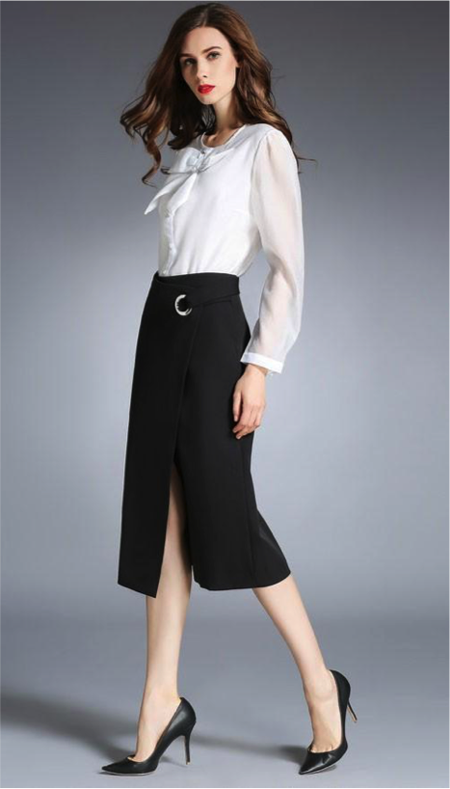
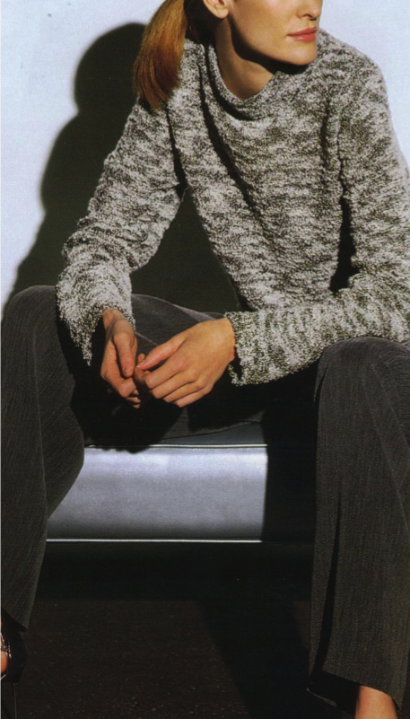
23
INFORMAL ATTIRE
©personal impact 2019
Notes:
Women do not need to wear a collar for this category, but they do need to wear something tailored in design on the bottom, such as dress pants, a straight skirt or A-line skirt.
Dressing to Win in the Workplace: Page 5, 6, 7, 10

Slide 24
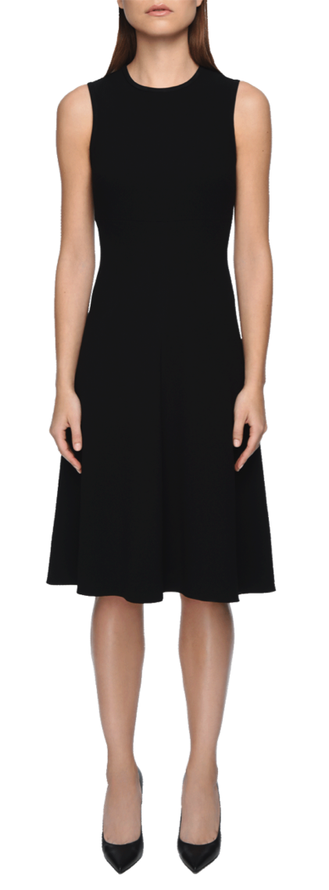
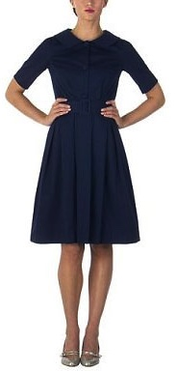
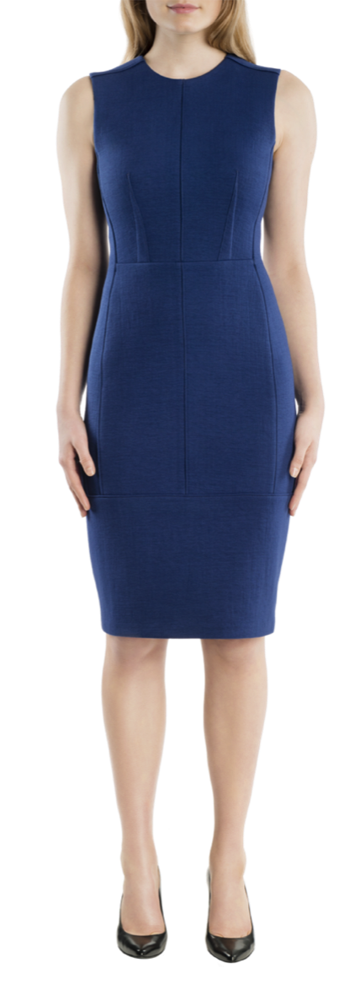
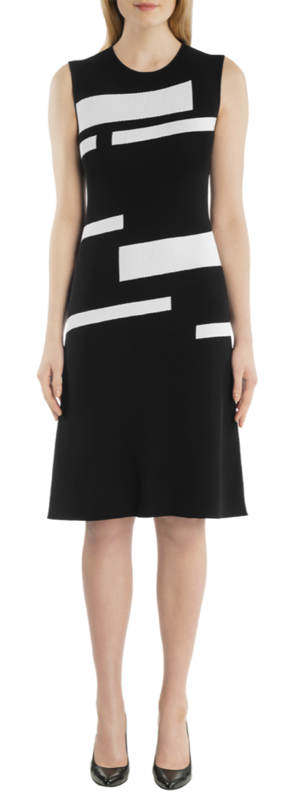
24
INFORMAL ATTIRE
©personal impact 2019
Notes:
A short sleeved or sleeveless dress would also fall into the informal category as long as it has some tailored elements and is in an appropriate fabric and style for business.
Dressing to Win in the Workplace: Page 5, 6, 7, 10

Slide 25
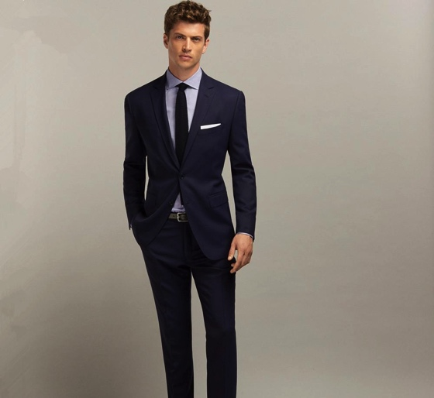

25
INFORMAL
FORMAL
©personal impact 2019
Notes:
Ask participants: If the perception of the matched business suit is authoritative, formal and persuasive. What visual messages do you think the informal category sends? [PARTICIPANTS WILL LIKELY SAY THINGS LIKE CASUAL, COMFORTABLE, EASY GOING, FUN, NORMAL, ETC.]
Informal Attire creates an unofficial, casual appearance. It’s functional, approachable, agreeable, friendly, easy going, comfortable and unstructured.
Dressing to Win in the Workplace: Page 10

Slide 26

26
INFORMAL PROFESSIONS
Formal Business Attire may be suitable for professions such as:
  Retail
  Technical
  Contractor
  Creative
  Communications
  Service
  Trades
  Food Service
©personal impact 2019
Notes:
Informal Attire is best when your company is informal, it fits your client’s culture, you are attending casual business events, or you are interviewing for an entry level job with a company that has an informal dress policy and you know a tailored jacket is not expected.
Some of the positions for which Informal Attire may be suitable are: Retail, a technician, a contractor, creative industries, communications, service, or trades & food services.
However, unless this category is part of a uniform or fit’s the company culture, it isn’t the category that will establish you as someone with a high level of authority and impress your employer or potential client. It would be appropriate to wear for work in a company that has adopted a business casual or informal dress policy and does not require a tailored jacket, or in situations where you want to appear relaxed or task-oriented.
Dressing to Win in the Workplace: Page 10

Slide 27



27
3 CATEGORIES PROFESSIONAL ATTIRE
©personal impact 2019
Notes:
Here again are examples of the three categories in women’s business wear. So, we now know that the most formal category is the matched business suit and the most informal category is a collared top combined with a tailored bottom. But, by taking some of the tailored design details of Formal Business Attire and mixing in some of the untailored details of Informal Attire, we can create a softer and more relaxed formal look. So, we have one category in between, called Semi-formal Business Attire. The key garment for this category is a tailored style jacket. Examples of this are a blazer or sport coat.
Dressing to Win in the Workplace: Page 5, 6, 9

Slide 28




28
SEMI-FORMAL BUSINESS ATTIRE
©personal impact 2019
Notes:
Here are some examples Semi-formal Business Attire. However, what we are really doing is creating an unmatched business suit by taking the tailored details of the jacket and wearing it with a bottom that is a different colour and/or fabric. The jacket adds straight lines, angular shapes, structure and formality to your business image.
Dressing to Win in the Workplace: Page 5, 6, 9

Slide 29




29
SEMI-FORMAL BUSINESS ATTIRE
©personal impact 2019
Notes:
For men, the jacket is generally worn with trousers or slacks along with a collared dress shirt and necktie for the most formal look in this category. Some companies may allow men to go without a necktie for a more relaxed look, some companies may also allow a collared knit shirt or sweater, and some companies may even allow an un-collared knit top in a refined fabric as long as a jacket is worn.
Dressing to Win in the Workplace: Page 5, 6, 9

Slide 30




30
SEMI-FORMAL BUSINESS ATTIRE
©personal impact 2019
Notes:
Women could wear dress pants or a skirt with tailored details. The shirt, blouse or sweater may be collared or un-collared, as long as it coordinates with the tailored look of the jacket and bottom.
Women may also wear a dress without a jacket if it has long sleeves or ¾ length sleeves, has tailored details and is an appropriate fabric.
Dressing to Win in the Workplace: Page 5, 6, 9

Slide 31




31
SEMI-FORMAL BUSINESS ATTIRE
©personal impact 2019
Notes:
Some companies may even allow both men and women to wear dark denim jeans or corduroy pants instead of trousers, slacks, or a skirt with a jacket for dress-down days.
Dressing to Win in the Workplace: Page 5, 6, 9

Slide 32

32
SEMI-FORMAL COMMUNICATES
Is Softly Tailored and is perceived as:
  Semi-Authoritative
  Semi-Approachable
  Polished
  Influential
  Capable
  Credible
  Dependable
  Less Formal
©personal impact 2019
Notes:
The semi-formal category is a softly tailored look that is semi-authoritative. It comes across as semi-approachable and polished. It says influential, capable, credible and dependable, but appears more receptive and less formal than a matched business suit.
So, you are probably wondering when it is appropriate to wear this category. Well, it is appropriate for situations when you want to be perceived as more relaxed than the formal category, while maintaining a certain level of authority.
What I really like about this category is that it is the most flexible category. It flows between the formal category and the informal category. This category is highest level of business attire used in an informal business environment and also fits nicely in a relaxed formal business environment.
Interactive Exercise: Discuss career positions for Semi-formal Business Attire.
Ask Participants: What kinds of career positions might be appropriate for the Semi-formal Business Attire category? [OPEN DISCUSSION]
Dressing to Win in the Workplace: Page 9

Slide 33

33
SEMI-FORMAL PROFESSIONS
Semi-Formal Business Attire may be suitable for professions such as:
  Communications
  Marketing
  Sales
  Service
  Retail or Hospitality Management
  Reception
  Customer Service
DRESSING TO WIN IN THE 21ST CENTURY
Notes:
Since this category flows between Formal Business Attire and Informal Attire it also has the most flexibility, except in the most formal business environments. A few industries it may be appropriate for are: Communications, marketing, sales, service, retail or hospitality management, reception or customer service.
The semi-formal category also works well when it fits with your client’s company culture or lifestyle, and when informal attire is expected yet you need to look more authoritative or you are interviewing for a job at a company with an informal dress policy.
However, if you are ever in a situation where you are not sure what to wear, I would advise you to dress-up a little. It is always better to over-dress than under-dress, especially if you are trying to make a good first impression.
Dressing to Win in the Workplace: Page 9

Slide 34
34
COLOUR
©personal impact 2019
Notes:
There are some other things to keep in mind when it comes to personal appearance that can make a huge difference in your professional image and can add or take away from your effectiveness. One of those things is colour.
Everyone has a psychological and physiological response to colour. A psychological response is how we respond to colour based on our upbringing, culture or personal taste. So, an example of a psychological response might be: “My mother made me wear pink every day when I was a little girl and now, I can’t stand pink!”
Physiological responses are a bit different. Colours are made of energy, so it is important to understand that the energy of different colours and how they affect us and the people around us in different ways.
So, it’s not only important to dress in appropriate clothing styles for business, but it’s also important to dress in appropriate colours based on the message you want to communicate, and on how you want people to react to you.
Dressing to Win in the Workplace: Page 24 - 25

Slide 35




35
SERIOUS COLOUR
©personal impact 2019
Notes:
Darker colours, especially dark cool colours, are considered the most formal colours and generally work well for business because they are perceived as the most serious. They communicate authority, maturity, stability and dependability. The darker the shade of any colour, the more reliable you appear.
Dressing to Win in the Workplace: Page 24 - 25

Slide 36


36
NAVY & CHARCOAL GREY
©personal impact 2019
Notes:
However, there are two colours that are considered to be the most effective colours for business: charcoal grey and navy blue. This is because blue conveys trust and grey conveys authority, so when you darken these two colours to navy blue and charcoal grey, they become effective colours for business, especially if you want to be perceived as serious about your work.
If you want to appear formal or authoritative, one of the most effective colour combinations for business is a dark matched suit with a light-coloured shirt or blouse. Men should wear a bright coloured tie and women should wear simple accessories and make-up. This works because the eye is drawn to contrast. So, when you wear this colour combination, you are not only perceived as serious, but the eye is drawn to your face, making you appear even more authoritative.
Dressing to Win in the Workplace: Page 24 - 25

Slide 37


37
BLACK
©personal impact 2019
Notes:
Ask Participants: How many of you like Black? [MOST WILL LIKELY RAISE THEIR HAND.]
In my opinion, black is a great colour. It is dramatic, makes us look slimmer, hides our flaws and can be mysterious. However, because black is the darkest colour, it is also the most authoritative colour. So, because it is so authoritative, too much black be intimidating and unapproachable in a business setting.
So, I usually recommend to my clients that, if you like black but don’t want to appear overly intense or intimidating, break it up so that you are wearing a black jacket with different coloured bottoms or vice-versa.
Women have a little more flexibility with black, but it is still important to monitor how people respond to you.
Dressing to Win in the Workplace: Page 24 - 25

Slide 38




38
DEPENDABLE COLOUR
©personal impact 2019
Notes:
Many of us have worked in situations where we want to be perceived as more approachable yet still credible and effective. Examples of this might be customer service, sales or working on a team project. If you want to come across as a team player, or a little more approachable, yet still credible and dependable, choose medium muted colours and neutrals. Muted colours and neutrals are more approachable than dark colours, yet still appear credible.
Dressing to Win in the Workplace: Page 24 - 25

Slide 39




39
CALMING COLOUR
©personal impact 2019
Notes:
Lighter colours and pastels send a message that you care, and they have a calming affect on others. They tend to work well in environments where you need to be perceived as gentle and reassuring. Examples of this are working in health care, with young children or with the elderly. This is particularly effective when worn in lower contrast or monochromatic combinations.

Slide 40




40
ENGERGIZING COLOUR
©personal impact 2019
Notes:
Bright colours raise the energy level in a room, blood pressure and brain activity. They grab your attention and keep it. However, because they are such powerful colours, a little goes a long way.
They tend to work best in more progressive work environments unless they are worn as accent colours. I suggest that men in more conservative business environments limit this to a brightly coloured tie. An example of when a bright coloured shirt or blouse would be effective would be if you were working in an informal environment on a team where you are brainstorming or need interaction, such as professional team sports. Another example might be if you are presenting an idea and you want to keep your audience from falling asleep.
Again, women have more flexibility then men. However, for both men and women, extremely bright colours such as florescent colours and metallic colours, with the exception of metal accessories, have no place in the workplace. So, it is most important to remember how others may react to colour and use this to help you achieve your goal.
Dressing to Win in the Workplace: Page 24 - 25

Slide 41


41
PRINTS & PATTERNS
©personal impact 2019
Notes:
While on the topic of colour, let’s talk about fabrics, prints and patterns.
The most effective fabrics, prints, and patterns for business are the same for both men and women. Natural fabrics like wool, cotton and silk, or natural fabrics with a small percentage of synthetic fibres, are considered more professional. Outer garments made of structured, matte fabrics are considered more professional than shiny, flimsy or clingy fabrics.
Solid colours and traditional men’s wear patterns, such as hound’s tooth, herringbone, plaids and tweeds and patterns such as geometric, checks and stripes, are considered more serious in a business setting.
Dressing to Win in the Workplace: Page 6, 11

Slide 42




42
PRINTS & PATTERNS
©personal impact 2019
Notes:
Foulards also work well. If you like softer patterns, swirled non-descriptive patterns and paisley work well. Smaller prints and patterns are considered more formal than larger ones.
Dressing to Win in the Workplace: Page 6, 11

Slide 43

43
FLORAL PRINTS
DRESSING TO WIN IN THE 21ST CENTURY
Notes:
Some patterns don’t work as well in the workplace and floral prints are one of them. Floral prints are generally considered more feminine and less professional. However, if you like floral prints and want to present yourself as more authoritative, I suggest you wear them only in small areas, such as a blouse or a necktie, or wear them only in more informal work environments.
Dressing to Win in the Workplace: Page 6, 11, 21, 22

Slide 44

44
ANIMAL PRINTS
DRESSING TO WIN IN THE 21ST CENTURY
Notes:
Animal prints say “I want to have fun”. However, because they are considered fun, the wearer may not be taken seriously as a professional.
Dressing to Win in the Workplace: Page 6, 11, 21, 22

Slide 45

45
NOVELTY PRINTS
©personal impact 2019
Notes:
It is also important to be careful with novelty prints. We most often see these on men’s garments, such as ties. However, because they are distracting and fun, the wearer may not be taken seriously. So, it’s best to wear the Mickey Mouse or Santa Claus necktie to social occasions rather than to work.
Dressing to Win in the Workplace: Page 6, 11, 21, 22

Slide 46

46
IMAGE MAKERS
©personal impact 2019
Notes:
So far in this workshop, we have discussed the importance of image and why it matters. We then broke down the components of professional attire and identified what to wear and when. Finally, we talked about the power of colour, fabric, prints and patterns. In this section, we are going to talk about image-makers. Image-makers are the details and finishing touches that can make an ordinary outfit look extraordinary. So, let’s get started.

Slide 47


47
MISFIT’S
©personal impact 2019
Notes:
One thing that can make your clothing look more professional is a good fit. How good or how bad a garment looks depends not only on the style, but also on how well it fits.
So, let’s talk about fit. Examples of poor fit include clothing that is too small or too tight, which emphasizes your body shape, draws attention to itself, and/or makes you look bigger. Clothing that is too big adds bulk, making you look frumpy.
Dressing to Win in the Workplace: Page 14, 21, 22

Slide 48


48
CLOTHING THAT FITS
Lengthening or shortening hemlines & Sleeves
Taking in side seams
Taking in waistbands
Adding shoulder pads
©personal impact 2019
Notes:
When something fits properly, the vertical seams should align to the shape of the body and the horizontal seams should be parallel to the floor. There should also be no wrinkles or pulling and hemlines and sleeve lengths should be the correct length.
If clothing doesn’t quite fit, a simple remedy is to have the clothing altered. It will instantly make you appear more professional and your clothing look more expensive.
To get the right fit, buy your clothing to fit the largest part of your body and then have the other parts altered to fit.
Some simple alterations include things like: lengthening or shortening hems or sleeves so that they are the right length for your body; taking in side seams on jackets, pants and skirts to give you a slimmer more fitted look; taking in waistbands to remove bulk around the waist; and adding small shoulder pads to help balance the top and bottom for those of us who are pear shaped.
Dressing to Win in the Workplace: Page 14, 21, 22

Slide 49

49
CLASSIC TAILORING FOR MEN
©personal impact 2019
Notes:
Women, have a little more flexibility than men do when it comes to clothing style and tailoring as long as it fits the body and is in an appropriate style. Business clothing for men doesn’t change as much year-to-year, so a classic tailored look will never go out of fashion. Let’s start by talking about some image-makers and classic tailoring for men.
Dressing to Win in the Workplace: Page 14 - 18

Slide 50

50
CLASSIC TAILORING FOR MEN
©personal impact 2019
Notes:
The current fashion trend for men is a slim cut suiting. Traditionally the hemline should cover the man’s seat. The jacket styles we see in todays fashion are a bit shorter than the classic style. However, for a formal or semi-formal business look, you will want to keep the hemline as long as possible. Also, when wearing suit jackets, sport coats, or blazers, the bottom button is always left open.
Dressing to Win in the Workplace: Page 14 -18

Slide 51


51
CLASSIC TAILORING FOR MEN
Wrong!
Right!
©personal impact 2019
Notes:
The jacket sleeve length should end at the wrist bone, at the break of your wrist. It should be at a length that leaves ¼ to ½ inch of shirt cuff to show.
Dressing to Win in the Workplace: Page 14 -18

Slide 52


52
CLASSIC TAILORING FOR MEN
Wrong!
Right!
©personal impact 2019
Notes:
When wearing classically styled trousers, the legs should fall in a straight line to the top of the heel with a slight break in front. The pant legs we see in men’s fashion today are quite narrow, but narrow pant legs should still be worn as long as possible without looking sloppy.
The waistband is worn at the waist, which for men is usually close to or just above the navel. The only exception to this is jeans, which, depending on the fashion trend, are sometimes worn slightly lower on the hips.
Dressing to Win in the Workplace: Page 14 -18

Slide 53

CLASSIC TAILORING FOR MEN
©personal impact 2019
Notes:
The highest quality dress shirts are made of 100% cotton with a high thread count. This provides the best look and feel. If you travel often, you may prefer cotton shirts with a small percentage of polyester or Lycra, which help make the shirt more wrinkle resistant. Some men like to wear an undershirt for a smoother look.
Dressing to Win in the Workplace: Page 14 -18

Slide 54

54
CLASSIC TAILORING FOR MEN
©personal impact 2019
Notes:
Your shirt cuff should fit the wrist and your shirt collar should fit the neck with enough room for two fingers to fit into the collar.
Dressing to Win in the Workplace: Page 14 -18

Slide 55
55
ACCESSORIES
NECKTIES HOSIERY SHOES
JEWELLERY WATCHES BELTS
HANDBAGS CARRY CASES
SCARVES GLASSES
POCKET SQUARES
GROOMING
ETC.
©personal impact 2019
Notes:
When dressing for work, the old saying ‘less is more’ is generally true. However, when it comes to accessories, ‘none’ looks boring. Like icing on a cake, accessories add personality, visual interest and pizzazz to any outfit.
Accessories come in many forms. Some examples of accessories include: shoes, handbags, jewelry, belts, scarves, neckties, glasses, pocket squares and hosiery. Grooming, which we will be talking about later in this workshop, is also a way to accessorize and finish your look.
Changing your accessories can instantly change the mood of an outfit. The correct accessory can change your look from casual to dressy, daytime to evening, or serious to fun. Because of this, it is important choose your work accessories carefully. So, let’s talk about accessories that work for work.
Dressing to Win in the Workplace: Page 12, 15, 16

Slide 56
56
NECKTIES
KNOT SIZE SHIRT COLLAR SIZE BONE STRUCTURE
SMALL | SMALL
MEDIUM | MEDIUM
LARGE | LARGE
©personal impact 2019
Notes:
For men, the necktie is one of the most important accessories for a tailored look, both inside and outside of the office. It adds interest and colour to an outfit. In addition, the vertical lines draw attention to the face and can have a slimming effect on the body.
The size of the knot should be in scale with and chosen based on the width of the tie, the size of the lapel, the size of the shirt collar and the man’s bone structure. Match small-with-small, medium-with-medium, large-with-large.

Slide 57

57
NECKTIES
©personal impact 2019
Notes:
Always coordinate your tie with the colours on your shirt, jacket or both. For a more formal look, the best fabric for ties is silk. Silk appears more luxurious and drapes well. As you can see, the necktie length should end at the center of the belt buckle. Above the belt is too short. Below the belt draws attention, well, below the belt.

Slide 58

58
4-IN-HAND
©personal impact 2019
Notes:
Here is a short video that demonstrates how to tie a 4-in-Hand tie knot. [VIDEO 2 MINUTES. OPTIONAL]

Slide 59
59
HALF-WINDSOR
©personal impact 2019
Notes:
Here is a short video that demonstrates how to tie a Half-Windsor tie knot. [VIDEO 2:15 MINUTES. OPTIONAL]

Slide 60
60
FULL WINDSOR
©personal impact 2019
Notes:
Here is a short video that demonstrates how to tie a Full Windsor tie knot. [VIDEO 2:12 MINUTES. OPTIONAL]

Slide 61


61
SOCKS
Right!
Wrong!
©personal impact 2019
Notes:
For a professional look, men should always wear socks to work, and they should be long enough to cover the shins when sitting so that no skin is showing.
When choosing your socks, think about what you will be wearing with them. The general rule is, the thinner the sock, the more formal the sock. When worn with suits and slacks, socks should be fairly thin. Thicker socks are more casual and not generally appropriate for business wear. Sport socks are generally not worn to work unless they are part of a uniform.
For a classic professional look, men’s socks in neutral tones that blend with your hemline are best. And, unless you’re a ‘Rock Star’, white socks should never be worn with dark pants and shoes.
Dressing to Win in the Workplace: Page 15

Slide 62




62
HOSIERY
Right!
Wrong!
©personal impact 2019
Notes:
For women, the key is to not try to be a fashion statement. Hosiery worn for work should never be distracting and should always worn with Formal Business Attire unless the company has approved no-hosiery. In hot climates or in summer weather, hosiery may be optional in some industries. But, if hosiery isn’t worn, the legs and feet must be groomed.
When hosiery is worn, skin or neutral tones that blend with your hemline look the most professional. Lightweight, sheer hosiery is considered more formal than opaque hosiery, although some companies do permit darker tones, heavier weights and opaque hosiery in the winter months or when worn with pants. When in doubt, check the company policy.
Dressing to Win in the Workplace: Page 12

Slide 63



63
FOOTWEAR
©personal impact 2019
Notes:
Ask participants: What about shoes? Let’s look at examples of shoes. I have three examples of shoes on the screen. Which pair would you say are the most appropriate for work? [COMPARE AND DISCUSS SHOE EXAMPLES] What kinds of shoes create a professional tailored look? [OPEN DISCUSSION]
The best shoes for work for both men and women are updated classic styles made of quality leather or suede, with thin soles and neutral colours in the same tone or darker than your hemline.
Dressing to Win in the Workplace: Page 12, 15

Slide 64










64
FOOTWEAR
©personal impact 2019
Notes:
When it comes to any accessory or clothing piece, if it is something that you purchased for another activity, such as the beach, a night-club, to climb a mountain, ride a horse or go to the gym, it should be used for that activity and not be worn for work.
Dressing to Win in the Workplace: Page 12, 15, 21, 22

Slide 65



65
FOOTWEAR
©personal impact 2019
Notes:
At work, men’s shoes should be up-to-date classic styles with thinner soles for a more formal look. They may be lace-up or slip-on styles.
Dressing to Win in the Workplace: Page 15, 21

Slide 66





66
FOOTWEAR
©personal impact 2019
Notes:
These are a few more examples of women’s footwear that would be appropriate for the workplace. For women, pumps are considered to be the most professional and formal for work.
Dressing to Win in the Workplace: Page 12, 21, 22

Slide 67

67
FOOTWEAR
©personal impact 2019
Notes:
Closed-toe and closed-heel shoes are considered more formal. Check company policies regarding open-toed shoes, sling-backs and backless styles such as mules. The same goes for dress boots.
Dressing to Win in the Workplace: Page 12

Slide 68


68
FOOTWEAR
©personal impact 2019
Notes:
Dress boots are considered more informal and may or may not be permitted in a formal work environment. Some companies allow them, and others don’t. Men’s Beatle boots and other dress style boots also may or may not be allowed in the workplace depending on company policy. I suggest not wearing them for a job interview unless you know for sure that they are approved by the company dress policy.
Dressing to Win in the Workplace: Page 12, 15

Slide 69



69
ACCESSORIES
©personal impact 2019
Notes:
Again, when it comes to anything you wear for work, avoid extremes, dramatic details or anything that distracts from the message you are trying to convey.
Men’s jewellery and accessories should be simple and classic in design. Jewellery should be kept to only classic pieces, such as rings, watches and tie clips. Metals should match metals, leathers should match leathers. For example: belt leather should match shoe leather and belt buckles should match the watch metal.
Dressing to Win in the Workplace: Page 15, 16

Slide 70






70
ACCESSORIES
Wrong!
Right!
©personal impact 2019
Notes:
For women, jewellery should be understated and coordinate with a classic business attire look. Small simple jewellery styles are considered more formal.
Stick with jewellery made of metals, pearls, precious stones. These can be real or faux, as long as they appear real. Classic bead designs may also be worn. Keep ornate pieces and glamour pieces for social activities unless you are working in the fashion industry.
Dressing to Win in the Workplace: Page 12, 13

Slide 71

71
ACCESSORIES
©personal impact 2019
Notes:
Women should check company policy regarding earring size and quantity. Most companies prefer only one earring in each ear. Men should remove jewellery from ears and any other visible piercings for a more professional look.
Facial jewellery is generally not worn and should be removed unless you know for sure that it is permitted in the dress policy. I know that, in some Eastern cultures, smaller nose piercings are commonly worn by women, and that this is becoming more accepted in Western cultures. However, I would suggest removing the jewellery unless you know for sure that it is permitted in the workplace.
Dressing to Win in the Workplace: Page 12, 13, 15, 16, 18, 20 21, 22, 23

Slide 72



72
ACCESSORIES
©personal impact 2019
Notes:
For a classic professional look, watches that are classic in design and analogue in style rather than digital are preferred. Digital watches are considered casual and many companies consider them too casual. That also goes for smart watches and Fitbits.
Dressing to Win in the Workplace: Page 12, 13, 15, 16, 18, 20 21, 22, 23

Slide 73


73
CARRY CASES
©personal impact 2019
Notes:
Cases such as brief cases and smart phone cases should communicate professionalism and business. Black is considered the most formal colour because it is a dark colour. Laptops should be carried in carry-cases or tote bags, not backpacks.
Women should carry a briefcase, computer case, or a handbag, but not all three. Carrying too many bags creates a cluttered, disorganized appearance. It can also create juggling problems.
Dressing to Win in the Workplace: Page 12, 13, 15, 16, 18, 20 21, 22, 23

Slide 74
74
IMAGE BREAKERS
2
4
1
3
SEXY
SLOPPY
SOCIAL
SWEATY
©personal impact 2019
Notes:
Ok, so far we have talked about the how-to’s of professional attire. However, sometimes even when we think we’ve done everything right, we may have overlooked an important detail.
Your clothing, accessories, and the way you care for yourself can reveal a lot about your personality and purpose. Getting it wrong can confuse those who see you and can leave them questioning your ability or willingness to perform an activity or task. In a business setting, this is a sure way to make a bad impression and, in some cases, could even get you fired.
In this section, we are going to talk about Image Breakers. Image Breakers consist of clothing styles, fabrics and accessories that are inappropriate for work. They also include hygiene and grooming mistakes.
If your clothing or accessories say, “social, sexy, sweaty or sloppy,” they have no place in the work place, even on casual days. These could send the message that you are there to goof off, get a date, go to the gym or hang out with friends. Most employers and clients would agree that this is not a message that will enhance your professional credibility or the credibility of the company. Business clothing should be serious and indicate that you are serious about your work.
Dressing to Win in the Workplace: Page 21 - 23

Slide 75
75
IMAGE MAKERS
2
4
3
1
CAPABLE
SERIOUS
CREDIBLE
PROFESSIONAL
©personal impact 2019
Notes:
Employers and clients want to know that you are credible, capable, professional, serious, and there to do your job to the best of your ability. Don’t let them be fooled by your personal appearance.
We have already discussed many things to avoid in the other sections of this workshop, but here are a few more.
Dressing to Win in the Workplace: Page 21 - 23

Slide 76

76
STATEMENT
©personal impact 2019
Notes:
Unless you are in the fashion industry, don’t try to be a fashion statement. Fad clothing and accessories should be saved for social activities.
On the other hand, frilly details, such as extensive ruffles, tiers or lace, may not only be just as distracting but will soften your and cause you to lose authority.
Dressing to Win in the Workplace: Page 21 - 23

Slide 77

77
SLOGANS
©personal impact 2019
Notes:
Watch what you say! Novelty prints, slogans and advertising on clothing can say a lot about you and your personality. The wrong logo or slogan speaks louder than words and may damage both your reputation and your company’s reputation. However, your company’s logo proudly displayed advertises your company and you as its representative.
Dressing to Win in the Workplace: Page 21 - 23

Slide 78

78
SEX
©personal impact 2019
Notes:
Warm weather and the company dress policy may warrant sleeveless tops. However, tank tops cropped tops, backless styles and halters are not considered appropriate work attire.
The general rule is, ‘more skin – less credibility’. T a few more examples of revealing clothing.
Dressing to Win in the Workplace: Page 21 - 23

Slide 79

79
BACK | SHOULDERS | MIDRIFF
©personal impact 2019
Notes:
The heat and the company dress policy may warrant sleeveless tops. However tank tops cropped tops, backless styles and halters are not considered work wear attire.
Dressing to Win in the Workplace: Page 21 - 23

Slide 80

80
NECKLINES
©personal impact 2019
Y
Notes:
Women often don’t think about showing cleavage when they get dressed in the morning. However, the rule for necklines is that your neckline should not be lower than 2 inches above where your cleavage starts. This goes for any workplace.
Dressing to Win in the Workplace: Page 21 - 23

Slide 81

81
SKIRT LENGTHS?
©personal impact 2019
Notes:
Skirts be should no shorter than 3 inches above the knee. However, if you’re like me and your skirt tends to ride up when you sit down, I would suggest a longer hemline.
Think about it this way. Would you wear a micro mini-skirt to hike in the woods or go downhill skiing? Of course not! Although mini-skirts, low cut tops, and sexy styles can be fun, fashion forward, and great for some activities, they may not be comfortable or appropriate for others. Work is one of those activities.
Dressing to Win in the Workplace: Page 21 - 23

Slide 82

82
SWEATY
DRESSING TO WIN IN THE 21ST CENTURY
Notes:
Although most people would agree that maintaining a healthy lifestyle is important, dressing like you belong in a gym while working in a corporate environment will take away from your credibility. Save the sneakers, yoga gear, tracksuits, leggings, casual T-shirts, shorts and hoodies for fitness activities. Active wear is called ‘active wear’ for a reason.
Dressing to Win in the Workplace: Page 21 - 23

Slide 83

83
HYGIENE
©personal impact 2019
Notes:
Another thing that doesn’t cost a lot, but makes a big difference is hygiene and grooming. Hygiene and grooming neglect is always noticed.
Poor hygiene, or perceived poor hygiene, immediately influences peoples’ impression of you and can hold your social and business interactions back. Hygiene includes anything related to cleanliness, such as body odour, teeth, breath, skin condition, dandruff, etc. Nobody wants to be around somebody that smells bad or looks dirty.
Dressing to Win in the Workplace: Page 21 - 23

Slide 84

84
GROOMING
©personal impact 2019
Notes:
Grooming is the finishing touch that completes your look and, when done wrong, can look sloppy.
Dressing to Win in the Workplace: Page 18, 21, 22, 23

Slide 85

85
TUCK IT IN…
©personal impact 2019
Notes:
In the business world, anything that is perceived to be worn for comfort may also be perceived as sloppy or like you just don’t care.
For men, shirts should be tucked into their pants and sleeves should be rolled down. Even though un-tucked shirts may be the current fashion, in the business world, it is generally considered too relaxed and may be perceived as sloppy.
Women can wear their tops un-tucked as long as they fit well and are styled to be worn that way.
Dressing to Win in the Workplace: Page 21 - 23

Slide 86

86
CLOTHING CONDITION
©personal impact 2019
Notes:
Always consider the condition your clothing and accessories. If it is worn out, in poor condition, needs repair, wrinkled, stained, or dirty, it will appear sloppy, unprofessional and may be seen as a reflection of your personality.
Dressing to Win in the Workplace: Page 21 - 23

Slide 87

87
HAIR
©personal impact 2019
Notes:
Hair should not look like you just rolled out of bed. It should be neat, clean and in an understated hairstyle. Unless your industry is fashion-forward or very casual, un-natural hair colours and extreme hairstyles are generally not accepted in mainstream workplaces.
For men, facial hair should be short, neat, clean and well-groomed.
Dressing to Win in the Workplace: Page 18, 21, 22, 23

Slide 88

88
MAKE-UP
©personal impact 2019
Notes:
I always recommend that women wear make-up when doing business. It acts as an accessory, drawing the eye to the face, and completes the look. However, make-up for business should be kept subtle and understated.
Dressing to Win in the Workplace: Page 18, 21, 22, 23

Slide 89

89
HANDS
©personal impact 2019
Notes:
Hands should be well-groomed. Men’s nails should be kept short and clean, and their hands and cuticles should be moisturized so the don’t appear dry. Women’s nails should all be one length.
When wearing nail enamel, most companies prefer neutral and soft colours, French Manicures, and, if coloured enamel is approved, any colour from the red family.
Chipped nail enamel is distracting, looks sloppy and should never be worn to work.
Dressing to Win in the Workplace: Page 18, 21, 22, 23

Slide 90

90
TATTOOS
©personal impact 2019
Notes:
Tattoos have become fairly common in recent years. However, they can be very distracting. They draw attention to themselves and can draw negative attention to you, influencing people’s reactions towards you. Most companies prefer tattoos to be kept covered so they are not visible while working.
Dressing to Win in the Workplace: Page 21 - 23

Slide 91

91
FRAGRANCE
©personal impact 2019
Notes:
Ask participants: How many of you like fragrance? Raise your hand if you do. [OPEN DISCUSSION ON WHY SOME LIKE FRAGRANCE AND SOME DON’T]
Up until recently, most men and women wore fragrance. However, over the past 20 years or so, it has been acknowledged that many people are allergic to fragrance. Some people are sensitive to fragrance and some people just don’t like it. Because of this, many companies in North America and other parts of the world have adopted a fragrance-free policy. So, it is always a good idea to check the company policy before putting your fragrance on in the morning.

Slide 92

PROFESSIONAL POLISH
Dressing for Wprk
in the 21St Century
COPYRIGHT PERSONALIMPACTINT. 2019
Notes:
When getting dressed in the morning, consider the time, place, and purpose of your day’s activities, and then choose your clothing and accessories accordingly. If the activity is work, ‘dress for success’ and avoid anything that might be distracting.
The right image can make the difference between just getting by and really succeeding. Image isn’t about being fake or artificial. It’s about being versatile and having the ability to make a good impression in any given situation.
When it comes to business attire, even in an informal environment, if it doesn’t seem quite right, it probably isn’t. Dress for success by using good judgment and common sense. This will create positive impressions that will help you soar to the top.

